Slide 1
Welcome to AP biology!
Teacher: Mrs. Mathis Room: SET 312
Please find your assigned seat. If you do not have one, then please sit at a side table until I can make you one!

Slide 2
1
2
3
4
First, each person needs to get 8 sticky notes.
Then, number your sticky notes
#1, 2, 3, 4, 5, 6, 7, 8 Keep the #s small
5
6
7
8

Slide 3
On the next slide, you will see eight sentences for you to complete.
Finish sentence #1 on sticky note #1.
Finish sentence #2 on sticky note #2.
Finish sentence #3 on sticky note #3.
And so on…
Do NOT write my sentence starter.
Just finish each sentence on the corresponding sticky note.
Get it?

Slide 4
One topic I am most looking forward to learning about in AP biology is __________ because…
One of my biggest challenges (or weaknesses) as a learner is __________.
After I graduate from high school, I plan to __________________.
One of my greatest strengths or skills is ________________________.
The best teacher I’ve had (so far) was ________ because…
I signed up to take AP Biology because ______________.
One thing I am excited about for this school year is ______________.
A question I have (about anything) is ______________________.

Slide 5
We will number off 1-8.
Whichever number you get, place that sticky note on top of all your others and go to the corresponding poster.
Take turns sharing your answers to the first question aloud to the other people at your poster station.
When everyone is finished sharing, leave your sticky note on the poster and get ready to move to the next poster.

Slide 6
Poster Rotations
Continue to share your sticky note #s at each of the corresponding poster stations.
Listen for the call to rotate.

Slide 7
Back at your starting poster:
With your group, read through all of the sticky note responses at your poster.
Next, sort them into groups. (try to get them in to 5 groups or less based on similarities).
Lastly, as a group choose someone to share the TOP 3 most common responses to your poster prompt aloud to the class.

Slide 8
GET TO KNOW YOUR TEACHER, THE CLASSROOM, AND THE COURSE!
In each group, select:
1 Reader/Recorder –
to write down all group member names (first and last),
To read aloud each question,
and record the group’s answers
3 Investigators –
Move around the room to find evidence to answer each question.
Do NOT share or reveal answers with other groups
Whisper answers to Reader/Recorder
This will be a 2-part activity

Slide 9
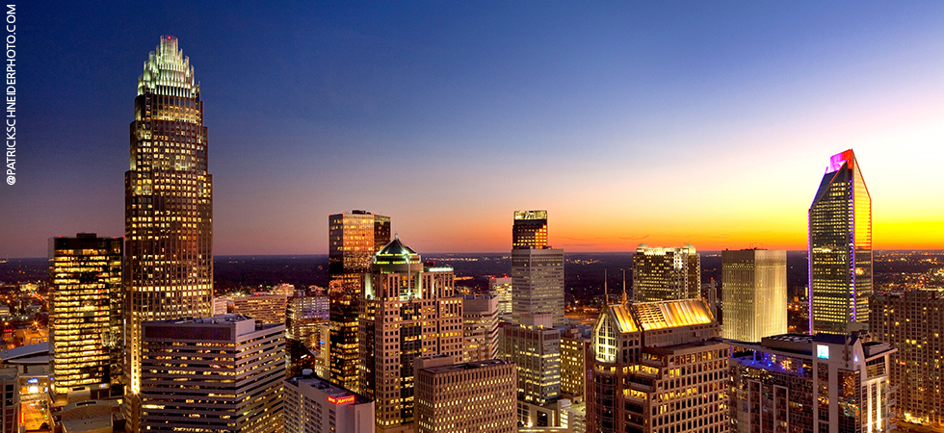
GET TO KNOW YOUR TEACHER, THE CLASSROOM, AND THE COURSE!
Goals:
Be the first group to correctly answer all questions on PART 1 of the scavenger hunt!
Learn a little bit about your teacher and the class.
Discover resources around the room.

Slide 10
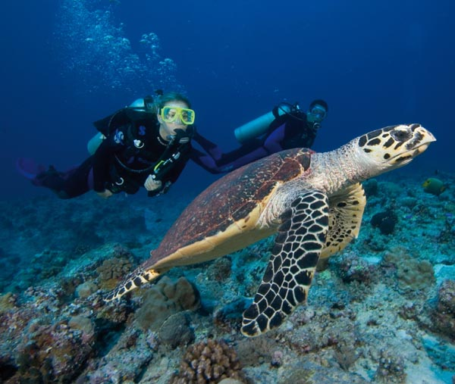
Part 2 – A Deeper Dive
You will still collaborate together in your table groups, but this time everyone will complete their OWN sheet for small participation grade.
Most of the handouts that are referenced are on the front table up here.

Slide 11
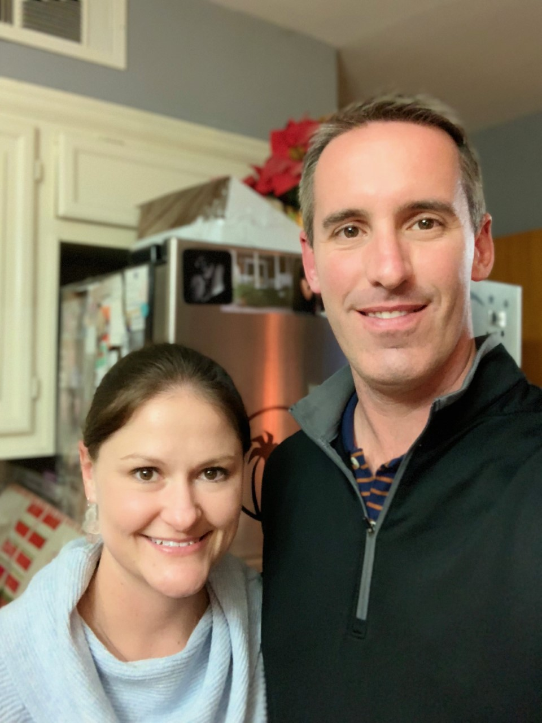
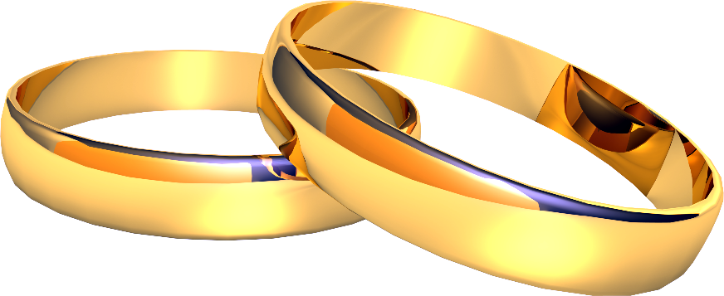
My Husband Jason
Married in 2010

Slide 12
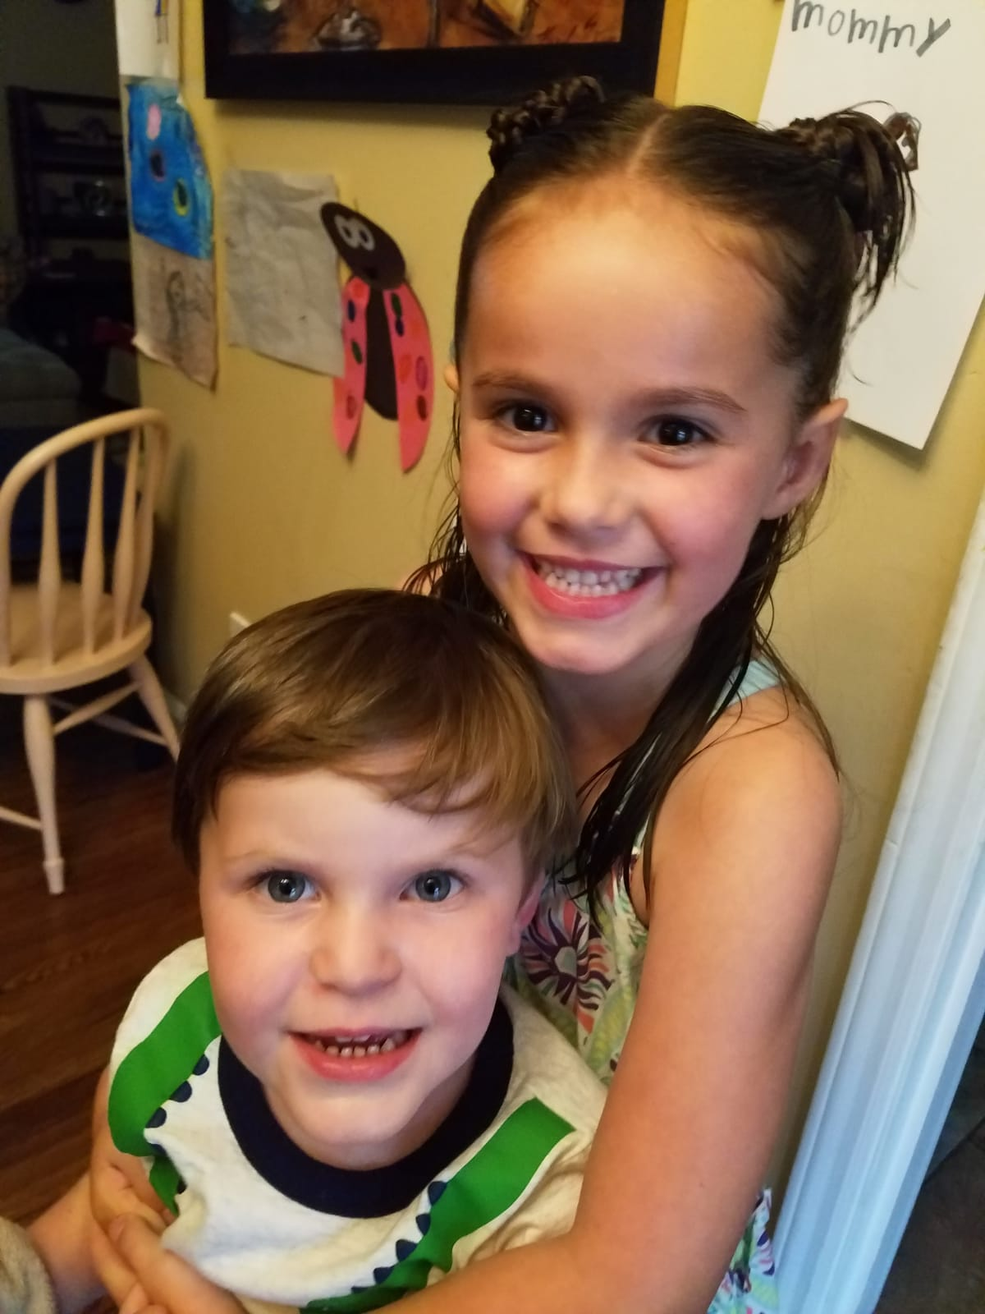
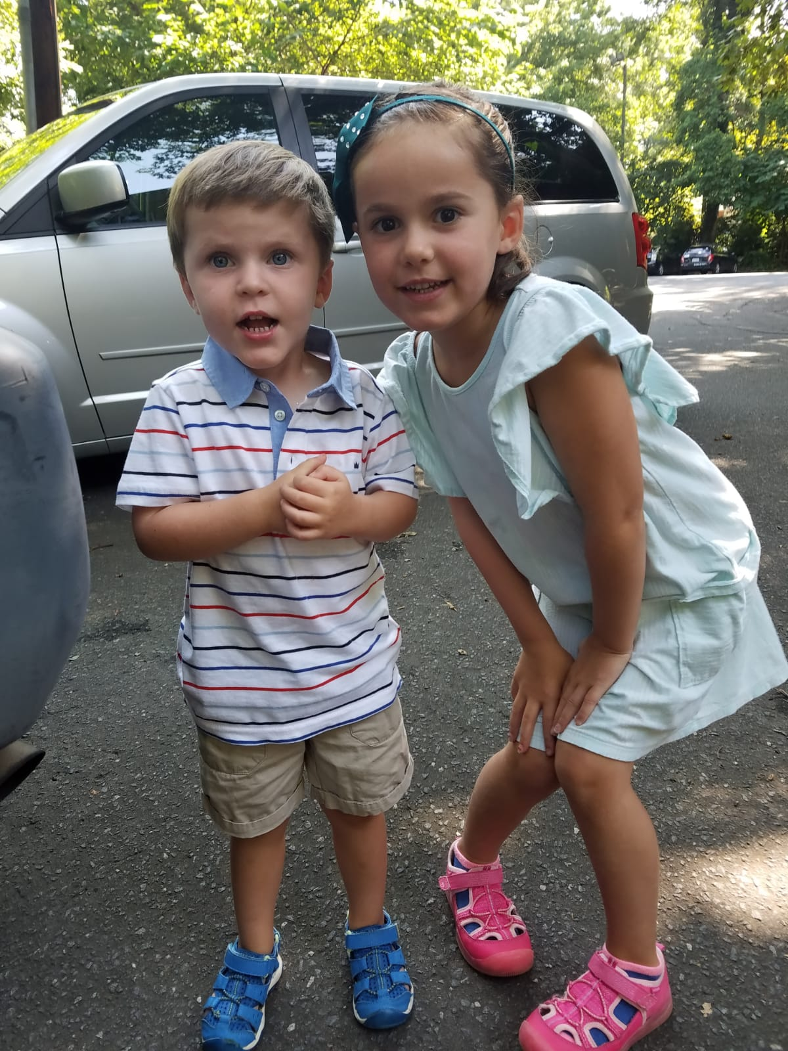
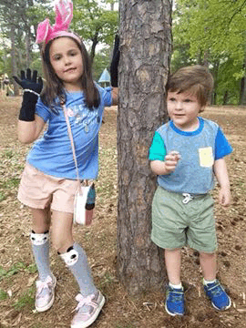
My Children
Emily (6) and Ethan (3)

Slide 13
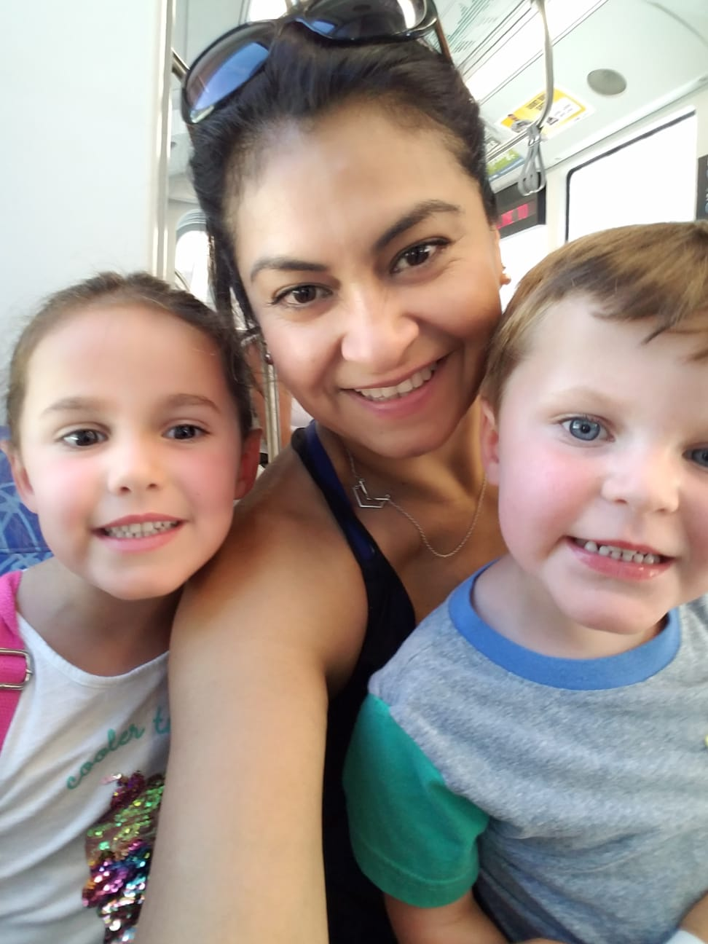
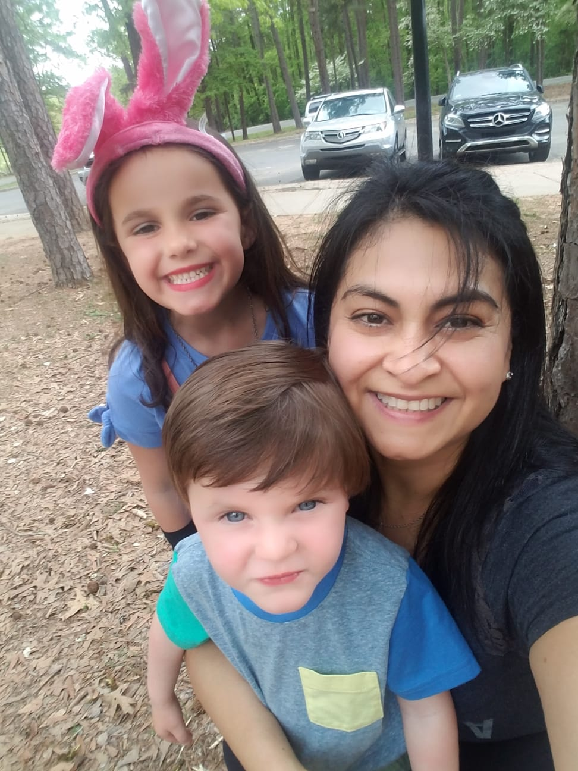
With Nanny Olga ☺
She is from Mexico!

Slide 14
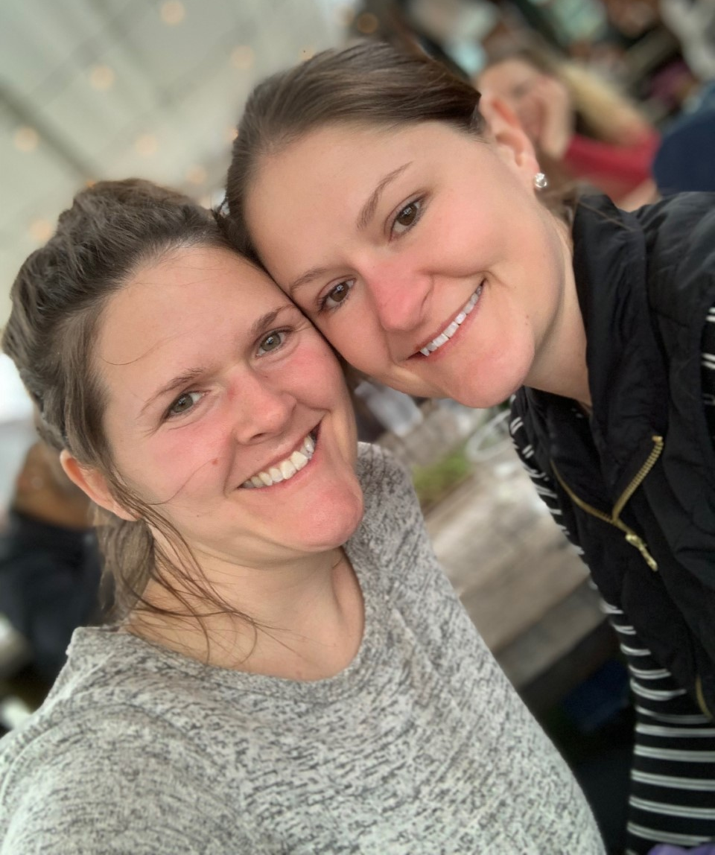
My Sister
Katie
(she’s 4 years younger)

Slide 15
Education
Graduated from Myers Park in 2001
Earned my Bachelor’s degree in Biology at UNC – Chapel Hill

Slide 16
Career
Began teaching Biology at Waddell High School in 2005 (3 years)
Taught for 1 year at West Charlotte HS
Spent 6 years at Garinger High School
Came back to MP in 2015 (5th year)!

Slide 17
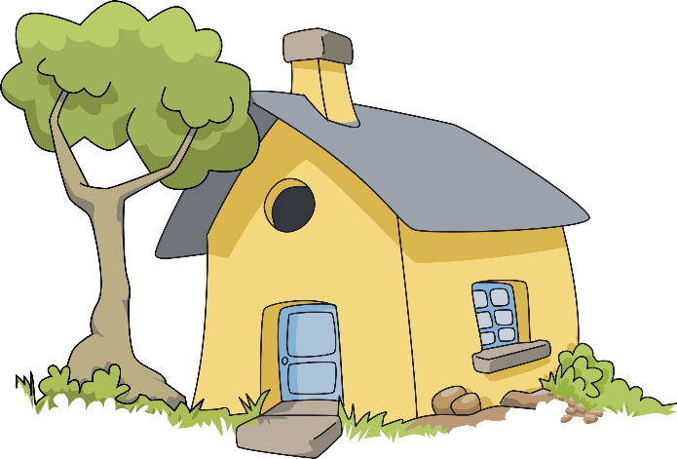
Basic Facts
I love cats!
My favorite color is purple.
I played varsity volleyball and when I was a student here at MP.
I played trumpet in the band.
I still live in the house I was born/grew up in.

Slide 18
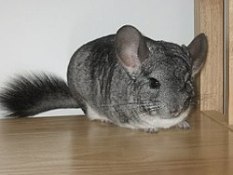
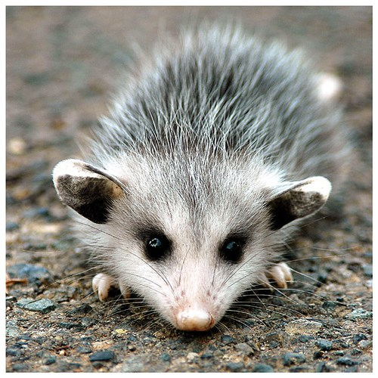
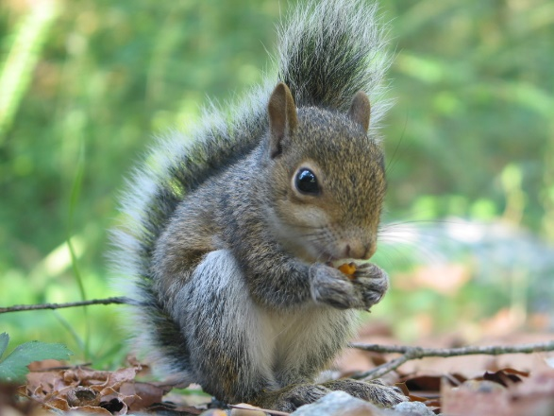
Interesting Facts
I used to have a pet squirrel named Pockets
…and a pet Chinchilla named Dusty
…and 3 baby possums (Winkin, Blinkin and Nod)
I played band here at MP…trumpet!
(That’s how I met my husband)
When I was 5 years old I broke both of my arms
…at the same time
…it made coloring difficult ☹

Slide 19
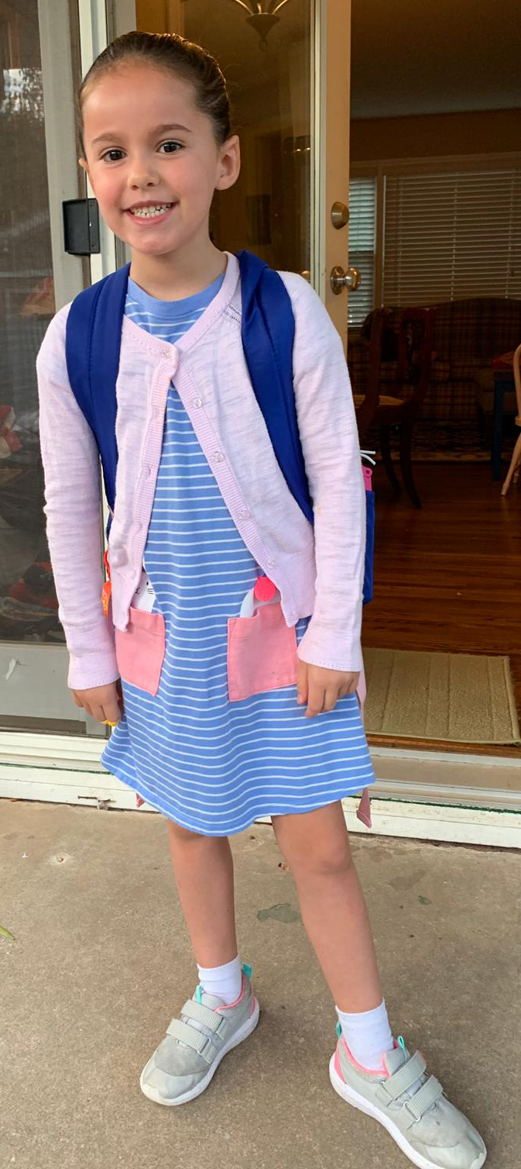
Tuesday August 27, 2019
TURN IN: if you have your signed safety contracts, place them in the TURN IN TRAY for your block (above the warm-up table)
HAVE OUT:
“Part 2” of yesterdays course scavenger hunt
Green formula/reference sheet
Today you will also need:
Calculator
Pen or Pencil
Scratch paper (optional)

Slide 20
AP Biology
Strategies & Activities
You need this book: The Survival of the Sickest by Dr. Sharon Moalem
This course will have a LOT of reading (both in and out of class)
Class will consist of lecture, hands-on lab work, virtual labs, group work, collaboration, partner discussion, class discussion, online videos, quizzes, homework assignments, POGILS, and more!

Slide 21
AP Scores & AP Credit
Most colleges require a 4 or 5 (some accept a 3) on the AP exam to earn college credit for the course
Scores of 3 and up indicate the student is ready for college level work.
Students who take an AP course (even if they don’t score a 3, 4, or 5) are still better prepared for college than those who don’t experience the AP program

Slide 22
How have past year’s students done on the AP Bio Exam?
2018 Average Score was 3.2 (25 students) 72% scores 3 or higher
2019 Average Score was 3.15 (54 students) 77.8% scores 3 or higher ☺

Slide 23
Wednesday August 28, 2019
PICK UP:
Graphing notes from Warm-Up tray
TURN IN: if you have your signed safety contracts, place them in the TURN IN TRAY for your block (above the warm-up table)
HAVE OUT:
Yesterday’s Standard Error Sample problems

