Slide 1
Warm-Up
Extra Math Practice

Slide 2
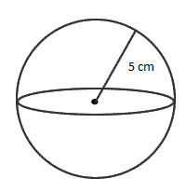
1: Surface Area and Volume
What is the SA/V (surface area to volume ratio) for this cell? Round your answer to the nearest hundredths.
8 cm

Slide 3
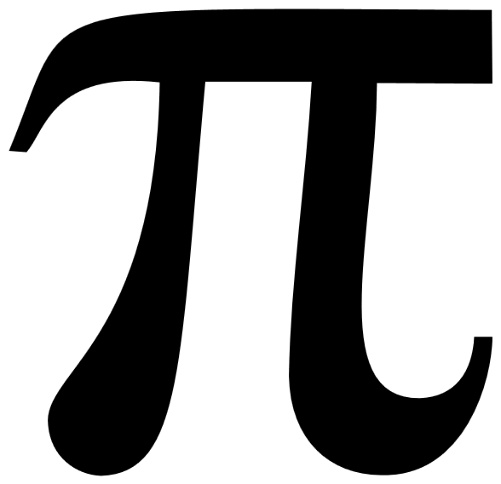
A1: Surface Area and Volume
What is the SA/V (surface area to volume ratio) for this cell? Round your answer to the nearest hundredths.
SA= 4 r²
⁼4(3.14) 8²
⁼803.84
Volume of a sphere= 4/3 r³
⁼4/3 (3.14)8³
^{=2143.5733}
^{SA/V=} 803.84/2143.5733 = .375 =.38
8 cm

Slide 4
2: Hardy Weinberg
A census of turtles nesting on a Galapagos Island revealed that 18 of them show a rare recessive condition that affected shell formation. The other 72 turtles in this population show no shell defect. If this population is in HW equilibrium, what is the frequency of the dominant allele? Give your answer to the nearest hundredth

Slide 5
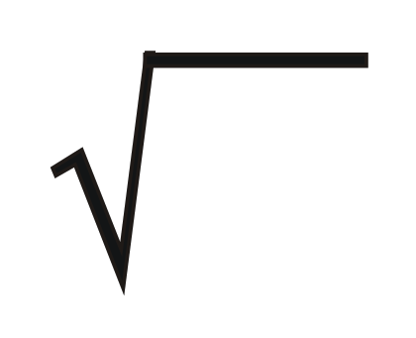
A2:Looking for p – frequence of dominant allele
18/90 = homo.rec = q² = .2
q = .2 = .4472
p = 1- .45 = .55
p=.55
answer to the nearest hundredth

Slide 6
3: Population Growth
N—total number in pop r—rate of growth
There are 4,000 grass hoppers living in a field. If 3,000 grasshoppers are born each month and 800 grasshoppers die each month, what is the per capita growth rate of grasshoppers over a month? Round to the nearest tenths.

Slide 7
A3: Population Growth
N=4000
dN/dt = Births – Deaths
= 3,000 – 800 = 2,200
dN/dt = r_{max}N
2,200 = r_{max} (4000)
r_{max} = 2200/4000 = 0.55 = 0.6
Round to the nearest tenths.

Slide 8
4: Primary Productivity
The net annual primary productivity of a particular coral ecosystem is found to be 6,500 kcal/m2. If respiration by the aquatic producers is 10,500 kcal/m2per year, what is the gross annual primary productivity for this ecosystem, in kcal/m2 per year? Round to the nearest whole number.

Slide 9
A4: Primary Productivity
NPP = GPP - R
6,500 = GPP – 10,500
6,500 + 10,500 = GPP
17,000=GPP
Round to the nearest whole number.

Slide 10
5: Laws of Probability
Calculate the probability of rolling 2 dice simultaneously and obtaining 2 sixes. Express in fraction form.

Slide 11
A5: Laws of Probability
P(A and B) = P(A) x P(B)
Probability of a six is 1/6
Probability of six AND six
1/6 x 1/6 = 1/36
Express in fraction form

Slide 12
Q9:Gibbs Free Energy
PICK THE BEST CHOICE:
A chemical reaction is most likely to occur spontaneously if the
a) Free energy is negative
b) Entropy change is negative
c) Activation energy is positive
d) Heat of reaction is positive

Slide 13
Q9
Answer: A
Watch Bozeman Science: Gibbs Free Energy!

Slide 14
Q10: Dilution
Joe has a 2 g/L solution. He dilutes it and creates 3 L of a 1 g/L solution. How much of the original solution did he dilute? Round to the nearest tenths.

Slide 15
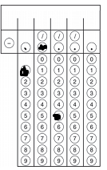
Q10: Dilution
We are looking for V1:
C1V1 = C2V2
2V1 = 1(3)
V1= 1.5

Slide 16
Q11: Q₁₀
Data taken to determine the effect of temperature on the rate of respiration in a goldfish is given in the table below. Calculate Q₁₀ for this data. Round to the nearest whole number.
Temperature (C) | Respiration Rate (Minute)
16 | 16
21 | 22

Slide 17
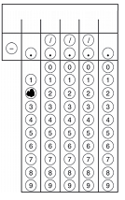
Q11
Q₁₀= ( 22 /16) ^{10/(21-16)}
Q₁₀= (1.375) ²
Q₁₀= 2
Watch Bozeman Science: Q10 - The Temperature Coefficient!

