Slide 1

Science Practices

Slide 2
6 Science practices
Throughout the course we will practice and assess these science practices:
SP1: Explain biological concepts, processes, and models.
SP2: Analyze visual representations
SP3: Determine scientific questions and methods
SP4: Represent and describe data
SP5: Statistical tests and data analysis
SP6: Argumentation

Slide 3
Homework
Find out what a Null Hypothesis is. Be ready to explain.

Slide 4
Science Practice 1: Using Models and Representations
Paul Anderson’s Bozeman Science: Models and Representations
Pros of Models?
Cons of Models?

Slide 5

Using Mathematics
What is a Null Hypothesis?
A null hypothesis is a statement that says there is no relationship between two measured phenomena, or no association among groups.
In other words, you are saying there is no statistical difference between data sets.
Statistical (mathematical) analysis of the data can help you to either
“reject” the null hypothesis (ie not accept the null) – and conclude that there is a relationship between the two variables and something other than chance is affecting the outcome
“accept” the null hypothesis (ie fail to reject) – and conclude that there is no relationship or statistical difference between two measured groups

Slide 6
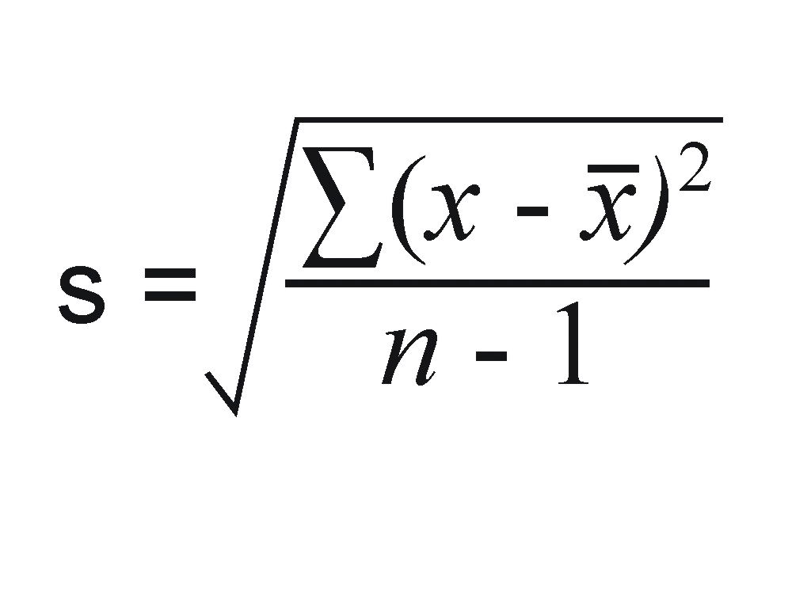
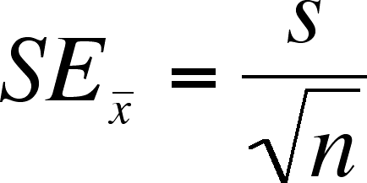
Using Mathematics
Standard Deviation
Standard Error of the Mean
A measure of variation
Equation:
Paul Anderson: Bozeman Science: “Standard Deviation”
A measure of precision
How “good” your data is
Equation:
Paul Anderson: Bozeman Science: “Standard Error”
Smaller error bars = more precise and reliable data
If error bars overlap, then there is no statistical difference between the data

Slide 7
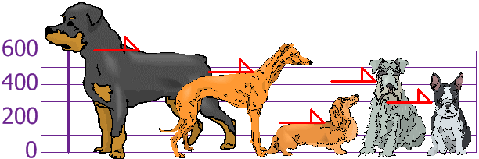
Standard Deviation Practice
You and your friends have just measured the heights of your dogs (in millimeters):
The heights (at the shoulders) are: 600mm, 470mm, 170mm, 430mm and 300mm.
To calculate SD: First, calculate the mean.
Mean = (600 + 470 + 170 + 430 + 300)/5 = 1970/5 = 394

Slide 8
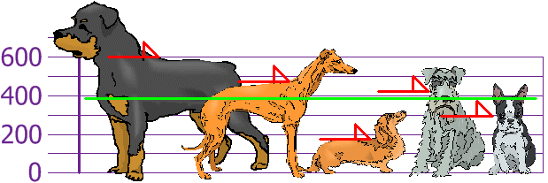
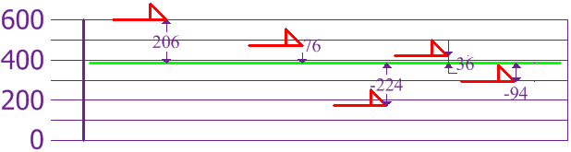
Mean = 394
Now we calculate each dog's difference from the Mean:
Ex:
600-394 = 206

Slide 9
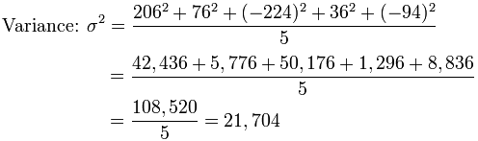
Now take each difference, square it, and then divide by (n-1)
N = sample size
Our sample size was 5 dogs, so 5-1 = 4
4
4
27,130
4

Slide 10
Calculate Standard Deviation…
So the Variance is 27,130
And the Standard Deviation is just the square root of Variance, so:
Standard Deviation =
√ (variance) = √27,130
= 164.71186...
= 165 (to the nearest mm)

Slide 11
Science Practice 2: Using Mathematics
Standard Deviation
Standard Error of the Mean
A measure of variation
Equation:
Paul Anderson: Bozeman Science: “Standard Deviation”
A measure of precision
How “good” your data is
Equation:
Paul Anderson: Bozeman Science: “Standard Error”
Smaller error bars = more precise and reliable data
If error bars overlap, then there is no statistical difference between the data

Slide 12
Standard Error and 95% Confidence Intervals
SLOWLY and CAREFULLY read the back page of the notes to yourself.
Highlight or annotate as you find helpful.
What questions do you have?

Slide 13
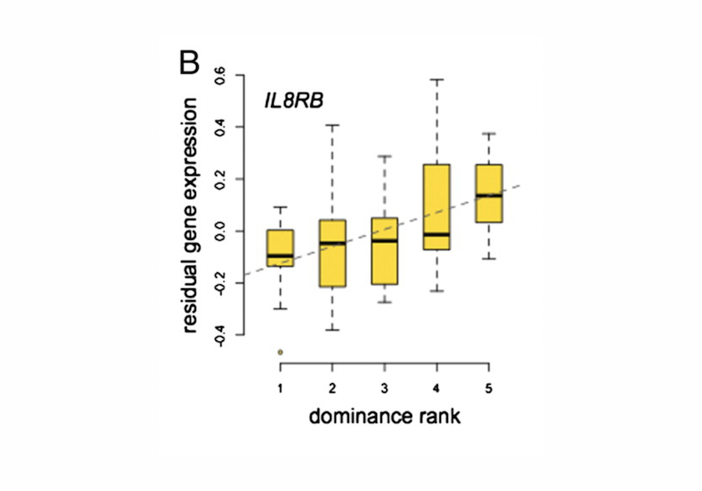
Partner Talk...
a. What are these?
c. What would be the Null Hypothesis for this experiment?
b. What do the dark black horizontal lines represent?
“There is no statistical difference between dominance ranking and gene expression of IL8RB.”

Slide 14
Partner Talk...
a. What does this dotted “line of best fit” represent?
b. What does the p-value of 0.003 tell us about this data?

Slide 15
Partner Talk...
Conclusion: Is there a statistical difference in residual gene expression in different dominance ranks? How do you know?

Slide 16
Using Mathematics
Practice Time
You may work with a partner near you!

Slide 17
Null Hypothesis:
There is no difference between the shell lengths of the muscles found at the two locations.
Use your calculator to calculate the mean values →
61
33

Slide 18
11.36
7.14
61 +/ (2 x 2.93)
61 ± 5.86
33 ± 3.68
2.93
1.84

Slide 20
Thursday August 29, 2019
PICK UP: Bozeman Chi Square sheet from warm-up tray.
4th block HAVE OUT: Sample Problem 2 of Standard Error worksheet

Slide 21
Standard Error Sample #2
There is no difference between the number of seeds which germinated when they were touching and when they were placed 2 cm apart.

Slide 22
9.00
13.43

Slide 23
9.00
13.43
2.03
2.54
0.37
0.46

Slide 24
9.00 +/- 0.74
13.43 +/- 0.93
MUST BE IN COMPLETE SENTENCES
There is no overlap between the two 95% confidence limits so we reject the null hypothesis (or do not accept) at the 5% level of probability and say that there is a significant difference between the number of seeds which germinated when they were touching and when they were placed 2cm apart.

Slide 25
Graphs PPT

Slide 26
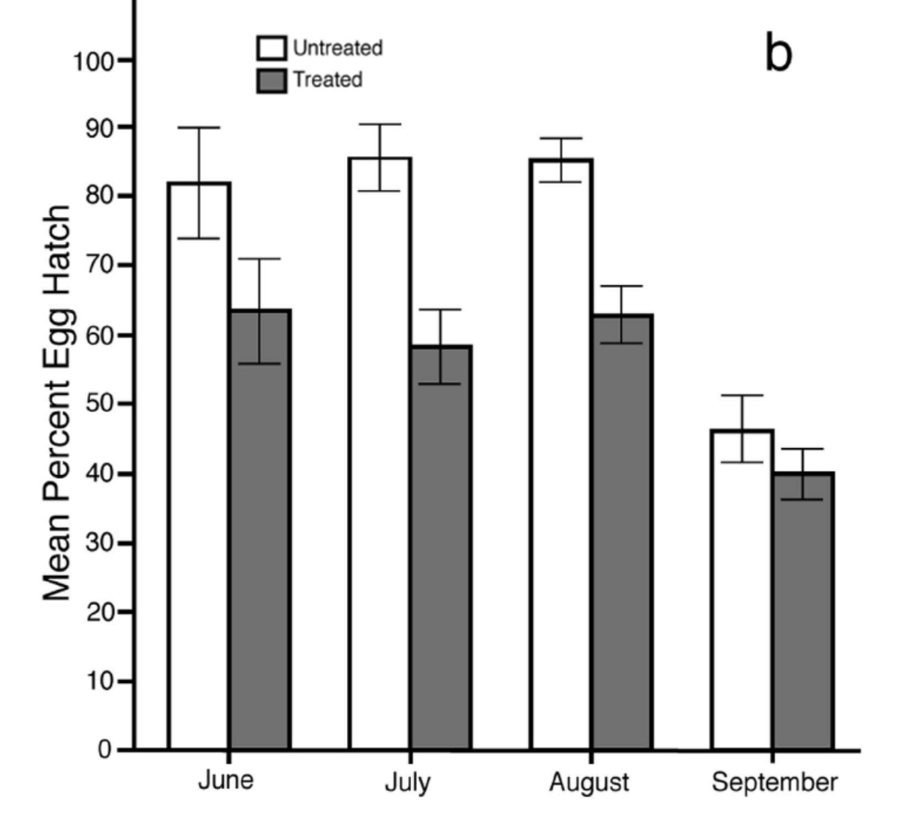
Science Practice: Scientific Questioning
What type of graph is this?
What is on the X-axis?
What is on the Y-axis?
What was the scientist measuring? Is this the independent or dependent variable?
Caption: Percentage of Aedes albopictus mosquito eggs that hatched at sites where male mosquitoes infected with Wolbachia bacteria were released (gray bars) and sites where the mosquito population was left untreated (white bars). The error bars represent 95% confidence intervals (CI).

Slide 27
Science Practice: Scientific Questioning
Why is it important to include untreated sites in this experiment?
Experimental Control – to have as a comparison to prove that the treatment variable is affecting the hatch percent.
Which months show a statistical difference between untreated and treated mosquito eggs? How did you determine this?
June, July, August; Error bars do NOT overlap, indicated a statistical difference.
Caption: Percentage of Aedes albopictus mosquito eggs that hatched at sites where male mosquitoes infected with Wolbachia bacteria were released (gray bars) and sites where the mosquito population was left untreated (white bars). The error bars represent 95% confidence intervals (CI).

Slide 28
Digging Deeper
Read the Background Information that accompanies this graph.
Then you will discuss and write answers to the questions on the back with the person next to you.
Be ready to share your responses.

Slide 29
Describe the differences in the percentages of eggs hatched between treated and untreated sites.
During which months do you see the greatest impact of the treatment? Why do you think that is?
Why is it important to include untreated sites in this study?
Describe what the error bars mean in this figure. How do you interpret the differences between treated and untreated sites based on the error bars?
Why didn’t the release of infected males result in zero eggs hatched at the treated site?
If this site was left untreated the following year, predict what this same graph might look like.
Based on these results, would you recommend treatment with Wolbachia as a way to reduce A. albopictus mosquito populations? Why or why not?
What concerns might scientists or the public have with the release of male mosquitoes treated with a laboratory strain of Wolbachia?
How could this approach to suppressing mosquito populations impact the spread of Zika or other mosquito-borne human pathogens?

Slide 30
Science Practice: Argumentation
How to Write a Scientific Explanation
Claim - a statement/conclusion that answers the original question
Evidence – scientific data that supports the claim
  must be sufficient and appropriate
  refer to calculations, error bars, etc.
Reasoning – justification that links the claim and the evidence
  gives the “why”
  relies on scientific principles (laws, definitions, concepts, processes, etc)
  The “bridge” that explains how/why your evidence does in fact support your claim.

Slide 31
Science Practice 3: Scientific Questioning
What is a QUESTION the scientist might have asked before collecting this data?
Can releasing male mosquitos infected with Wolbachia bacteria reduce the number of egg hatchings, and thus lower the mosquito population size?
Caption: Percentage of Aedes albopictus mosquito eggs that hatched at sites where male mosquitoes infected with Wolbachia bacteria were released (gray bars) and sites where the mosquito population was left untreated (white bars). The error bars represent 95% confidence intervals (CI).

Slide 32
Science Practice: Argumentation
What is a CLAIM that could be made from this data? (fill in chart; should answer the question)
Infecting male mosquitos with Wolbachia bacteria (reduces the reproductive success of the Aedes albopictus mosquito and) significantly lowers population size during the months of June, July, and August.
Caption: Percentage of Aedes albopictus mosquito eggs that hatched at sites where male mosquitoes infected with Wolbachia bacteria were released (gray bars) and sites where the mosquito population was left untreated (white bars). The error bars represent 95% confidence intervals (CI).

Slide 33
Science Practice: Argumentation
What is EVIDENCE supports this claim? (fill in chart)
Mean % of eggs hatched are lower in treated groups than untreated groups for all months
There is a statistical difference in the % of egg hatches for treated and untreated mosquitos during the months of June, July, and August because the error bars do not overlap between the control group (untreated) and experimental group (treated)..
Caption: Percentage of Aedes albopictus mosquito eggs that hatched at sites where male mosquitoes infected with Wolbachia bacteria were released (gray bars) and sites where the mosquito population was left untreated (white bars). The error bars represent 95% confidence intervals (CI).

Slide 34
Science Practice: Argumentation
Provide REASONING. (science ideas or concepts or principals from background)
Due to cytoplasmic incompatibility, uninfected female eggs fertilized by Wolbachia infected males produce infertile eggs that do not hatch, which lowers the total mosquito population.
Hatch rates for affected mosquitos (gray bars) are significantly lower than untreated mosquitos (white bars) for June, July, and August because the error bars do not overlap.
Caption: Percentage of Aedes albopictus mosquito eggs that hatched at sites where male mosquitoes infected with Wolbachia bacteria were released (gray bars) and sites where the mosquito population was left untreated (white bars). The error bars represent 95% confidence intervals (CI).

Slide 35
Science Practice: Argumentation
What is your final explanation? (How would you write your answer on a test?)
Hatch rates for affected mosquitos are significantly lower than untreated mosquitos for June, July, and August. ^{(C)} The mean hatch percentages at treated sites (gray bars) is significantly lower than untreated sites because the error bars (representing 95% confidence intervals) do not overlap ^{(E).} This suggests that the Wolbachia-infection treatment does have the ability to suppress mosquito populations by reducing fertility. ^{(R)}
Caption: Percentage of Aedes albopictus mosquito eggs that hatched at sites where male mosquitoes infected with Wolbachia bacteria were released (gray bars) and sites where the mosquito population was left untreated (white bars). The error bars represent 95% confidence intervals (CI).

Slide 36
Science Practices Continued
Bozeman Science: Chi-Squared Test
M&M Statistics / A Chi Square Analysis
The X² Test – Practice Worksheet

Slide 37
M&M Statistics / A Chi Square Analysis
% color | Plain | Peanut | Crispy | Minis | Peanut Butter | Almond
Brown | 13% | 12% | 17% | 13% | 10% | 10%
Yellow | 14% | 15% | 17% | 13% | 20% | 20%
Red | 13% | 12% | 17% | 12% | 10% | 10%
Green | 16% | 15% | 16% | 12% | 20% | 20%
Blue | 24% | 23% | 17% | 25% | 20% | 20%
Orange | 20% | 23% | 16% | 25% | 20% | 20%
How will we determine the EXPECTED value for our M&M candies?
Multiply the Mars % for each color by the total number of candies in your bag.
How will we determine the OBSERVED value for our M&M candies?
Count each color of M&M in your bag

Slide 38
95% Confidence
The values in the table are
Critical Values
Degrees of Freedom | Probability (p value)
 | 0.90 | 0.50 | 0.25 | 0.10 | 0.05 | 0.01
1 | 0.016 | 0.46 | 1.32 | 2.71 | 3.84 | 6.64
2 | .0.21 | 1.39 | 2.77 | 4.61 | 5.99 | 9.21
3 | 0.58 | 2.37 | 4.11 | 6.25 | 7.82 | 11.35
4 | 1.06 | 3.36 | 5.39 | 7.78 | 9.49 | 13.28
5 | 1.61 | 4.35 | 6.63 | 9.24 | 11.07 | 15.09
If the x² value is greater than the critical number at the 0.05 level then, as a biologist, you can reject the null hypothesis.
If the x² value is less than the critical number then you can accept the null hypothesis.

Slide 39

Statistical Significance
Null Hypothesis: “There is no statistical difference…”
If X² is greater than the critical value (p-value .05 @__ DF) then REJECT the null - because the difference is statistically significant.
If X² is lower than the critical value (p-value .05 @__DF) then CANNOT REJECT the null (must keep it) because the difference is not statistically significant.

Slide 40
Reminder…if told to round…
.123
The 1 is in the tenths place
The 2 is in the hundreds place
The 3 is in the thousandths place

Slide 41

How to write your conclusion
I (accept / reject) the Null Hypothesis because the X² value of ________ is (greater than / less than) the critical value of _________ at 5% probability and ____ degrees of freedom. This means…
X² > critical value → do NOT ACCEPT the Null (reject)
X² < critical value → ACCEPT the Null (cannot reject)

Slide 42
Putting It All Together: Mealworm Behavior Lab (modification of AP Lab 12)
3 Part Lab
Must have all writings in your lab notebook
Will culminate in small group presentations of lab findings through a “Mini Poster”
Formal Grade: lab notebook + participation + Mini Poster

