Slide 1
Quantitative Skills: Graphing

Slide 2
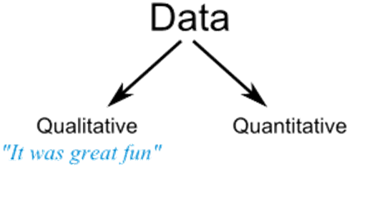
Categories of data:
Qualitative data is not numerical and is usually subjective.
Quantitative data is numerical and lends itself to statistical analysis.
Think / Pair / Share
How would you define “Qualitative” and “Quantitative” data?
Which one is better? Why?
1.75 mL
Notes:
http://ibscrewed4maths.blogspot.com/2011/03/types-of-data.html

Slide 3
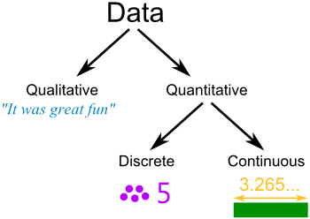
Quantitative data can be either discrete or continuous.
Think / Pair / Share
How would you define “Discrete” and “Continuous” data?
Discrete data has finite values, such as integers, or bucket categories such as “red” or “tall”.
Continuous data has an infinite number of values and forms a continuum.

Slide 4
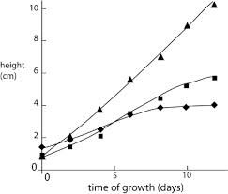
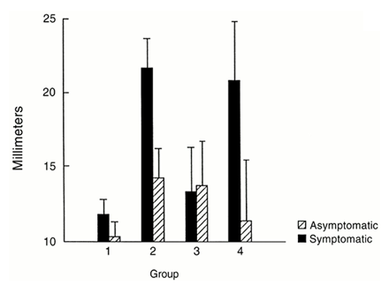
Which graph shows continuous data and which graph shows discrete data?
Graph A
Graph B
Continuous
Discrete

Slide 5
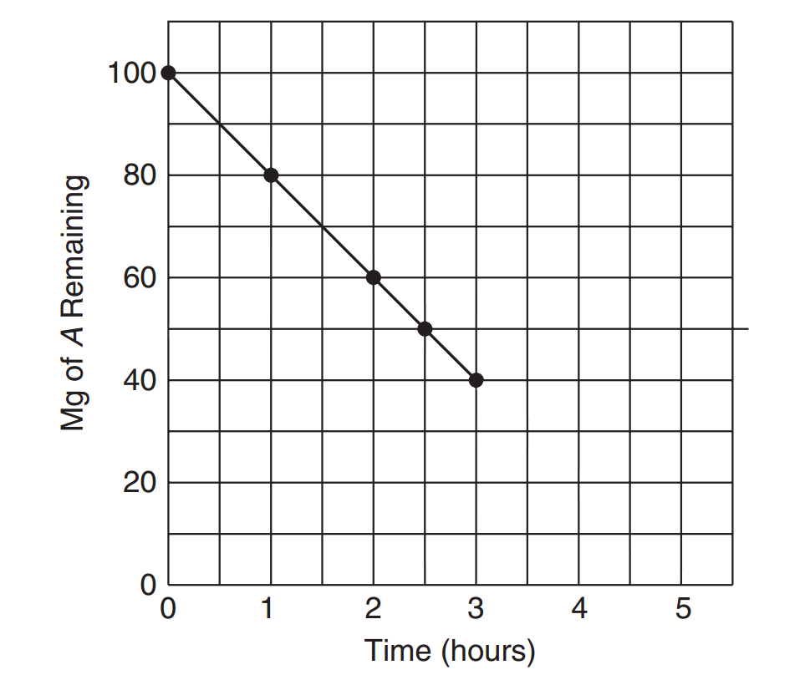
Line Graphs
Used when data on both scales of the graph (the x and y axes) are continuous.
The dots indicate measurements that were actually made.

Slide 6
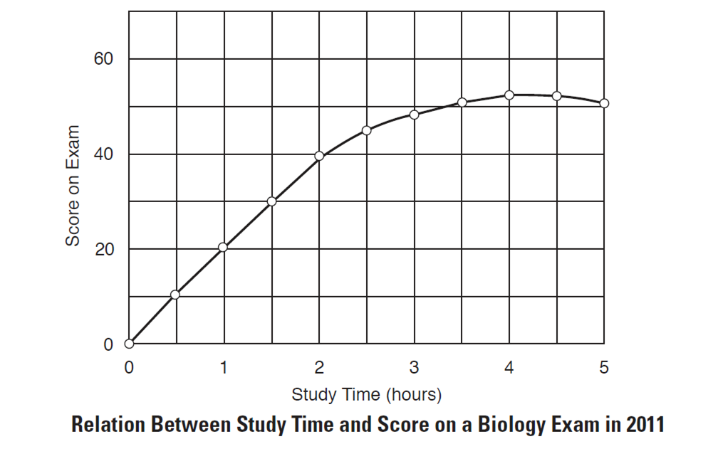
Basic Traits of A Good Graph
Turn & Talk
What would be a good title for this graph?
1. A Good Title
A good title is one that tells exactly what information the author is trying to present with the graph.
Relation Between Study Time and Score on a Biology Exam
-or-
Study Time vs. Score on a Biology Exam
Notes:
AP® Biology Investigative Labs: An Inquiry-Based Approach

Slide 7
Basic Traits of A Good Graph
Axes should be consistently numbered.
Axes should contain labels, including units.
Notes:
AP® Biology Investigative Labs: An Inquiry-Based Approach

Slide 8
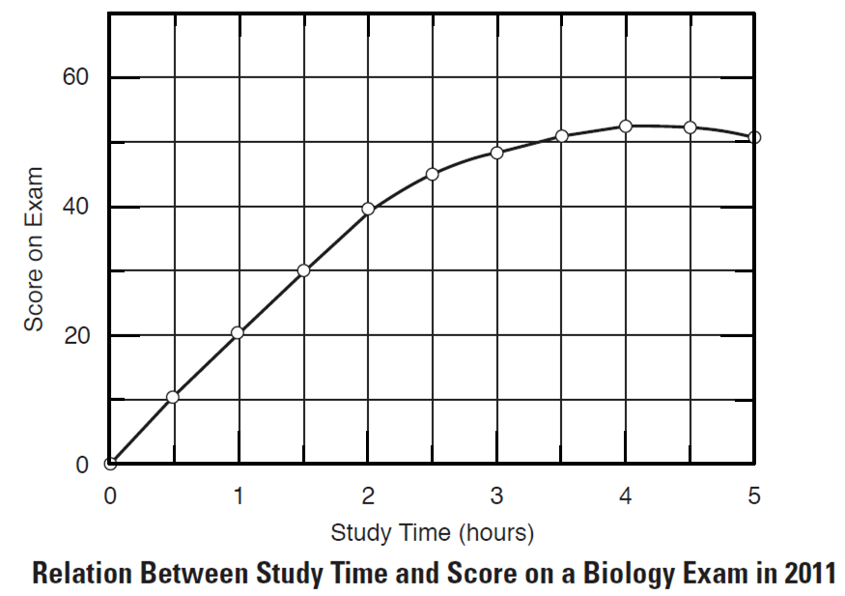
Basic Traits of A Good Graph
The independent variable is always shown on the x axis.
The dependent variable is always shown on the y axis.
Dependent
Variable
Independent
Variable
Notes:
AP® Biology Investigative Labs: An Inquiry-Based Approach

Slide 9
Basic Traits of A Good Graph
The line should not be extended to the origin if the data do not start there.
Notes:
AP® Biology Investigative Labs: An Inquiry-Based Approach

Slide 10
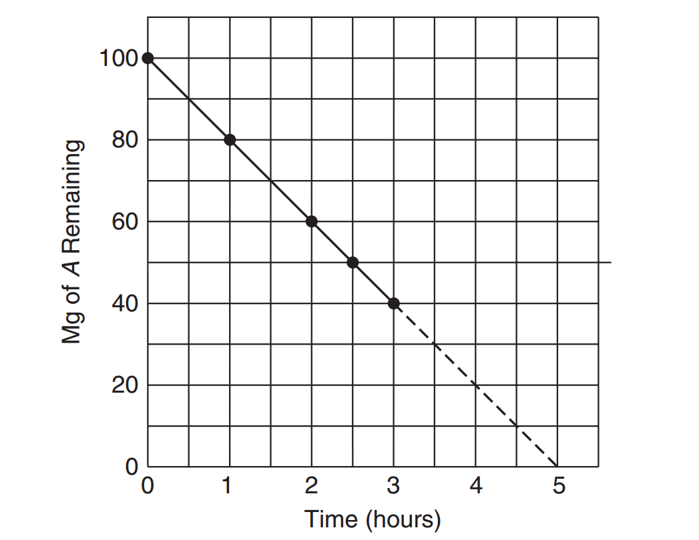
Extrapolation is a prediction of what the chart might look like beyond the measured set of data. A broken line is used, indicating this a prediction and not data actually collected.

Slide 11
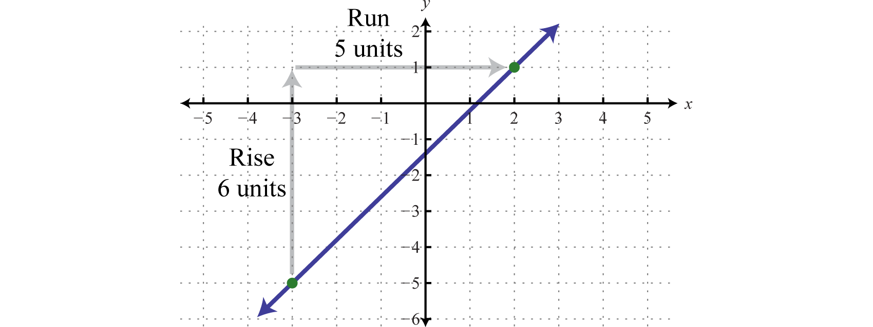
The slope of a line indicates the rate at which the variables being graphed are changing.
Δy y₂ – y₁
m =
=
Δx x₂ – x₁
Rise
Slope =
Run

Slide 12
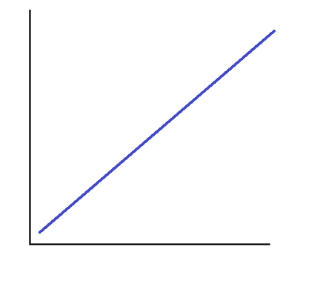
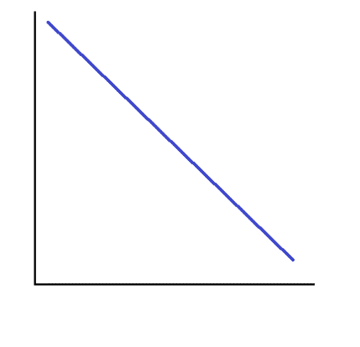
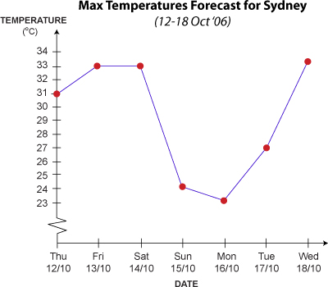
Positive Slope
Negative Slope
Zero Slope
Rate Increasing
Rate Decreasing
Constant Rate
Indicates some values
were skipped

Slide 13
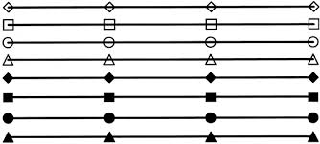
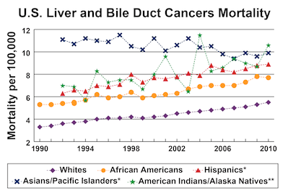
Line charts can be plotted with multiple data sets, allowing for better comparison.
Makes use of a legend

Slide 14
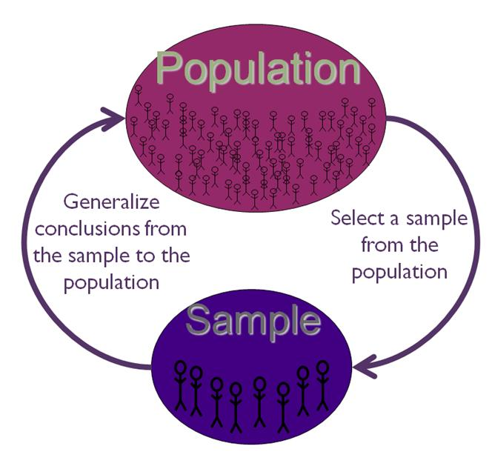
Population vs. Sample
Often, researchers want to know things about a population (N), but it may not be feasible to obtain data for every member of an entire population.
A sample (n) is a smaller group of members of a population selected to represent the population. The sample must be random.

Slide 15
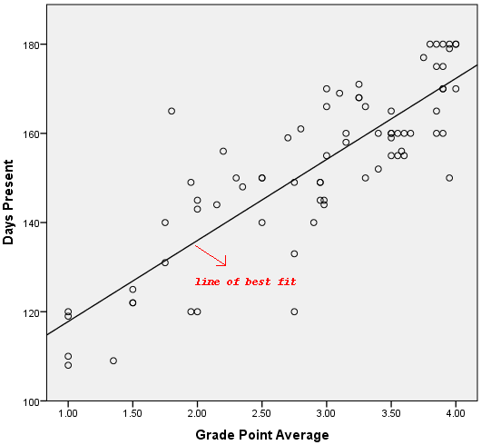
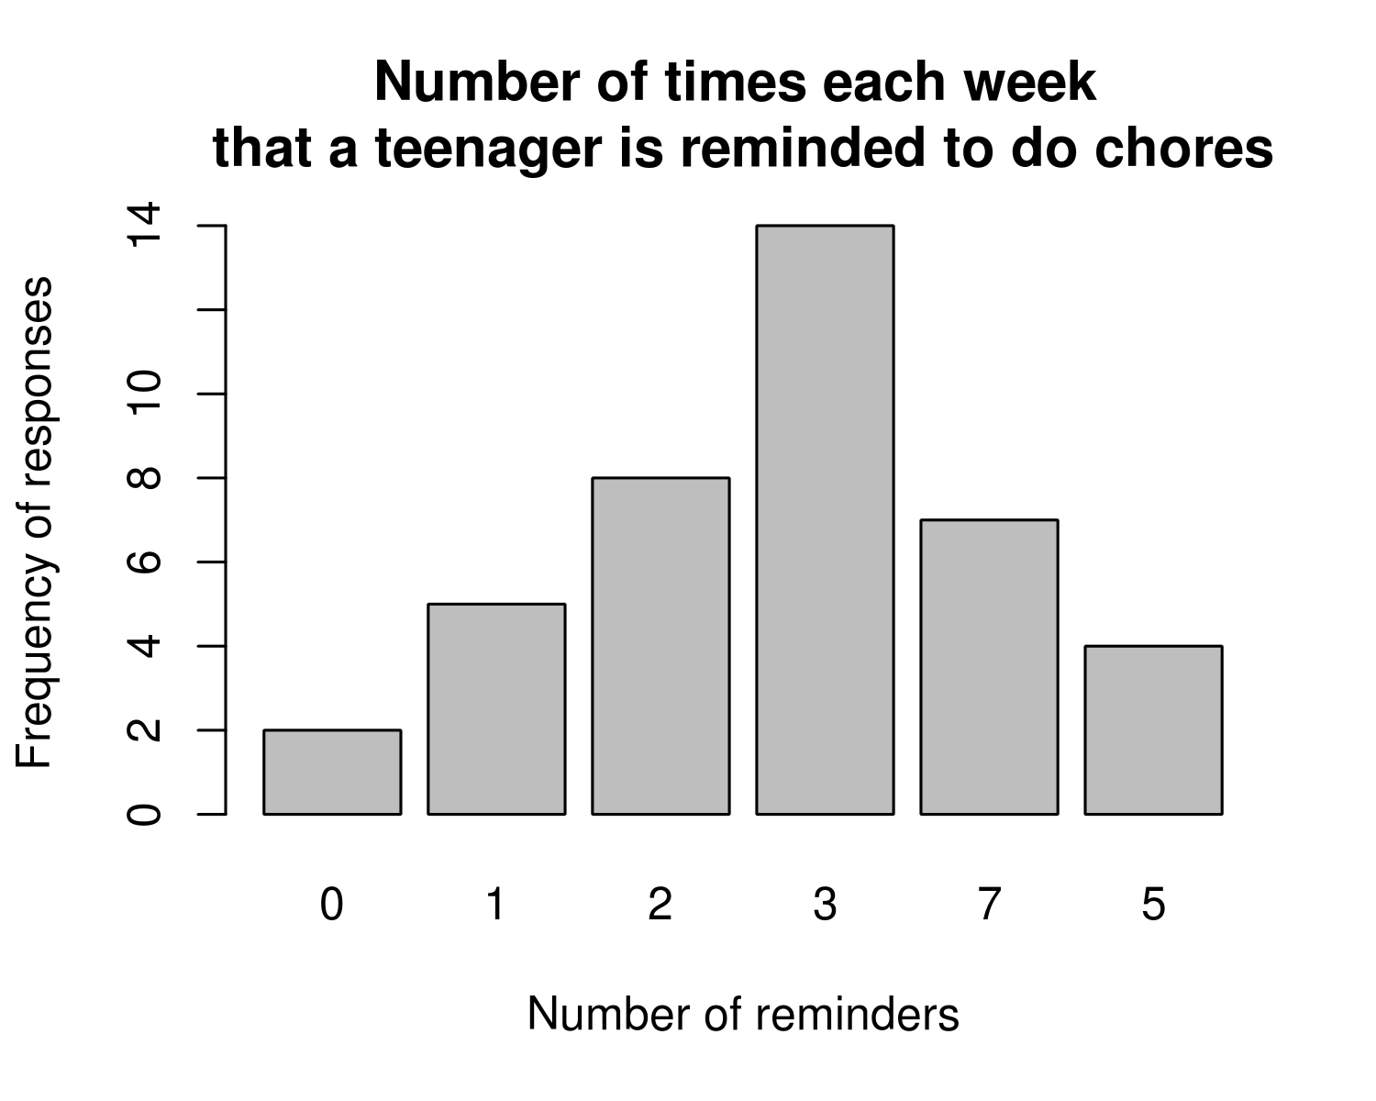
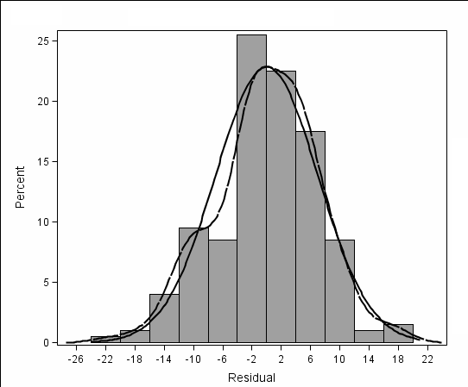
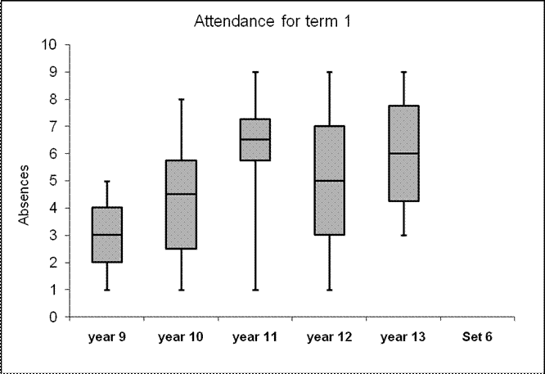
What type of graph is it?
Bar Graph
Scatterplot
Histogram
Box-and-Whiskers

Slide 16
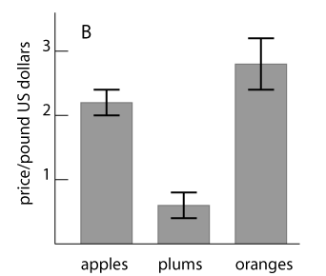
Bar Graphs
a) What are these?
b) What do they tell you about the data?
Notes:
AP Biology Quantitative Skills Manual

Slide 17
Propose a NULL HYPOTHESIS for this graph.
Should the Null be “accepted” or “rejected”? Why?
Notes:
AP Biology Quantitative Skills Manual

Slide 18
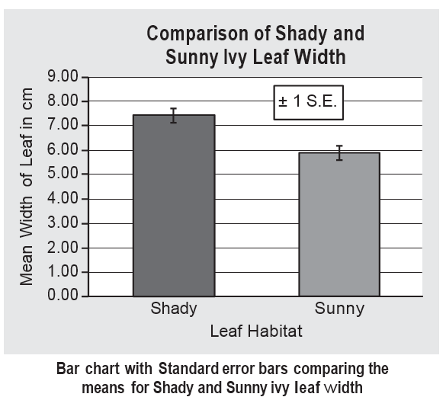
What can you conclude from this graph?
Notes:
AP Biology Quantitative Skills Manual

Slide 19
Scatterplots
Used when comparing one measured variable against another.
Used when looking for trends.
Notes:
AP Biology Quantitative Skills Manual

Slide 20
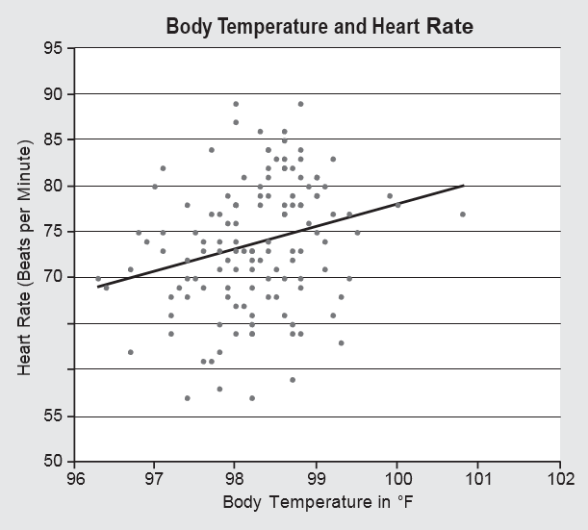
If the relationship is thought to be linear, a linear regression line or best fit line can be plotted to help define the pattern.
Notes:
AP Biology Quantitative Skills Manual

Slide 21
Box-and-Whisker Plots
Allow graphical comparison of two samples of nonparametric data (data that do not fit a normal distribution).

Slide 22
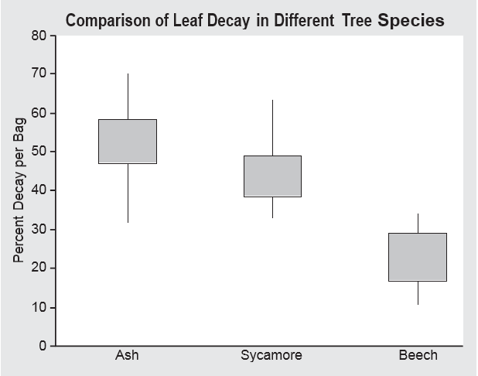
In a box-and-whisker graph, the ticks at the tops and bottoms of the vertical lines show the highest and lowest values in the dataset, respectively. The top of each box shows the upper quartile, the bottom of each box shows the lower quartile, and the horizontal line represents the median.
Notes:
AP Biology Quantitative Skills Manual

Slide 23
References: AP® Biology Investigative Labs: An Inquiry-Based Approach and AP® Biology Quantitative Skills: A Guide for Teachers

