Slide 1
AP Biology Math Review 2018
Work as a group to solve each math problem on the large white board.
Each individual should record their answers to each question on the blue “grid in” sheet.
After all groups have completed all questions, we will go through, check, & discuss!

Slide 2
Tips
Grid LEFT to right
Use the formula sheet
Don’t round until the end
Look at HOW the answer should be given
“round to nearest…”
.123
The 1 is in the tenths place
The 2 is in the hundreds place
The 3 is in the thousandths place

Slide 3
Statistical Significance
Null Hypothesis: “There is no statistical difference…”
If X² is greater than the critical value (p-value .05 @ DF) then REJECT the null - because the difference is statistically different)
If X² is lower than the critical value (p-value .05 @ DF) then CANNOT REJECT the null (must keep it)

Slide 4
Q1: Chi Square
A heterozygous red eyed female was crossed with a red eyed male. The results are shown below. Red eyes are sex-linked dominant to white. Determine the chi square value. Round to the nearest hundredth.
Phenotype | # flies observed
Red Eyes | 134
White Eyes | 66

Slide 5
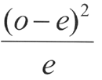
Chi Square Strategy
Given—observed
You have to figure out expected. Usually to do a Punnett square to figure this out
Plug in + +

Slide 6
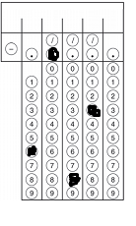
Expected
Observed—134 red eyes, 66 white eyes
Chi-Square
red
white
X^{R} X^{r}
X^{R}
X^{R}
X^{R}
X^{r}
+
X^{R}
Y
X^{R}
Y
X^{r}
Y
(134-150)²
/150
(66-50)²
/50
+
3:1 ratio
134+ 66=200
(.75)(200) = 150 red
(.25)(200) = 50 white
1.70666 +
+ 5.12
6.83

Slide 7
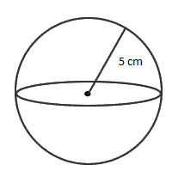
Q2: Surface Area and Volume
What is the SA/V (surface area to volume ratio) for this cell? Round your answer to the nearest hundredths.

Slide 8
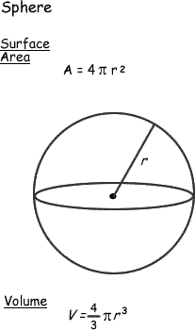
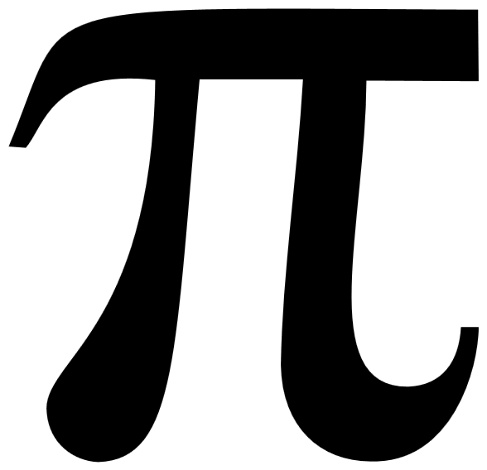
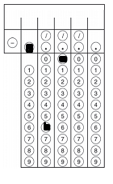
Q2
SA= 4 r²
⁼4(3.14) 5²
⁼314
Volume of a sphere= 4/3 r³
⁼4/3 (3.14)5³
^{=523.33}
^{SA/V=314/523.33}
=.60

Slide 9
Q3: Water Potential and Solution Potential
Solute potential= –iCRT
i = The number of particles the molecule will make in water; for NaCl this would be 2; for sucrose or glucose, this number is 1
C = Molar concentration (from your experimental data)
R = Pressure constant = 0.0831 liter bar/mole K
T = Temperature in degrees Kelvin = 273 + °C of solution
Sample Problem
The molar concentration of a sugar solution in an open beaker has been determined to be 0.3M. Calculate the solute potential at 27 degrees Celsius. Round your answer to the nearest tenths.

Slide 10
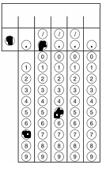
Q3
Solute potential= –iCRT
-i= 1
C= 0.3
R = Pressure constant = 0.0831
T= 27 +273=300K
Solute concentration= -7.5

Slide 11
Q4: Hardy Weinberg
A census of birds nesting on a Galapagos Island revealed that 24 of them show a rare recessive condition that affected beak formation. The other 63 birds in this population show no beak defect. If this population is in HW equilibrium, what is the frequency of the dominant allele? Give your answer to the nearest hundredth

Slide 12
Hardy Weinberg Strategy
Figure out what you are given
Allele (p or q) or Genotypes (p2, 2pq, q2)
Figure out what you are solving for
Manipulate formulas to go from given to solving for
Always dealing with decimals

Slide 13
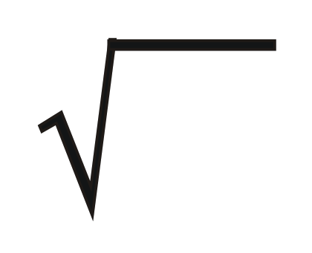
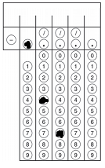
Q4:Looking for p—dominant allele
Homozygous Recessive=q²=24/87= .2758
q²⁼ .2758
q=.5252
p+q=1
p=.47

Slide 14
Q5: Rate
Hydrogen peroxide is broken down to water and oxygen by the enzyme catalase. The following data were taken over 5 minutes. What is the rate of enzymatic reaction in mL/min from 2 to 4 minutes? Round to the nearest hundreds
Time (mins) | Amount of O₂ produced (mL)
1 | 2.3
2 | 3.6
3 | 4.2
4 | 5.5
5 | 5.9

Slide 15
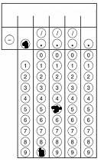
Q5
Rise/run= rate= 5.5-3.6/4-2
Rise/run= rate= 1.9/2
Rise/run= rate= .95

Slide 16
Q6: Laws of Probability
Calculate the probability of tossing three coins simultaneously and obtaining three heads. Express in fraction form.

Slide 17
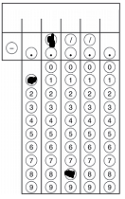
Q6
Probability of a heads is ½
Probability of heads AND a heads AND a heads
½ X ½ X ½=1/8

Slide 18
Q7: Population Growth
N—total number in pop r—rate of growth
There are 2,000 mice living in a field. If 1,000 mice are born each month and 200 mice die each month, what is the per capita growth rate of mice over a month? Round to the nearest tenths.

Slide 19
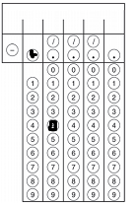
N=2000
dN/dt = 1000-200 = 800
dN/dt = r_{max}N
800 = r_{max} (2000)
R_{max} = 800/2000 = 0.4

Slide 20
Q8
The net annual primary productivity of a particular wetland ecosystem is found to be 8,000 kcal/m2. If respiration by the aquatic producers is 12,000 kcal/m2per year, what is the gross annual primary productivity for this ecosystem, in kcal/m2 per year? Round to the nearest whole number.

Slide 21
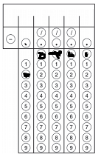
Q8
NPP=GPP-R
8,000 = GPP – 12,000
8,000+ 12,000= GPP
20,000=GPP

Slide 22
Q9:Gibbs Free Energy
PICK THE BEST CHOICE:
A chemical reaction is most likely to occur spontaneously if the
a) Free energy is negative
b) Entropy change is negative
c) Activation energy is positive
d) Heat of reaction is positive

Slide 23
Q9
Answer: A
Watch Bozeman Science: Gibbs Free Energy!

Slide 24
Q10: Dilution
Joe has a 2 g/L solution. He dilutes it and creates 3 L of a 1 g/L solution. How much of the original solution did he dilute? Round to the nearest tenths.

Slide 25
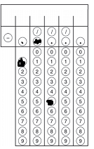
Q10: Dilution
We are looking for V1:
C1V1 = C2V2
2V1 = 1(3)
V1= 1.5

Slide 26
Q11: Q₁₀
Data taken to determine the effect of temperature on the rate of respiration in a goldfish is given in the table below. Calculate Q₁₀ for this data. Round to the nearest whole number.
Temperature (C) | Respiration Rate (Minute)
16 | 16
21 | 22

Slide 27
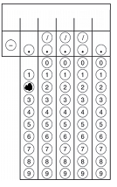
Q11
Q₁₀= ( 22 /16) ^{10/(21-16)}
Q₁₀= (1.375) ²
Q₁₀= 2
Watch Bozeman Science: Q10 - The Temperature Coefficient!

Slide 28
Q12:Standard Deviation
Grasshoppers in Madagascar show variation in their back-leg length. Given the following data, determine the standard deviation for this data. Round the answer to the nearest hundredth.
Length(cm): 2.0, 2.2, 2.2, 2.1, 2.0, 2.4 and 2.5

Slide 29
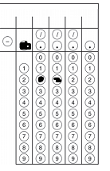
Average = 2.0 + 2.2 +2.2+2.1+2.0 +2.4 +2.5/7=2.2
Dev = -.2+ 0+ 0+-.1+-.2+.2+.3
Dev Squared = .04+0+0+.01+.04 +.04+.09=
Sum of the Devs Squared = 0.22

Slide 30
Q13: log
What is the hydrogen ion concentration of a solution of pH 8? Round to the nearest whole number

Slide 31
Q13
[H+] if pH = 8.0
[H+] = 10^{-pH} [H+] = 10^{-8.0}
1÷10⁸ = 0.00000001

Slide 32
AP Biology Math Review 2018
Take out a calculator and green formula sheet.
2) Pick a grid sheet. You will solve each problem and grid in the answer.

Slide 33
Q1: Chi Square
A heterozygous red eyed female was crossed with a red eyed male. The results are shown below. Red eyes are sex-linked dominant to white. Determine the chi square value. Round to the nearest hundredth.
Phenotype | # flies observed
Red Eyes | 134
White Eyes | 66

Slide 34
Q2: Surface Area and Volume
What is the SA/V (surface area to volume ratio) for this cell? Round your answer to the nearest hundredths.

Slide 35
Q3: Water Potential and Solution Potential
Solute potential= –iCRT
i = The number of particles the molecule will make in water; for NaCl this would be 2; for sucrose or glucose, this number is 1
C = Molar concentration (from your experimental data)
R = Pressure constant = 0.0831 liter bar/mole K
T = Temperature in degrees Kelvin = 273 + °C of solution
Sample Problem
The molar concentration of a sugar solution in an open beaker has been determined to be 0.3M. Calculate the solute potential at 27 degrees Celsius. Round your answer to the nearest tenths.

Slide 36
Q4: Hardy Weinberg
A census of birds nesting on a Galapagos Island revealed that 24 of them show a rare recessive condition that affected beak formation. The other 63 birds in this population show no beak defect. If this population is in HW equilibrium, what is the frequency of the dominant allele? Give your answer to the nearest hundredth

Slide 37
Q5: Rate
Hydrogen peroxide is broken down to water and oxygen by the enzyme catalase. The following data were taken over 5 minutes. What is the rate of enzymatic reaction in mL/min from 2 to 4 minutes? Round to the nearest hundreds
Time (mins) | Amount of O₂ produced (mL)
1 | 2.3
2 | 3.6
3 | 4.2
4 | 5.5
5 | 5.9

Slide 38
Q6: Laws of Probability
Calculate the probability of tossing three coins simultaneously and obtaining three heads. Express in fraction form.

Slide 39
Q7: Population Growth
N—total number in pop r—rate of growth
There are 2,000 mice living in a field. If 1,000 mice are born each month and 200 mice die each month, what is the per capita growth rate of mice over a month? Round to the nearest tenths.

Slide 40
Q8
The net annual primary productivity of a particular wetland ecosystem is found to be 8,000 kcal/m2. If respiration by the aquatic producers is 12,000 kcal/m2per year, what is the gross annual primary productivity for this ecosystem, in kcal/m2 per year? Round to the nearest whole number.

Slide 41
Q9:Gibbs Free Energy
PICK THE BEST CHOICE:
A chemical reaction is most likely to occur spontaneously if the
a) Free energy is negative
b) Entropy change is negative
c) Activation energy is positive
d) Heat of reaction is positive
Watch Bozeman’s
“Gibbs Free Energy”!

Slide 42
Q10: Dilution
Joe has a 2 g/L solution. He dilutes it and creates 3 L of a 1 g/L solution. How much of the original solution did he dilute? Round to the nearest tenths.

Slide 43
Q11: Q₁₀
Data taken to determine the effect of temperature on the rate of respiration in a goldfish is given in the table below. Calculate Q₁₀ for this data. Round to the nearest whole number.
Temperature (C) | Respiration Rate (Minute)
16 | 16
21 | 22
Watch Bozeman’s
“Q₁₀ the Temperature Coefficient”!

