Slide 1
investigation 3 Comparing Dna sequenCes to unDerstanD evolutionary relationships with Blast
How can bioinformatics be used as a tool to determine evolutionary relationships and to better understand genetic diseases?

Slide 2
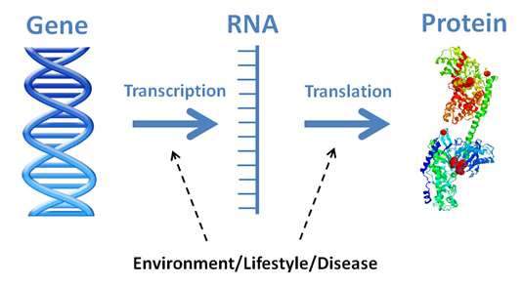
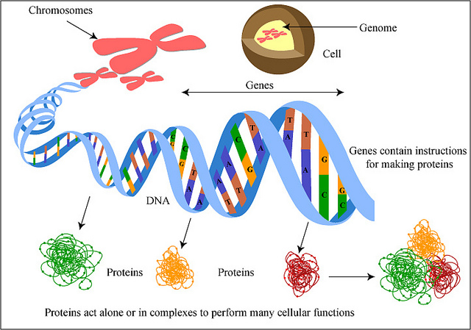
BAckground
Read and Annotate (5 pts)
Comments/Connections
Questions
Vocabulary
Complete the Pre-Lab #1
(discuss with your group!)

Slide 3
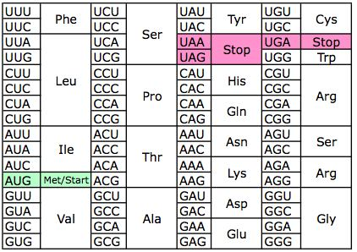
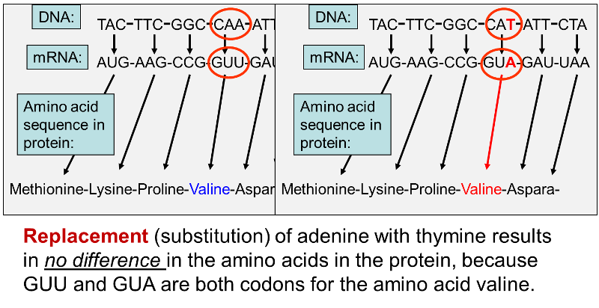
#2) Different DNA…SAME PROTEIN?

Slide 4
Part 1
Read and annotate again (2 pts)

Slide 5
The Lab - overview
Part : Use BLAST research tool to compare GENE differences/similarities
Part 2: Use BLAST research tool to compare PROTEIN differences/similarities
Part 3: Select your OWN GENE to look up and BLAST – compare GENE and PROTEIN similarities across chosen species

Slide 6
Download blast files
Files are on the weebly.
Go to https://blast.ncbi.nlm.nih.gov/Blast.cgi
Open PDF and scroll down to mouse GULO gene. Copy the gene sequence.

Slide 7
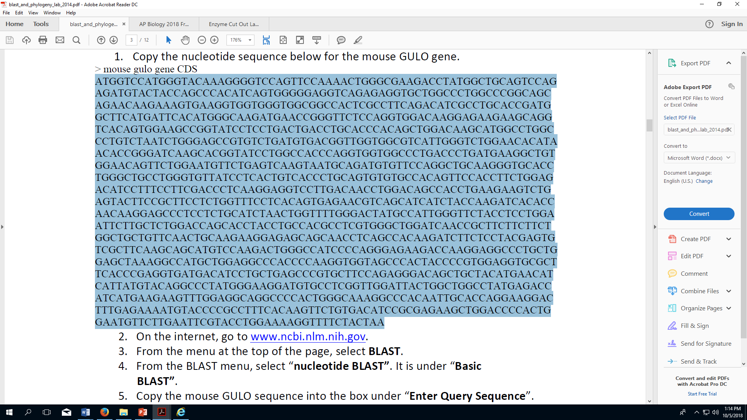

Slide 8
PRocedure
Click here
www.ncbi.nlm.nih.gov

Slide 9
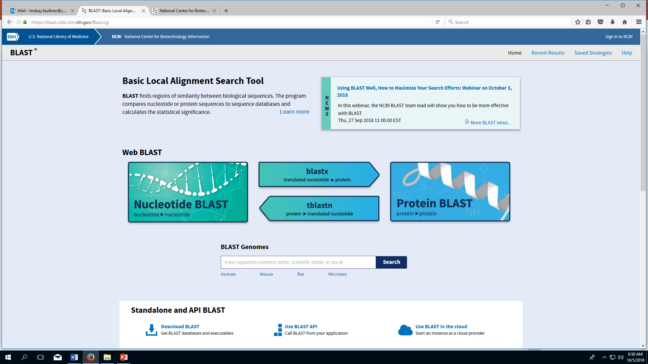

Slide 10
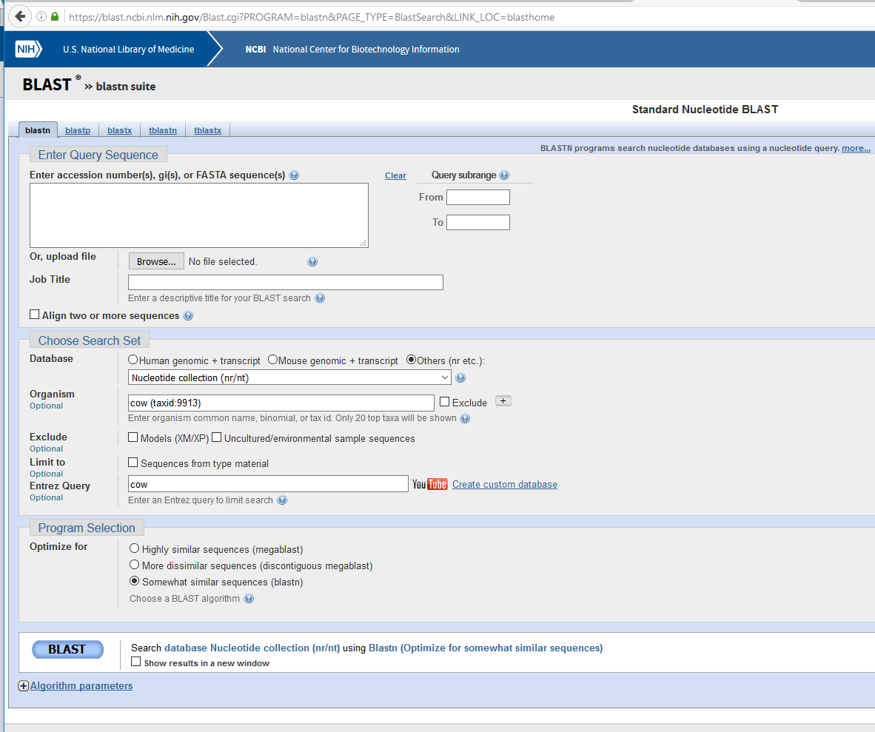
Paste Mouse GULO gene here

