Slide 1

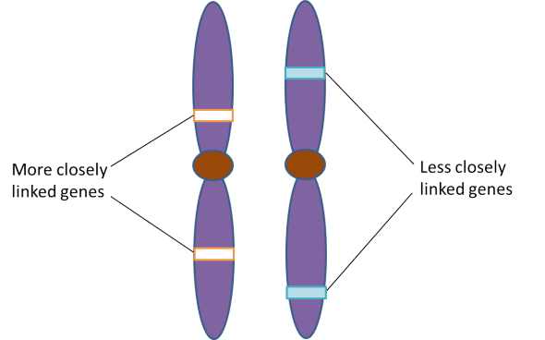
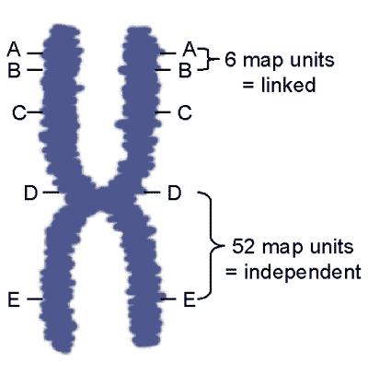
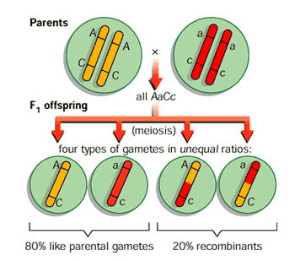
Autosomal linkage
Genes that do not obey Mendel’s Law of Independent Assortment

Slide 2
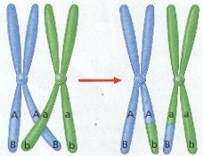
Linked genes
Linkage is the tendency for a group of genes, on the __________ chromosome, to be inherited ___________________
For linkage to occur, the genes must be ___________ to each other

Slide 3
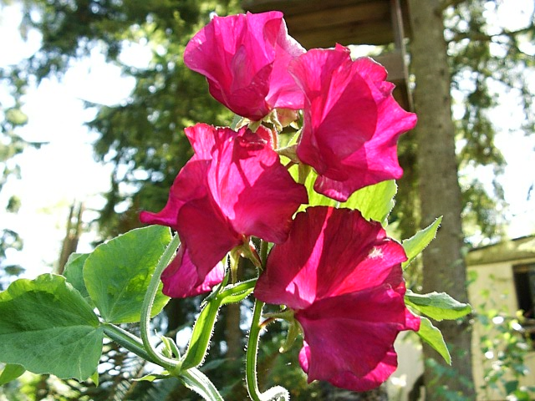
Are the genes linked?
If genes are NOT linked, they are expected to follow Mendel’s Law of Independent Assortment
Sweet Peas | Characters | Traits | Alleles
 | Flower color | Purple | F
 |  | Red | f
 | Pollen grain shape | Long | L
 |  | Round | l

Slide 4
Are the genes linked?
________________________allows scientists to determine if genes are linked or not
In order to perform a two-point test cross, one parent must be ___________, while the other parent is _________________ (for both traits)
P | Phenotypes | Purple Long | X | Red Round | (Pure Bred)
 | Genotypes | FfLl |  | ffll
Test cross
-all recessive

Slide 5
Are the genes linked?
If the genes are NOT linked, phenotypic offspring ratios should follow Mendelian rules
rl
RL
RrLl
¼ purple & long
RrLl X rrll
Rl
Rrll
¼ purple & round
RL
Rl
rL
rl
rl
rL
rrLl
¼ red & long
rl
rrll
¼ red & round

Slide 6
Are the genes linked?
If there are 1000 offspring and the genes are NOT linked, you would expect:
rl
RL
RrLl
¼ purple & long
250
Rl
Rrll
¼ purple & round
250
rL
rrLl
¼ red & long
250
rl
rrll
¼ red & round
250
a Mendelian ratio

Slide 7
Are the genes linked?
But, what if you have these results …
rl
RL
RrLl
¼ purple & long
380
Rl
Rrll
¼ purple & round
128
rL
rrLl
¼ red & long
118
rl
rrll
¼ red & round
374
NOT a Mendelian ratio

Slide 8
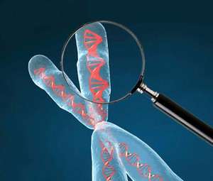
Linked genes
The parental combinations of alleles (purple/long and red/round) seem to be inherited as almost a 3:1 ratio to other offspring (recombinants)
It’s as though they were behaving as a single character
These genes are _______

Slide 9
Crossing over & recombinants
BUT, if these genes were perfectly linked together they would stay in their parental combinations (purple/long & red/round)
There would be no purple/round or red/long
These combinations are the result of _________________________between the linked alleles on their chromosomes during Meiosis I
These are called ________________________

Slide 10
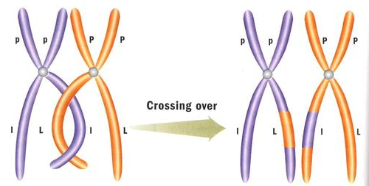
Meiosis & crossing over

Slide 11
Diagrams for linked genes
Genotypes for linked genes can be shown as:
This is an example of a ___________ combination (FfLl)
This genotype would give the same phenotype as:
  But this is an example of a ___________________

Slide 12
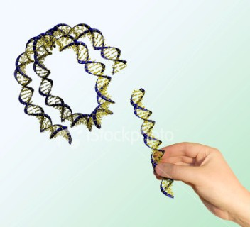
Recombinants
Note: recombinants are any combination of alleles that are not the same as the parental combinations
This is not exclusive to the crossing over of linked genes
We will see this word
again when we study
biotechnology!

Slide 13
Genetic diagram for linked genes
P | Phenotypes | Purple Long | X | Red Round | (Pure Bred)
 | Genotypes
 | Gametes | F L |  | f l
F1 | Phenotypes |  | All Purple Long
 | Genotypes

Slide 14
Genetic diagram for linked genes
F1 | Phenotypes |  | All Purple Long |  | (Self-fertilized)
 | Genotypes |  | crossing over in meiosis I
 | Gametes | F L | f l | F l | f L
 |  | Parental Combinations |  | Recombinants

Slide 15

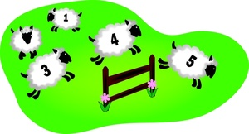
How often does crossing over occur?
Run a test cross!!
FfLl X ffll … and count your offspring

Slide 16
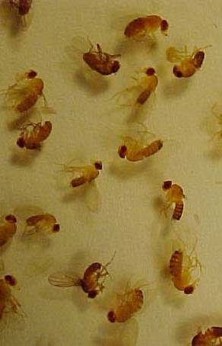
Calculating the cross over value
Drosophila | Characters | Traits | Alleles
 | Wing shape | Normal | B
 |  | Bent | b
 | Body colour | Normal | E
 |  | Ebony | e

Slide 17
Calculating the cross over value
Phenotypes | Heterozygous wild type | X | Ebony Bent
Genotypes | BbEe |  | bbee
Gametes | BE, Be, bE, be |  | be
If these genes are linked Be and bE could only be produced by crossing over

Slide 18
Calculating the cross over value
Phenotypes | Wild type |  | Normal Ebony | Bent Normal | Bent Ebony
Genotypes | BbEe |  | Bbee | bbEe | bbee
Numbers | 83 |  | 82 | 76 | 71
Approx. Ratio | 25% |  | 25% | 25% | 25%
 | Parental combination | Recombinants = 50% of the offspring |  |  | Parental combination

Slide 19
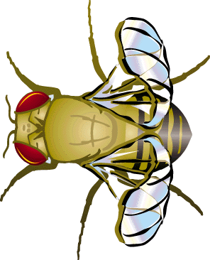
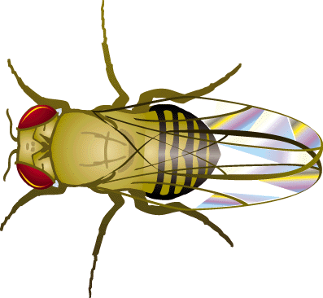
Calculating the cross over value
These results are typical of non-linked genes
The recombinants are in the same frequency as the parental combinations
Note: in this example, bent wing flies are a bit crippled so their offspring are not as viable. This accounts for their lower numbers.

Slide 20
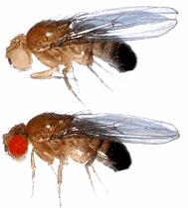
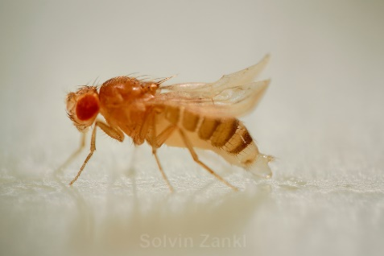
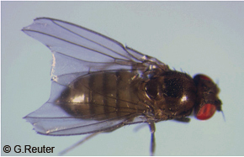
Calculating the cross over value
Drosophila | Characters | Traits | Alleles
 | Eye colour | Red | P
 |  | Pink | p
 | Body colour | Normal | E
 |  | Ebony | e

Slide 21
Calculating the cross over value
Phenotypes | Heterozygous wild type | X | Pink Ebony
Genotypes | PpEe |  | ppee
Gametes | PE, Pe, pE, pe |  | pe
Phenotypes | Wild type | Red Ebony | Pink Normal | Pink Ebony
Genotypes | PpEe | Ppee | ppEe | ppee

Slide 22
Calculating the cross over value
Phenotypes | Wild type | Red Ebony | Pink Normal | Pink Ebony
Genotypes | PpEe | Ppee | ppEe | ppee
Numbers | 601 | 3 | 4 | 584
 | Parental combinations | Recombinants < 50% |  | Parental combinations
The frequency of the recombinants is less than 50%
This is an example of _________________

Slide 23
Calculating the cross over value
The % recombination in a test cross is called the ____________________________________(cov)
The cross over value between ebony and pink =
This value is important as it tells us ____________ the ______ of the gene are on the chromosome
Cross over values from several pairs of genes permit a geneticist to plot a ________________

Slide 24
Are these genes linked?
B = normal wing
b = bent wing
V = normal eye
v = vermillion eye
Two-Point Test Cross:
bbvv (parental type) x BbVv (parental type)
 | BV | bv | Bv | bV
bv | BbVv | bbvv | Bbvv | bbVv
Expected Results | 300 | 300 | 300 | 300
Actual Results | 310 | 315 | 287 | 288
No

Slide 25
Are these genes linked?
B = normal wing
b = bent wing
V = normal eye
v = vermillion eye
Calculate the cross over value.
 | BV | bv | Bv | bV
bv | BbVv | bbvv | Bbvv | bbVv
Expected Results | 300 | 300 | 300 | 300
Actual Results | 480 | 460 | 130 | 130
Yes

Slide 26
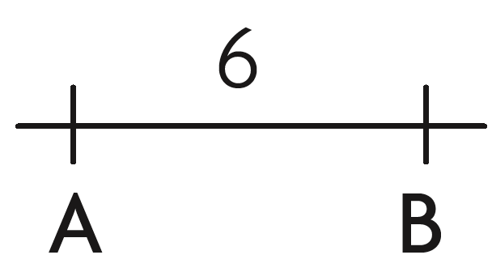
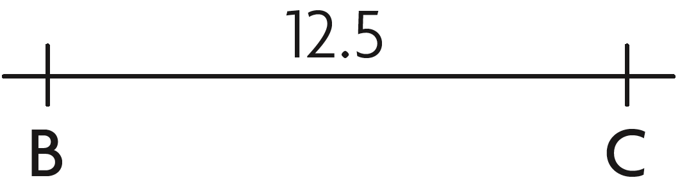
Mapping genes
Crossing over frequencies can be converted into map units
  1% = 1 mu (map unit)
    i.e. 5% crossing over rate = 5 map units
Genes A and B cross over 6% of the time
Genes B and C cross over 12.5% of the time

Slide 27
Mapping genes
Draw a linkage map based on the following percentages:
  A – B = 8%
  B – C = 10%
  A – C = 2%
B
A
C
8.0
2.0
8.0 + 2.0 = 10.0

Slide 28
Mapping genes
Draw a linkage map based on the following units:
  A – D = 2 mu
  B – D = 10 mu
  C – B = 3 mu
  A – C = 5 mu

