Slide 1
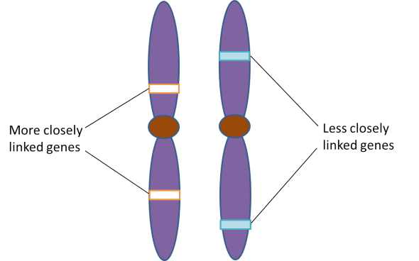
Autosomal linkage
Genes that do not obey Mendel’s Law of Independent Assortment

Slide 2
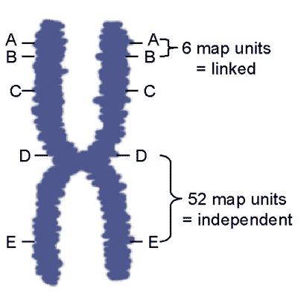
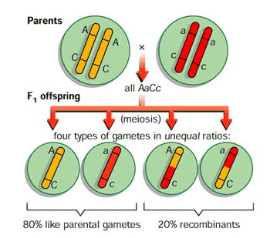
Autosomal linkage
Genes that do not obey Mendel’s Law of Independent Assortment

Slide 3
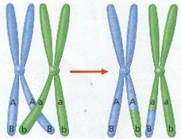
Linked genes
Linkage is the tendency for a group of genes, on the same chromosome, to be inherited together
For linkage to occur, the genes must be close to each other

Slide 4
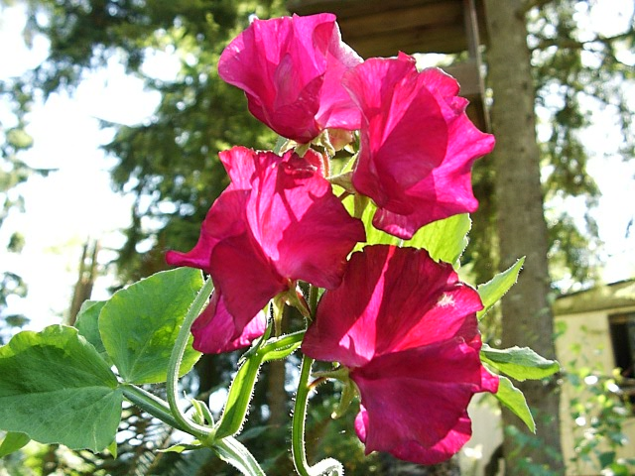
Are the genes linked?
If genes are NOT linked, they are expected to follow Mendel’s Law of Independent Assortment
Sweet Peas | Characters | Traits | Alleles
 | Flower color | Purple | F
 |  | Red | f
 | Pollen grain shape | Long | L
 |  | Round | l

Slide 5
Are the genes linked?
A two-point test cross allows scientists to determine if genes are linked or not
In order to perform a two-point test cross, one parent must be heterozygous, while the other parent is homozygous (for both traits)
P | Phenotypes | Purple Long | X | Red Round | (Pure Bred)
 | Genotypes | FfLl |  | ffll
Test cross
-all recessive

Slide 6
Are the genes linked?
If the genes are NOT linked, phenotypic offspring ratios should follow Mendelian rules
rl
RL
RrLl
¼ purple & long
RrLl X rrll
Rl
Rrll
¼ purple & round
RL
Rl
rL
rl
rl
rL
rrLl
¼ red & long
rl
rrll
¼ red & round

Slide 7
Are the genes linked?
If there are 1000 offspring and the genes are NOT linked, you would expect:
rl
RL
RrLl
¼ purple & long
250
Rl
Rrll
¼ purple & round
250
rL
rrLl
¼ red & long
250
rl
rrll
¼ red & round
250
a Mendelian ratio

Slide 8
Are the genes linked?
But, what if you have these results …
rl
RL
RrLl
¼ purple & long
380
Rl
Rrll
¼ purple & round
128
rL
rrLl
¼ red & long
118
rl
rrll
¼ red & round
374
NOT a Mendelian ratio

Slide 9
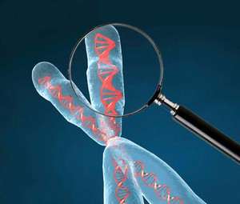
Linked genes
The parental combinations of alleles (purple/long and red/round) seem to be inherited as almost a 3:1 ratio to other offspring (recombinants)
It’s as though they were behaving as a single character
These genes are LINKED

Slide 10
Crossing over & recombinants
BUT, if these genes were perfectly linked together they would stay in their parental combinations (purple/long & red/round)
There would be no purple/round or red/long
These combinations are the result of CROSSING OVER between the linked alleles on their chromosomes during Meiosis I
These are called RECOMBINANTS

Slide 11
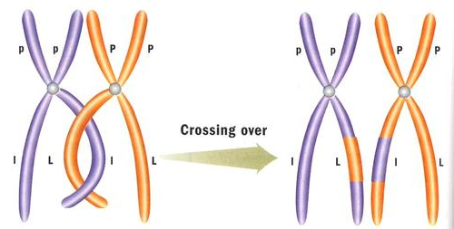
Meiosis & crossing over

Slide 12
Diagrams for linked genes
Genotypes for linked genes can be shown as:
This is an example of a parental combination (FfLl)
This genotype would give the same phenotype as:
But this is an example of a recombinant

Slide 13
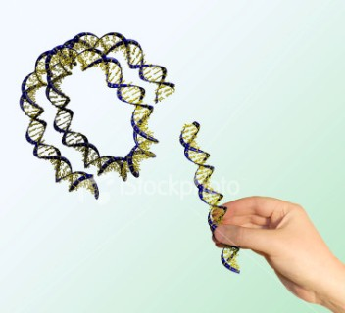
Recombinants
Note: recombinants are any combination of alleles that are not the same as the parental combinations
This is not exclusive to the crossing over of linked genes
We will see this word
again when we study
biotechnology!

Slide 14
Genetic diagram for linked genes
P | Phenotypes | Purple Long | X | Red Round | (Pure Bred)
 | Genotypes
 | Gametes | F L |  | f l
F1 | Phenotypes |  | All Purple Long
 | Genotypes

Slide 15
Genetic diagram for linked genes
F1 | Phenotypes |  | All Purple Long |  | (Self-fertilized)
 | Genotypes |  | crossing over in meiosis I
 | Gametes | F L | f l | F l | f L
 |  | Parental Combinations |  | Recombinants

Slide 16

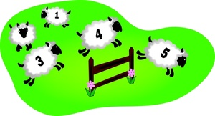
How often does crossing over occur?
Run a test cross!!
FfLl X ffll … and count your offspring

Slide 17
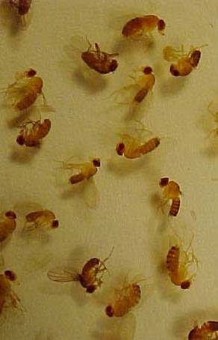
Calculating the cross over value
Drosophila | Characters | Traits | Alleles
 | Wing shape | Normal | B
 |  | Bent | b
 | Body colour | Normal | E
 |  | Ebony | e

Slide 18
Calculating the cross over value
Phenotypes | Heterozygous wild type | X | Ebony Bent
Genotypes | BbEe |  | bbee
Gametes | BE, Be, bE, be |  | be
If these genes are linked Be and bE could only be produced by crossing over

Slide 19
Calculating the cross over value
Phenotypes | Wild type |  | Normal Ebony | Bent Normal | Bent Ebony
Genotypes | BbEe |  | Bbee | bbEe | bbee
Numbers | 83 |  | 82 | 76 | 71
Approx. Ratio | 25% |  | 25% | 25% | 25%
 | Parental combination | Recombinants = 50% of the offspring |  |  | Parental combination

Slide 20
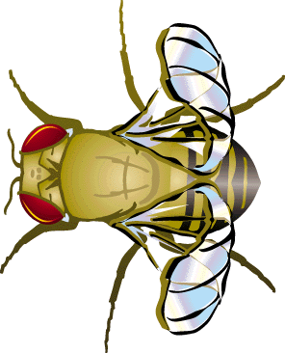
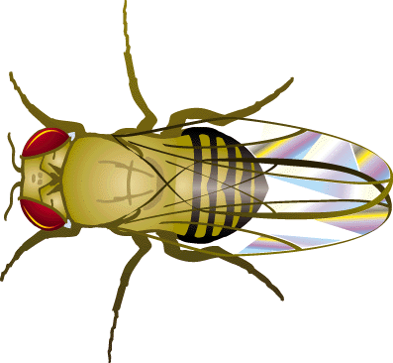
Calculating the cross over value
These results are typical of non-linked genes
The recombinants are in the same frequency as the parental combinations
Note: in this example, bent wing flies are a bit crippled so their offspring are not as viable. This accounts for their lower numbers.

Slide 21
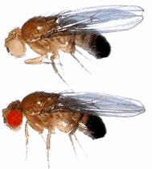
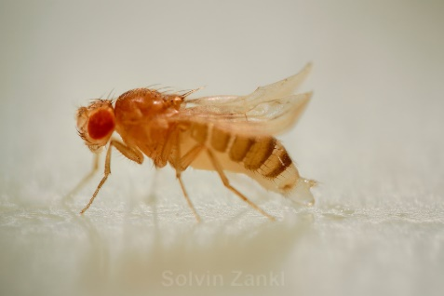
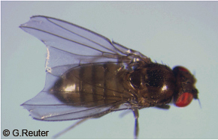
Calculating the cross over value
Drosophila | Characters | Traits | Alleles
 | Eye colour | Red | P
 |  | Pink | p
 | Body colour | Normal | E
 |  | Ebony | e

Slide 22
Calculating the cross over value
Phenotypes | Heterozygous wild type | X | Pink Ebony
Genotypes | PpEe |  | ppee
Gametes | PE, Pe, pE, pe |  | pe
Phenotypes | Wild type | Red Ebony | Pink Normal | Pink Ebony
Genotypes | PpEe | Ppee | ppEe | ppee

Slide 23
Calculating the cross over value
Phenotypes | Wild type | Red Ebony | Pink Normal | Pink Ebony
Genotypes | PpEe | Ppee | ppEe | ppee
Numbers | 601 | 3 | 4 | 584
 | Parental combinations | Recombinants < 50% |  | Parental combinations
The frequency of the recombinants is less than 50%
This is an example of linkage

Slide 24
Calculating the cross over value
The % recombination in a test cross is called the CROSS OVER VALUE (cov)
The cross over value between ebony and pink =
This value is important as it tells us how far apart the loci of the gene are on the chromosome
Cross over values from several pairs of genes permit a geneticist to plot a gene map

Slide 25
Are these genes linked?
B = normal wing
b = bent wing
V = normal eye
v = vermillion eye
 | BV | bv | Bv | bV
bv | BbVv | bbvv | Bbvv | bbVv
Expected Results | 300 | 300 | 300 | 300
Actual Results | 310 | 315 | 287 | 288
No

Slide 26
Are these genes linked?
B = normal wing
b = bent wing
V = normal eye
v = vermillion eye
Calculate the cross over value.
 | BV | bv | Bv | bV
bv | BbVv | bbvv | Bbvv | bbVv
Expected Results | 300 | 300 | 300 | 300
Actual Results | 480 | 460 | 130 | 130
Yes

Slide 27
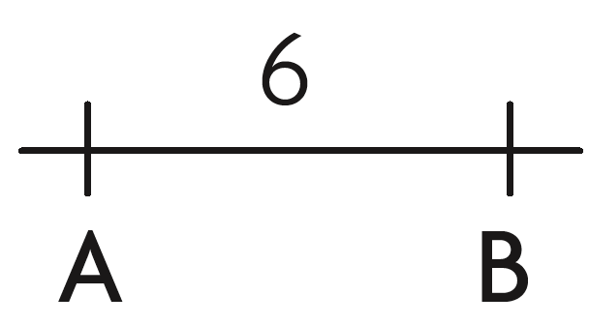
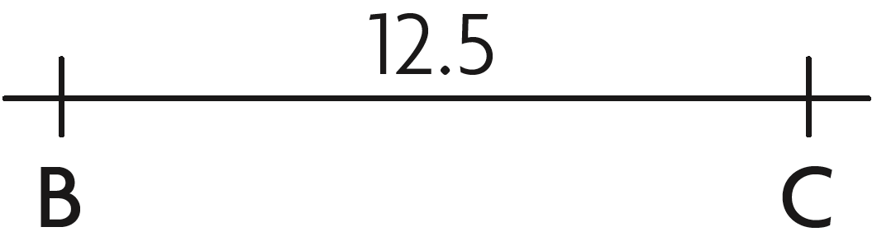
Mapping genes
Crossing over frequencies can be converted into map units
  1% = 1 mu (map unit)
    i.e. 5% crossing over rate = 5 map units
Genes A and B cross over 6% of the time
Genes B and C cross over 12.5% of the time

Slide 28
Mapping genes
Draw a linkage map based on the following percentages:
  A – B = 8%
  B – C = 10%
  A – C = 2%
Notice: the distance of (A-B) + (A-C) = (B-C)
8 2 10
B
A
C
8.0
2.0
8.0 + 2.0 = 10.0

Slide 29
Mapping genes
Draw a linkage map based on the following units:
  A – D = 2 mu
  B – D = 10 mu
  C – B = 3 mu
  A – C = 5 mu

Slide 30
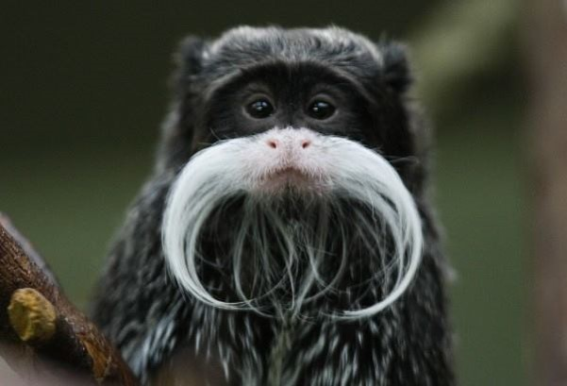
Any questions?

Slide 31
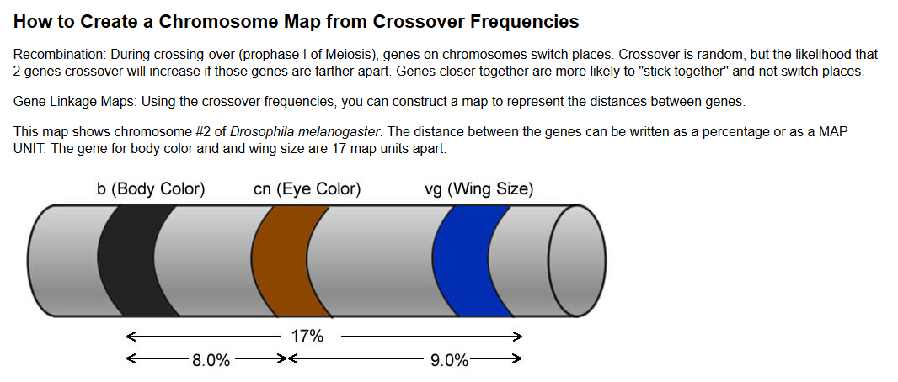
Time to Practice

Slide 32
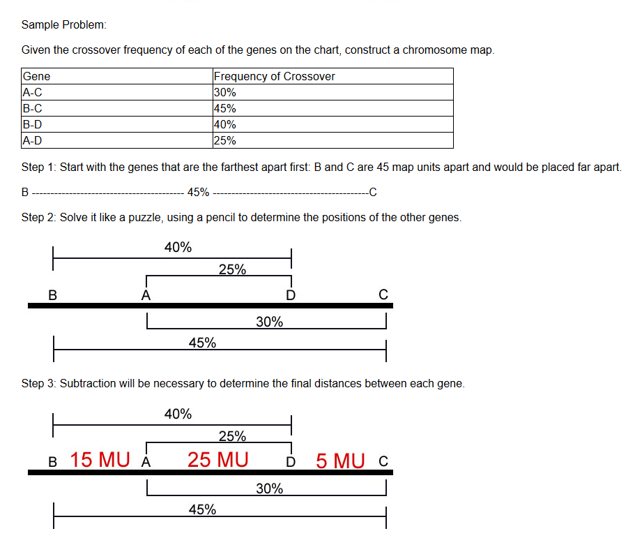

Slide 33
Let’s Do #1 on the Gene Mapping Worksheet
In 1911, Thomas Hunt Morgan collected the following crossover gene frequencies while studying Drosophila. Bar-shaped eyes are indicated by the B allele, and carnation eyes are indicated by the allele C. Fused veins on wings (A) and scalloped wings (S) are located on the same chromosomes.
Gene Combinations | Recombination Frequency
A/B | 2.5%
A/C | 3.0%
B/C | 5.5%
B/S | 5.5%
A/S | 8.0%
C/S | 11.0%

Slide 34
Try #2

Slide 35
Thought Lab 17.1: Mapping Chromosomes

