Slide 1
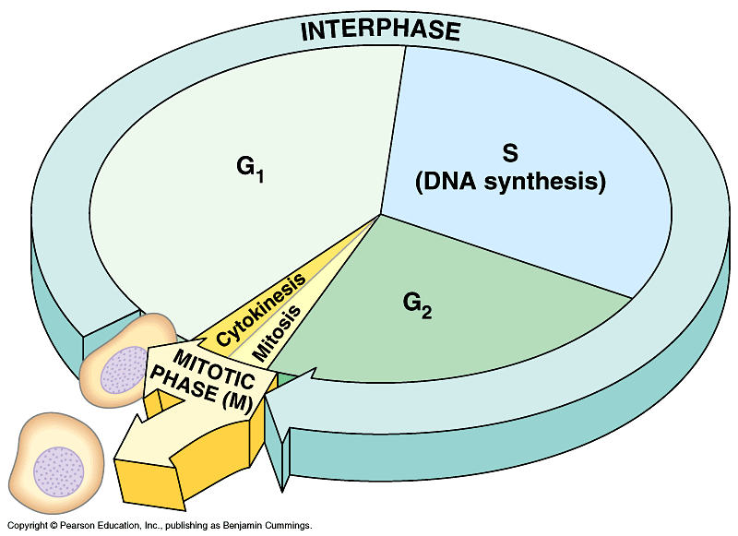
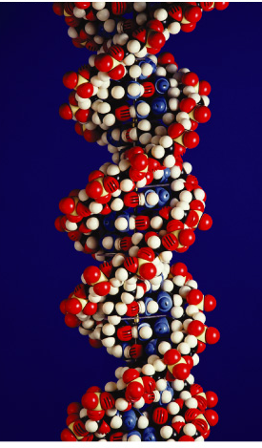
DNA Replication

Slide 2
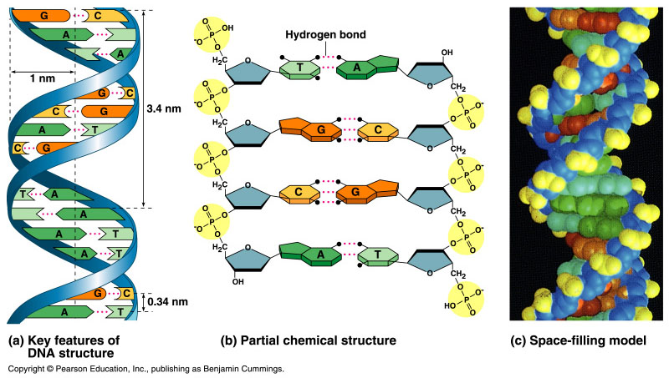
Double helix structure of DNA
“It has not escaped our notice that the specific pairing we have postulated immediately suggests a possible copying mechanism for the genetic material.”
Watson & Crick

Slide 3
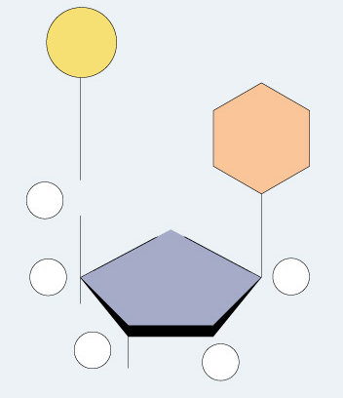
Directionality of DNA
nucleotide
PO₄
You need to number the carbons
  It matters!
N base
5′
CH₂
This will be
IMPORTANT!!
O
4′
1′
ribose
3′
2′
OH

Slide 4
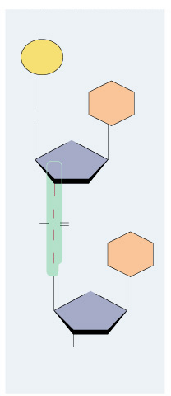
The DNA backbone
5′
PO₄
base
5′
CH₂
O
Putting the DNA backbone together
  Refer to the 3’ and 5’ ends of the DNA
4′
C
1′
3′
2′
O
–O
P
O
Sounds trivial, but…
this will be
IMPORTANT!!
O
base
5′
CH₂
O
4′
1′
3′
2′
OH
3′

Slide 5
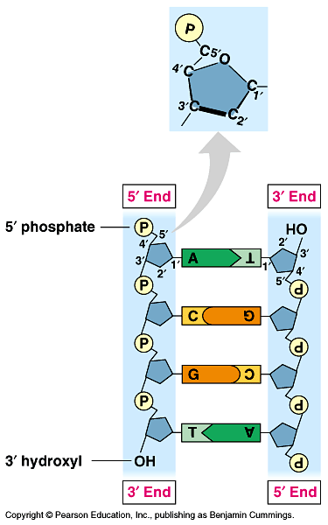
Anti-parallel strands
Nucleotides in DNA backbone are bonded from phosphate to sugar between 3’ and 5’ carbons
  DNA molecule has “direction”
  Complementary strand runs in opposite direction
  Called “anti-parallel strands”
5′
3′
3′
5′

Slide 6
Bonding in DNA
hydrogen
bonds
5′
3′
covalent
phosphodiester
bonds
3′
5′
….strong or weak bonds?
How do the bonds fit the mechanism for copying DNA?

Slide 7
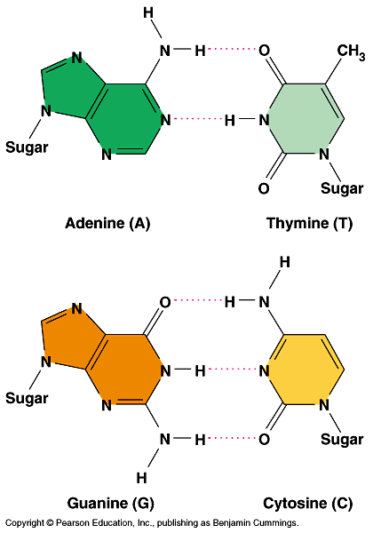
Base pairing in DNA
Purines
  Adenine (A)
  Guanine (G)
Pyrimidines
  Thymine (T)
  Cytosine (C)
Pairing
  A : T
    2 H bonds
  C : G
    3 H bonds
Remember:
kids from AG
are pure

Slide 8
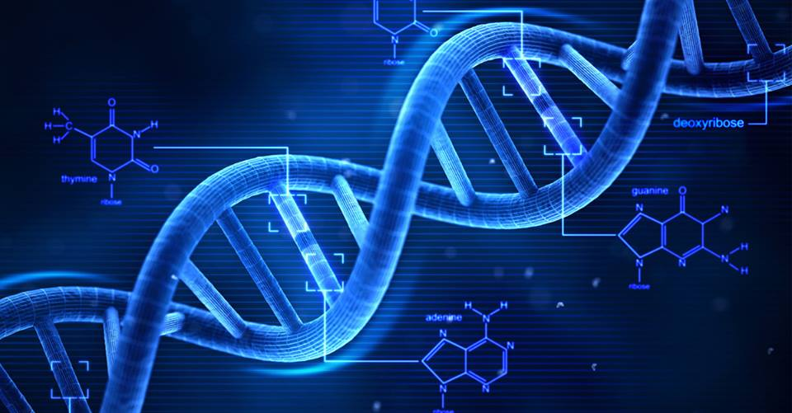

Slide 9
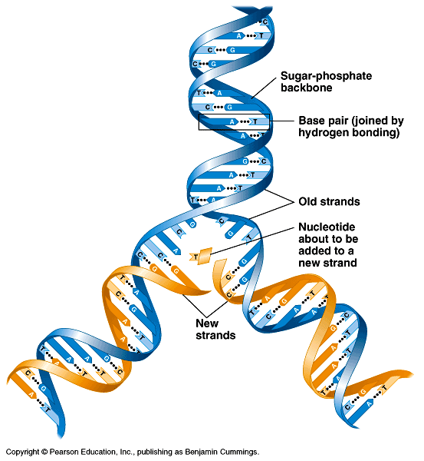
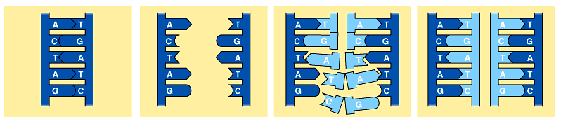
Copying DNA
Replication of DNA
  Base pairing allows each strand to serve as a template for a new strand
  New strand is ½ parent template & ½ new DNA
    Semiconservative copying process

Slide 10
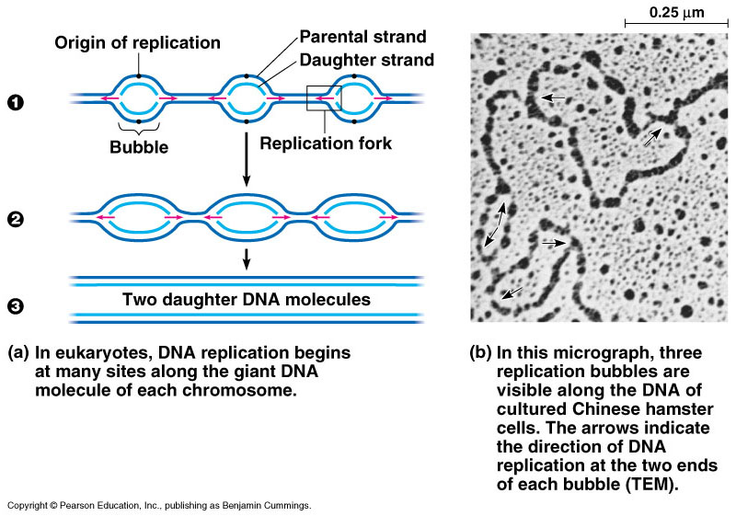
DNA replication
Let’s meet
the team…
Large team of enzymes coordinate replication

Slide 11
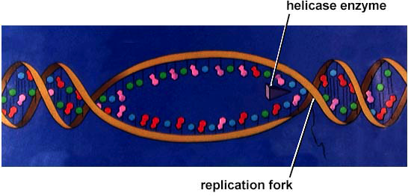
DNA replication: Step 1
I’d love to be
helicase & unzip
your genes…
Unwind DNA
  Enzyme: helicase
    Unwinds part of DNA helix
    Stabilized by single-stranded binding proteins
helicase
single-stranded binding proteins
replication fork

Slide 12
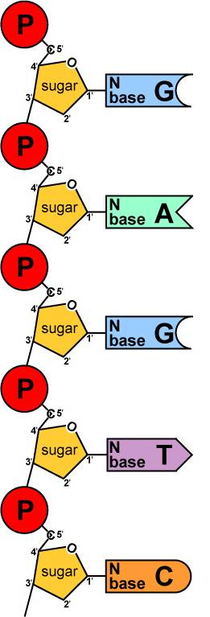
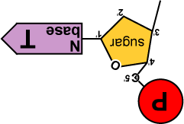
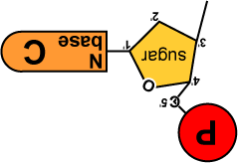
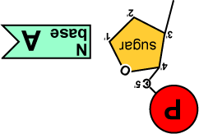
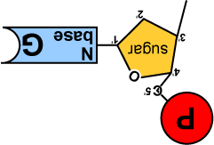
DNA replication: Step 2
Build daughter DNA strand
  Add new complementary bases
  Enzyme: DNA polymerase III
But…
We’re missing
something!
What?
Where’s the
ENERGY
for the bonding!
DNA
Polymerase III

Slide 13


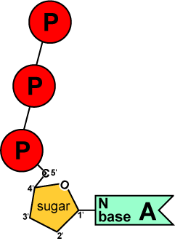
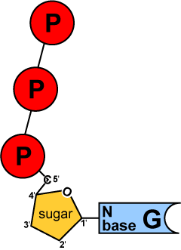
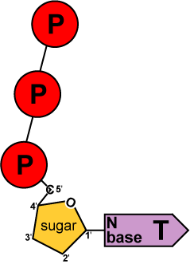
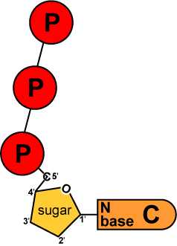
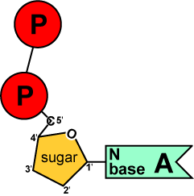
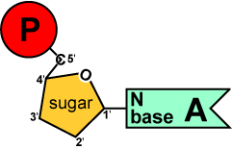
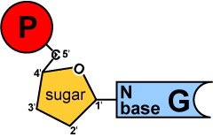
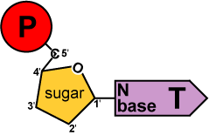
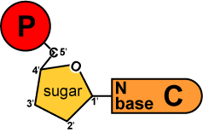
Replication energy
We come
with our own
energy!
Where does energy for bonding usually come from?
energy
You
remember
ATP!
Are there
other ways
to get energy
out of it?
energy
Are there
other energy
nucleotides?
You bet!
And we
leave behind a
nucleotide!
TTP
GTP
CTP
GMP
AMP
ATP
TMP
ADP
CMP
modified nucleotide

Slide 14
Replication energy
The nucleotides arrive as nucleosides
  DNA bases with P-P-P
    P-P-P = energy for bonding
  DNA bases arrive with their own energy source for bonding
Bonded by
DNA polymerase III
ATP
GTP
TTP
CTP

Slide 15
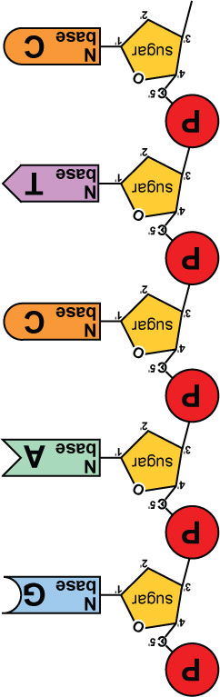
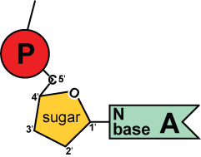
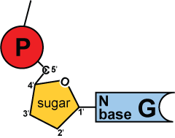
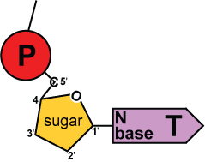
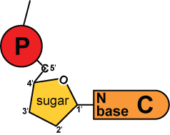
Replication
5′
3′
energy
DNA
Polymerase III
DNA
Polymerase III
Adding bases
  Can only add nucleotides to 3’ end of a growing DNA strand
  Strand only grows 5’ → 3’
energy
DNA
Polymerase III
energy
DNA
Polymerase III
energy
B.Y.O. ENERGY!
The energy rules
the process
3′
5′

Slide 16
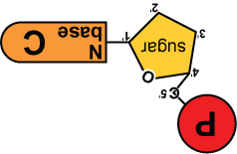
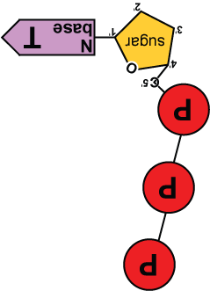
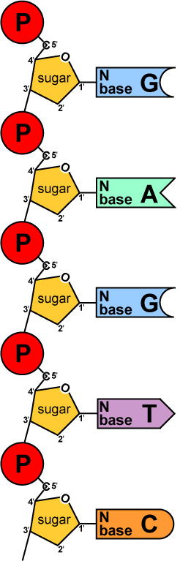
5′
3′
5′
need “primer” bases to add on to
3′
energy
no energy to bond
✗
energy
energy
energy
energy
ligase
energy
energy
3′
5′
3′
5′

Slide 17
Leading & lagging strands
Limits of DNA polymerase III
  can only build onto 3′ end of an existing DNA strand
5′
✗
Okazaki fragments
5′
3′
3′
5′
3′
5′
5′
Lagging strand
3′
ligase
growing
replication fork
3′
5′
✓
Leading strand
3′
5′
Lagging strand
  Okazaki fragments
  joined by ligase
    “spot welder” enzyme
3′
DNA polymerase III
Leading strand
  continuous synthesis

Slide 18
Replication fork/bubble
3′
5′
5′
3′
DNA polymerase III
leading strand
3′
5′
3′
5′
5′
5′
5′
3′
3′
lagging strand
3′
5′
5′
3′
5′
lagging strand
leading strand
growing
replication fork
3′
5′
5′
growing
replication fork
leading strand
5′
3′
3′
lagging strand
5′
5′
5′

Slide 19
Starting DNA synthesis: RNA primers
Limits of DNA polymerase III
  can only build onto 3′ end of an existing DNA strand
5′
3′
5′
3′
3′
5′
3′
5′
growing
replication fork
3′
primase
5′
DNA polymerase III
RNA
5′
RNA primer
  built by primase
  serves as starter sequence for DNA polymerase III
3′

Slide 20
Replacing RNA primers with DNA
DNA polymerase I
  removes sections of RNA primer and replaces with DNA nucleotides
DNA polymerase I
5′
3′
3′
ligase
5′
growing
replication fork
3′
5′
RNA
5′
3′
But DNA polymerase I still can only build onto 3′ end of an existing DNA strand

Slide 21
Chromosome erosion
Houston, we
have a problem!
All DNA polymerases can only add to 3′ end of an existing DNA strand
DNA polymerase I
5′
3′
3′
5′
growing
replication fork
3′
5′
DNA polymerase III
RNA
5′
Loss of bases at 5′ ends
in every replication
  chromosomes get shorter with each replication
  limit to number of cell divisions?
3′

Slide 22
Telomeres
Repeating, non-coding sequences at the end of chromosomes = protective cap
  limit to ~50 cell divisions
5′
3′
3′
5′
growing
replication fork
3′
telomerase
5′
Telomerase
  enzyme extends telomeres
  can add DNA bases at 5′ end
  different level of activity in different cells
    high in stem cells & cancers -- Why?
5′
TTAAGGG
TTAAGGG
TTAAGGG
3′

Slide 23
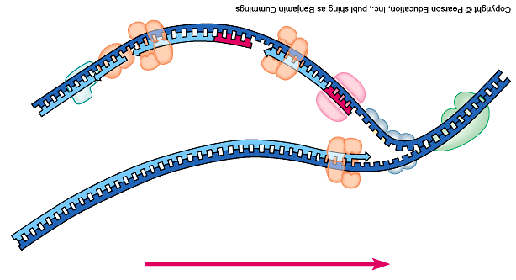
Replication fork
DNA
polymerase III
lagging strand
DNA
polymerase I
3’
Okazaki
fragments
primase
5’
5’
ligase
3’
5’
SSB
3’
helicase
DNA
polymerase III
5’
leading strand
3’
direction of replication
SSB = single-stranded binding proteins

Slide 24
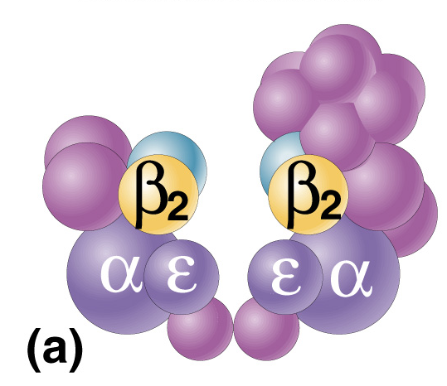
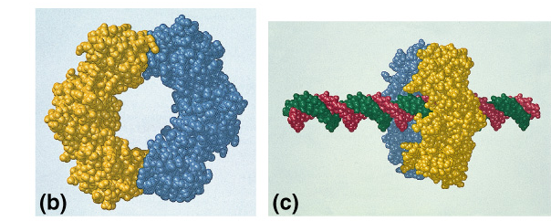
DNA polymerases
DNA polymerase III
  1000 bases/second
  Main DNA builder
DNA polymerase I
  20 bases/second
  Editing, repair & primer removal
DNA polymerase III
enzyme

Slide 25
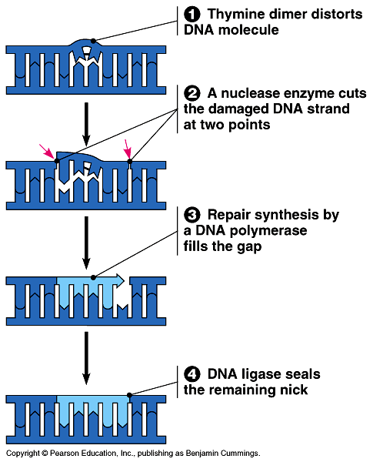
Editing & proofreading DNA
1000 bases/second = lots of typos
DNA polymerase I
  Proofreads & corrects typos
  Repairs mismatched bases
  Removes abnormal bases
    Repairs damage throughout life
  Reduces error rate from 1/10,000 to 1/100 million

Slide 26
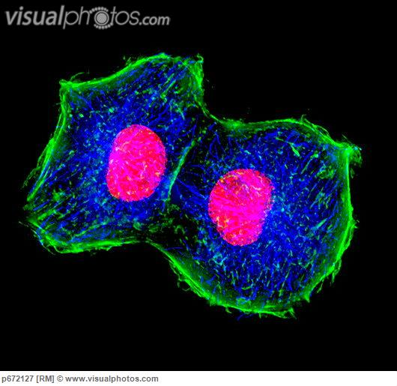
Fast & accurate
It takes E.coli <1 hour to copy 5 million base pairs in its single chromosome
  Divide to form 2 identical daughter cells
Human cells copy 6 billion bases & divide into daughter cells in only a few hours
  Remarkably accurate
  Only ~1 error per 100 million bases
  ~30 errors per cell cycle

Slide 27
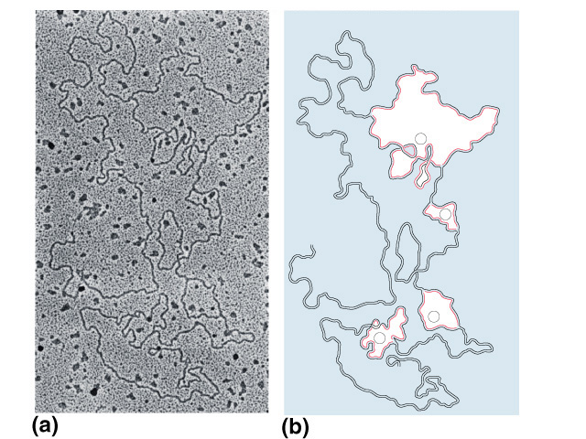
What does it look like?
1
2
3
4

Slide 28
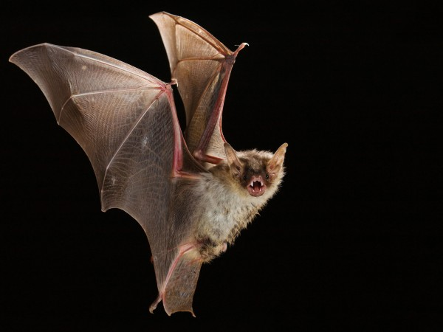
Any Questions??

