Slide 1

Chapter 24
The Origin of Species

Slide 2
What You Need to Know:
1) The difference between micro & macro evolution.
2) The biological concept of a species.
3) Prezygotic and postzygotic barriers that maintain reproductive isolation in natural populations.
4) How allopatric and sympatric speciation are similar and different.
5) How autopolyploidy can lead to sympatric speciation.
6) How punctuated equilibrium and gradualism describe two different tempos of speciation.

Slide 3
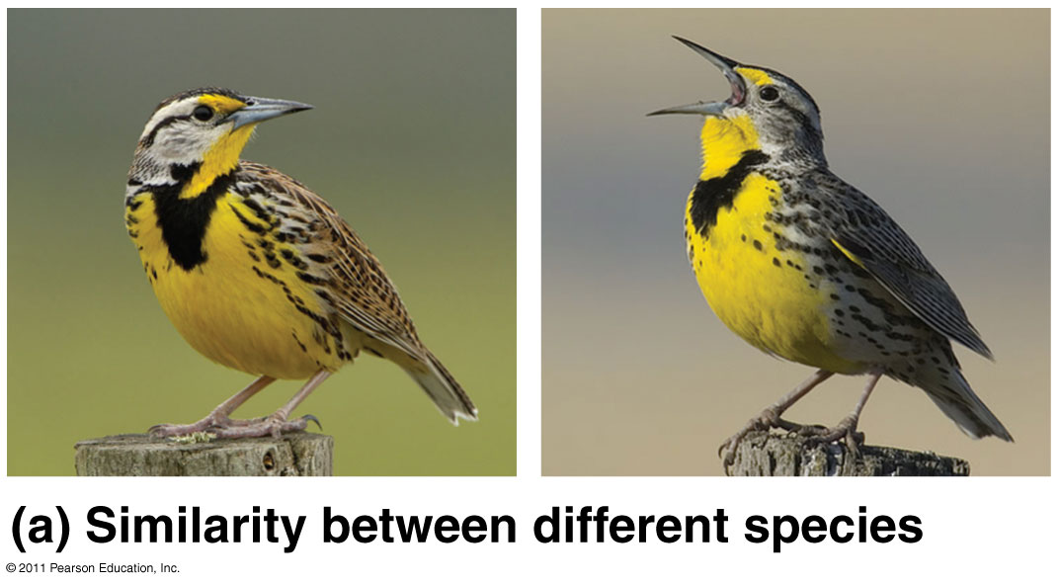
Speciation = origin of species
Microevolution: changes within a single gene pool
Macroevolution: evolutionary change above the species level
  cumulative effects of speciation over long periods of time

Slide 4
HHMI Video Clip:
Reproductive Isolation and Speciation
Running Time: 2:38 min
Notes:
https://www.youtube.com/watch?v=EmtIofdeUbc&feature=youtu.be

Slide 5
Biological Species Concept
Species = population or group of populations whose members have the potential to interbreed in nature and produce viable, fertile offspring
  Reproductively compatible

Slide 6
Other definitions of species:
Morphological – by body shape, size, and other structural features
Ecological – niche/role in community
Phylogenetic – share common ancestry, branch on tree of life

Slide 7
Reproductive Isolation
  Barriers that prevent members of 2 species from producing viable, fertile hybrids

Slide 8
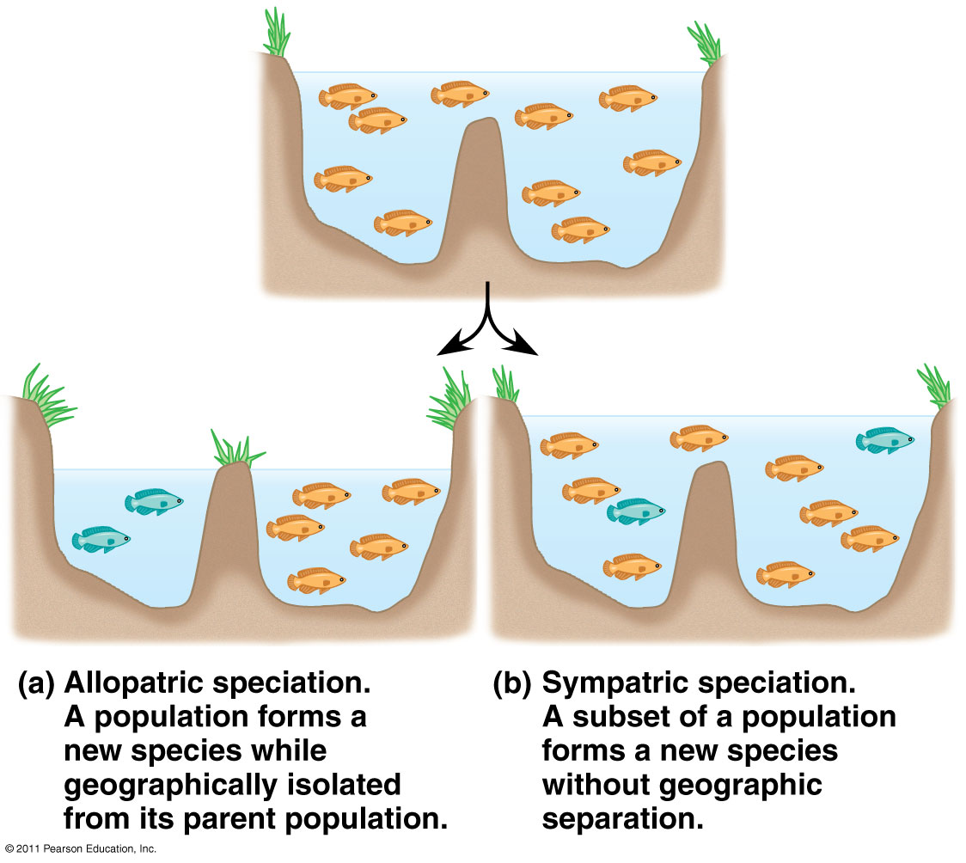
Two main modes of speciation

Slide 9
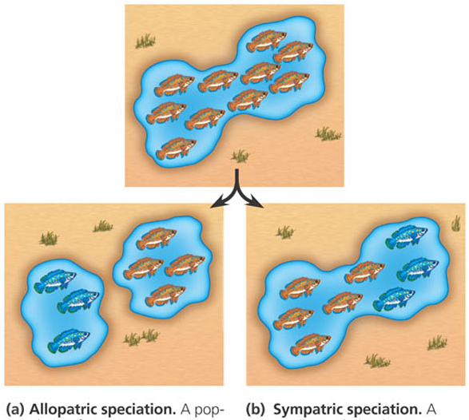
How do new species originate?
Populations must become isolated
    geographically isolated
    reproductively isolated
  isolated populations evolve independently
Isolation
  allopatric
    geographic separation
    “other country”
  sympatric
    still live in same area
    “same country”

Slide 10
Two main modes of speciation:
Allopatric Speciation “other country”
Geographically isolated populations
Caused by geologic events or processes Evolves by natural selection & genetic drift
Ex: Squirrels on N/S rims of Grand Canyon
Sympatric Speciation “same country”
Overlapping populations within home range
Gene flow between subpopulations blocked by: polyploidy sexual selection habitat differentiation
Ex: polyploidy in crops (oats, cotton, potatoes, wheat)

Slide 11
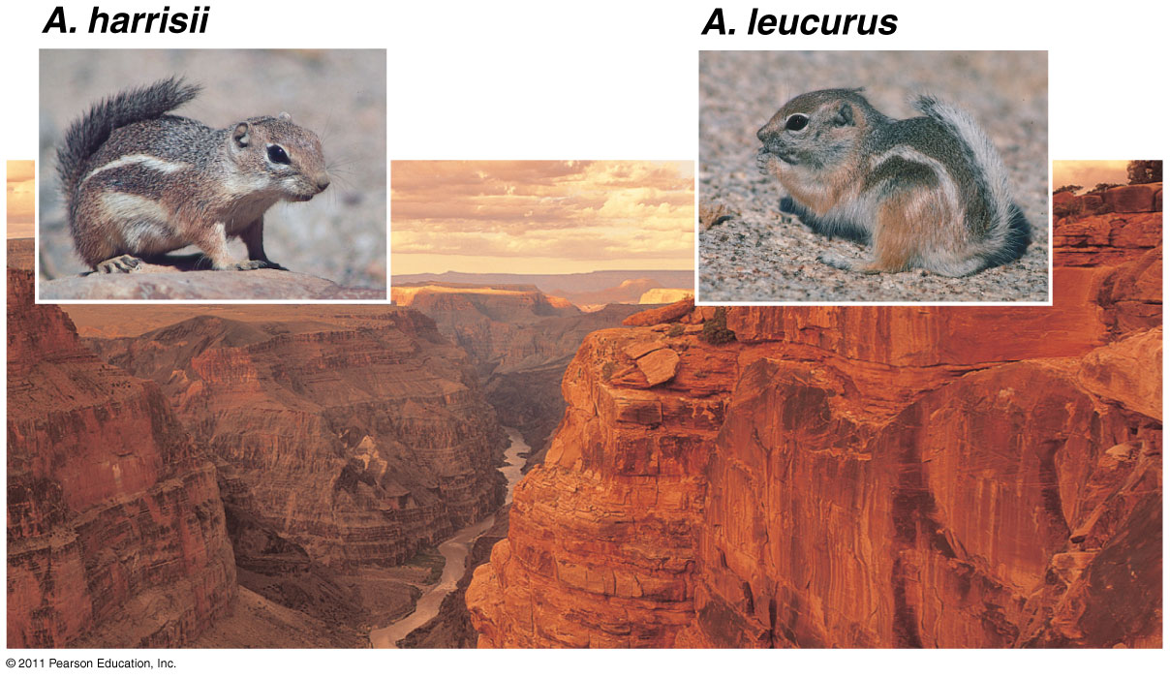
Allopatric speciation of antelope squirrels on opposite rims of the Grand Canyon

Slide 12
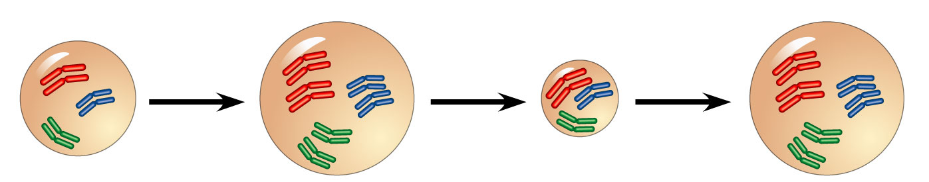
Sympatric Speciation by Polyploidy
Autopolyploid: extra sets of chromosomes
  Failure of cell division (2n → 4n)
  Ex: Strawberries are 4n, 6n, 8n, 10n (decaploid)!
2n
2n = 6
4n = 12
4n
Autopolyploid Speciation

Slide 13
Adaptive Radiation
Many new species arise from a single common ancestor
Occurs when:
  A few organisms make way to new, distant areas (allopatric speciation)
  Environmental change → extinctions → new niches for survivors
Ex: Hawaiian archipelago
Founding Parents

Slide 14
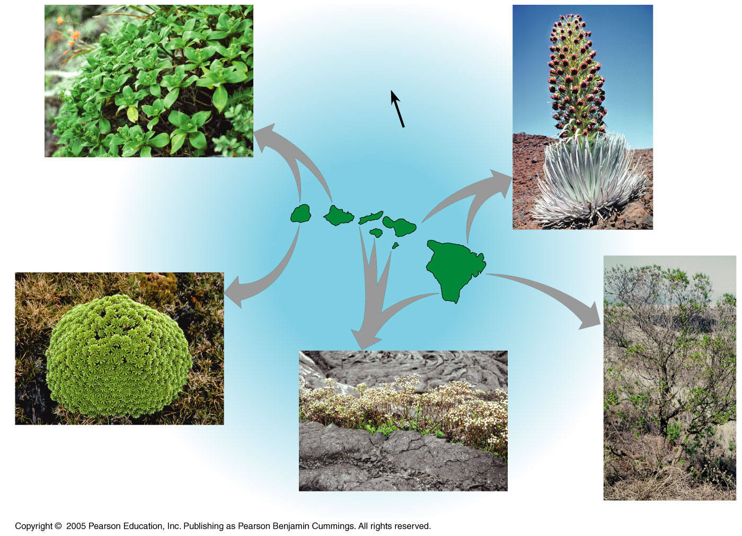
Adaptive Radiation: Hawaiian plants descended from ancestral tarweed from North America 5 million years ago (mya)
N
Dubautia laxa
1.3
million
years
KAUAI
5.1
million
years
MOLOKAI
MAUI
OAHU
3.7
million
years
LANAI
Argyroxiphium sandwicense
HAWAII
0.4
million
years
Dubautia waialealae
Dubautia scabra
Dubautia linearis

Slide 15
Types of Reproductive Barriers
Prezygotic Barriers:
  Impede mating/ fertilization
Types:
Geographic isolation
Habitat (ecological) isolation
Temporal isolation
Behavioral isolation
Mechanical isolation
Gametic isolation
Postzygotic Barriers:
  Prevent hybrid zygote from developing into viable adult
Types:
Reduced hybrid viability
Reduced hybrid fertility
Hybrid breakdown

Slide 16
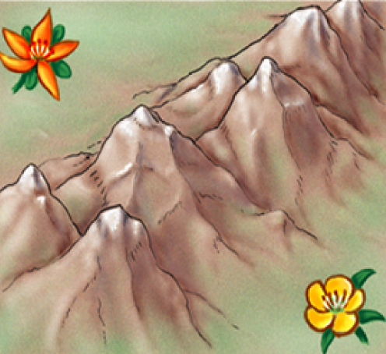
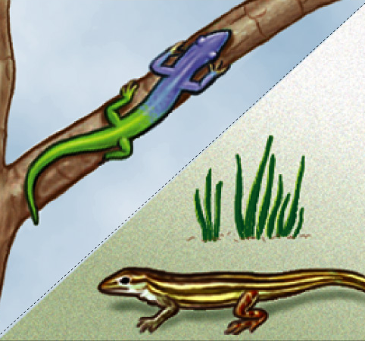
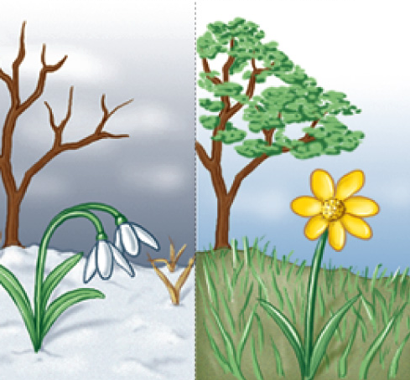
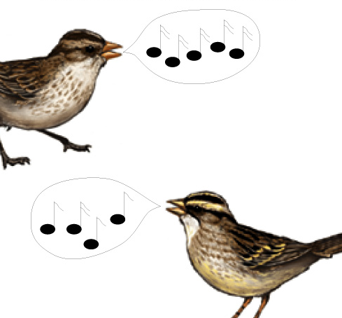
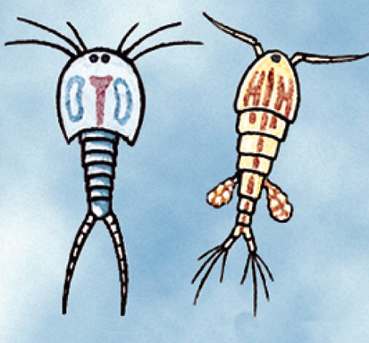
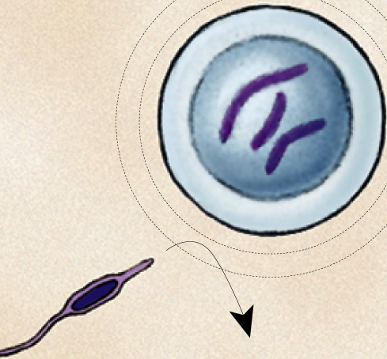
PRE-reproduction barriers
Obstacle to mating or to fertilization if mating occurs
geographic isolation
ecological isolation
temporal isolation
behavioral isolation
mechanical isolation
gametic isolation

Slide 17
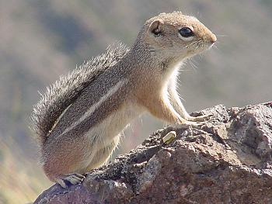
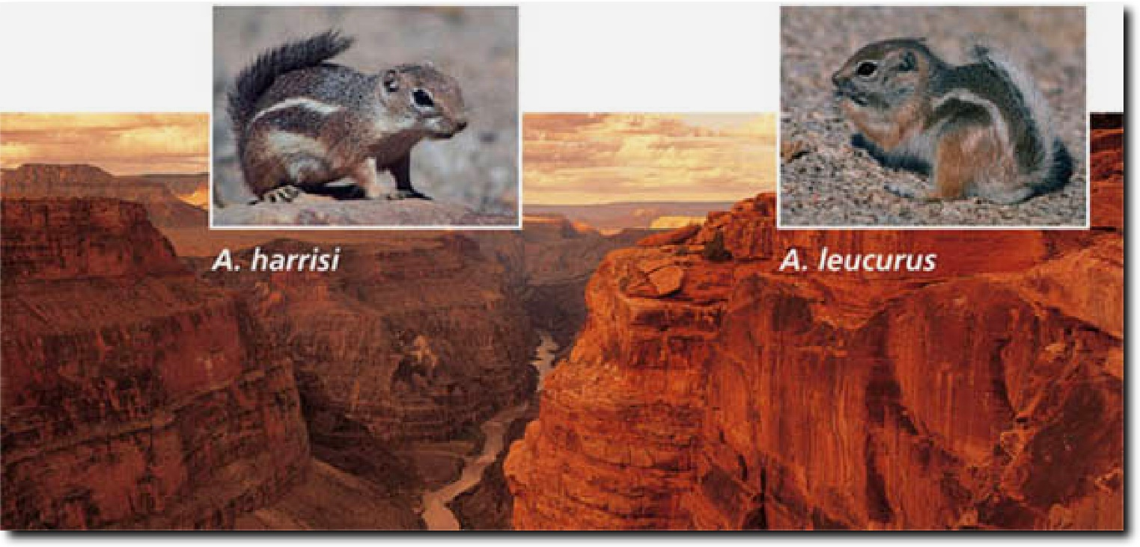
Geographic isolation
Ammospermophilus spp
Species occur in different areas
  physical barrier
  allopatric speciation
Harris’s antelope squirrel inhabits the canyon’s south rim (L). Just a few miles away on the north rim (R) lives the closely related white-tailed antelope squirrel

Slide 18
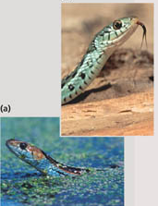
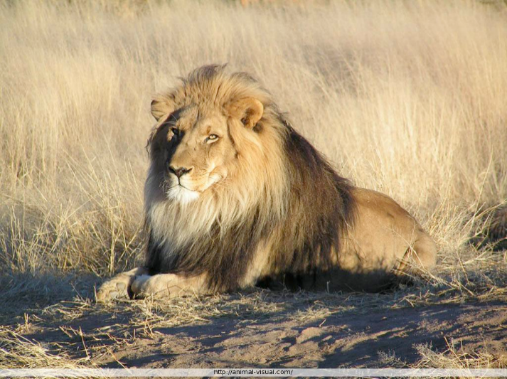
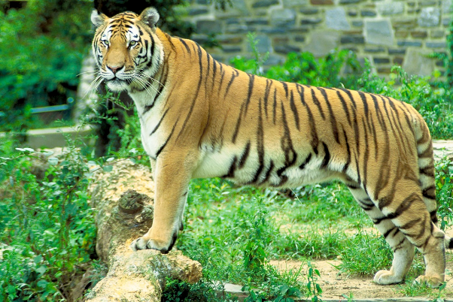
Ecological isolation
sympatric speciation
Species occur in same region, but occupy different habitats so rarely encounter each other
  reproductively isolated
2 species of garter snake, Thamnophis, occur in same area, but one lives in water & other is terrestrial
lions & tigers could hybridize, but they live in different habitats:
lions in grasslands
tigers in rainforest

Slide 19
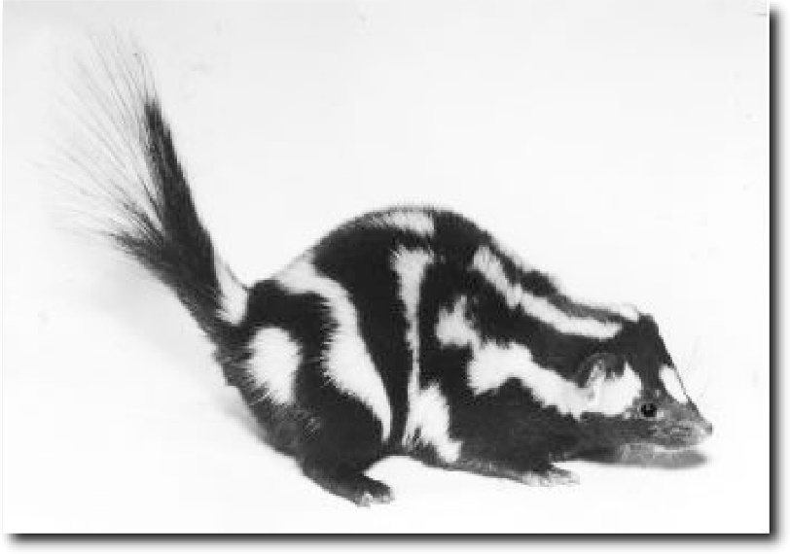
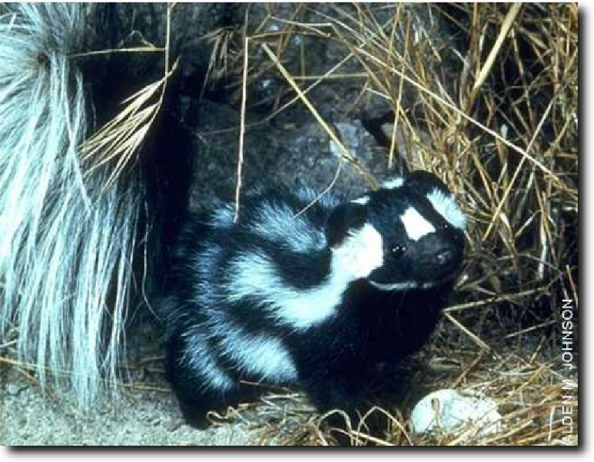
Temporal isolation
Species that breed during different times of day, different seasons, or different years cannot mix gametes
  reproductive isolation
  sympatric speciation
Eastern spotted skunk (L) & western spotted skunk (R) overlap in range but eastern mates in late winter & western mates in late summer

Slide 20
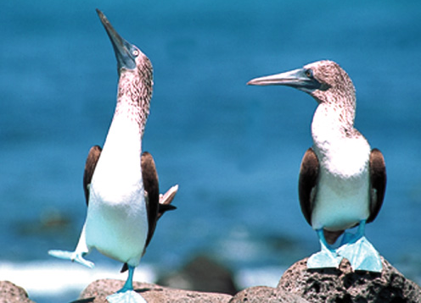
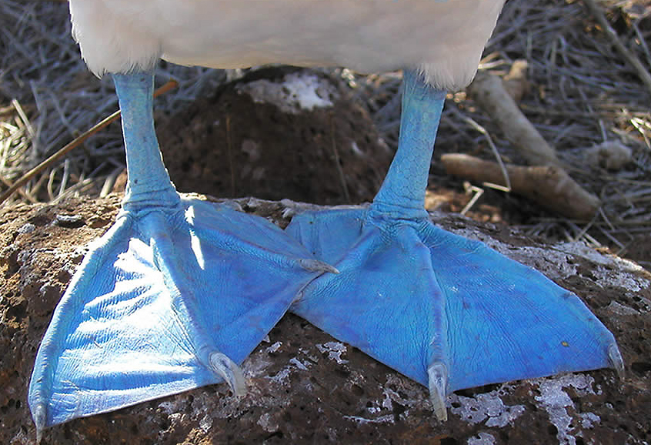
Behavioral isolation
sympatric speciation?
Unique behavioral patterns & rituals isolate species
  identifies members of species
  attract mates of same species 
    courtship rituals, mating calls
    reproductive isolation
Blue footed boobies mate only after a courtship display unique to their species
Notes:
The most comedic species of the Galapagos Islands is the Blue Footed Booby, what a ridiculous outfit and expression! Their name is in fact taken from the Spanish 'bobo' which means clown.
The Blue Footed Boobies above display part of their humorous courtship ritual whereby they raise their feet one at a time and then swivel their heads away from the prospective mate looking to the sky.
Other interesting Booby features are the highly evolved airbag systems in their skulls which allow them to dive bomb into the sea for fish from great height, and the egg and hatchling nesting boundaries they make which are rings of Boobie poop. They aren't the only Booby on the island — there are also Masked and Red Footed Boobies about.

Slide 21
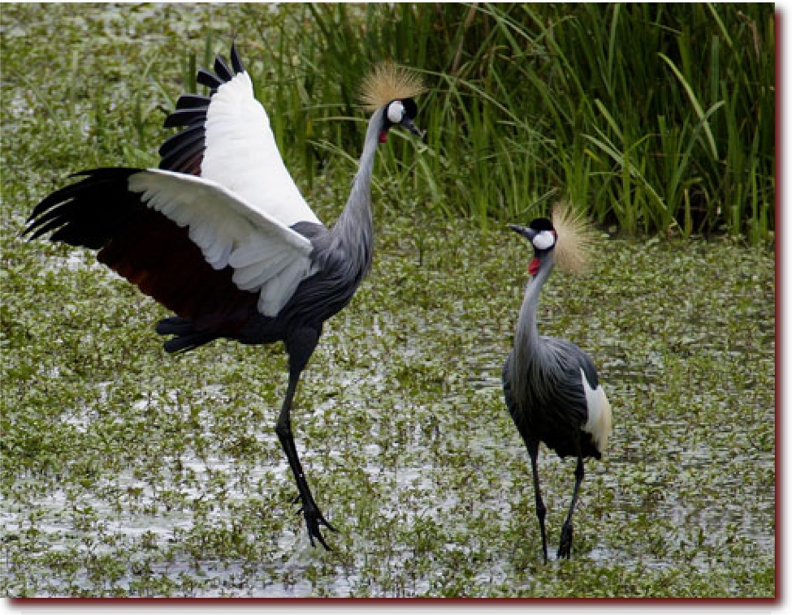

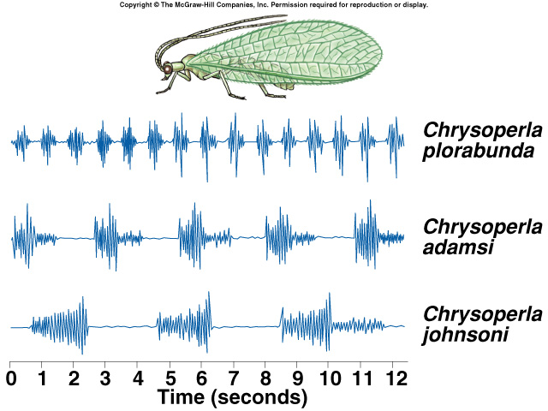
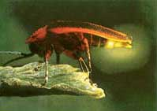
Recognizing your own species
courtship songs of sympatric
species of lacewings
courtship display of
Gray-Crowned Cranes, Kenya
firefly courtship displays

Slide 22
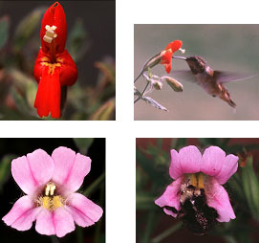
Mechanical isolation
sympatric speciation?
Morphological differences can prevent successful mating
  reproductive isolation
Plants
Even in closely related species of plants, the flowers often have distinct appearances that attract different pollinators.
These 2 species of monkey flower differ greatly in shape & color, therefore cross-pollination does not happen.
Notes:
The most comedic species of the Galapagos Islands is the Blue Footed Booby, what a ridiculous outfit and expression! Their name is in fact taken from the Spanish 'bobo' which means clown.
The Blue Footed Boobies above display part of their humorous courtship ritual whereby they raise their feet one at a time and then swivel their heads away from the prospective mate looking to the sky.
Other interesting Booby features are the highly evolved airbag systems in their skulls which allow them to dive bomb into the sea for fish from great height, and the egg and hatchling nesting boundaries they make which are rings of Boobie poop. They aren't the only Booby on the island — there are also Masked and Red Footed Boobies about.

Slide 23
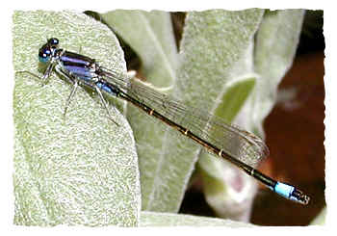

Mechanical isolation
Animals
For many insects, male &
female sex organs of
closely related species do
not fit together, preventing
sperm transfer
  lack of “fit” between sexual organs:
  hard to imagine for us… but a big issue for insects with different shaped genitals!
I can’t even imagine!
Damsel fly penises
Notes:
The selection is intense because it directly affects offspring production -- it is affecting sex itself

Slide 24
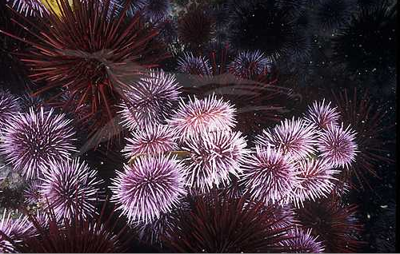
Gametic isolation
Gametic isolation
sympatric speciation?
Sperm of one species may not be able to fertilize eggs of another species
  mechanisms
    biochemical barrier so sperm cannot penetrate egg
      receptor recognition: lock & key between egg & sperm
    chemical incompatibility
      sperm cannot survive in female reproductive tract
Sea urchins release sperm & eggs into surrounding waters where they fuse & form zygotes. Gametes of different species— red & purple —are unable to fuse.

Slide 25
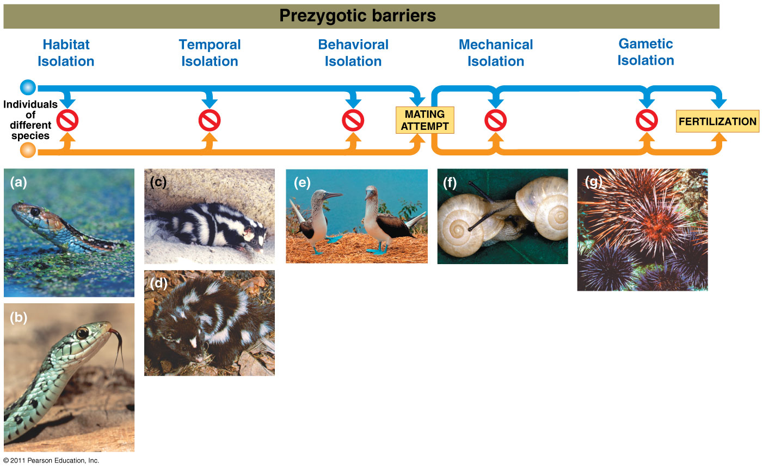
Types of Reproductive Barriers
REDUCED HYBRID
VIABILITY
REDUCED HYBRID
FERTILITY
HYBRID BREAKDOWN

Slide 26
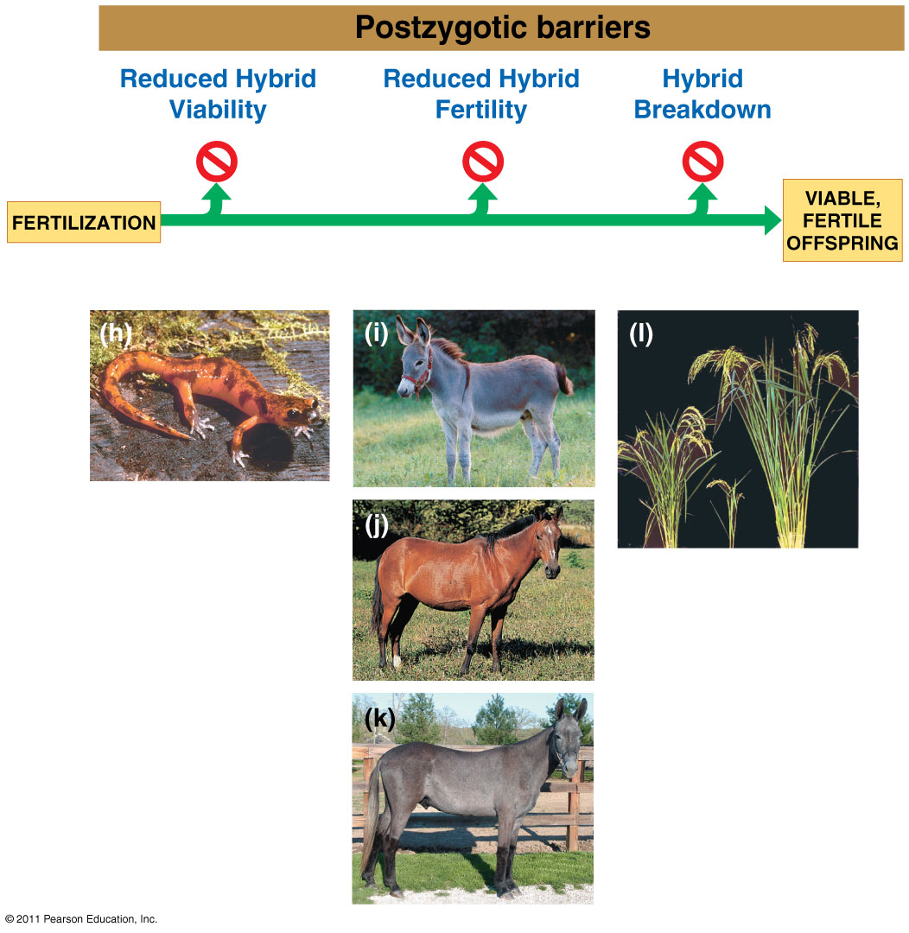
Types of Reproductive Barriers
REDUCED HYBRID
VIABILITY
REDUCED HYBRID
FERTILITY
HYBRID BREAKDOWN

Slide 27
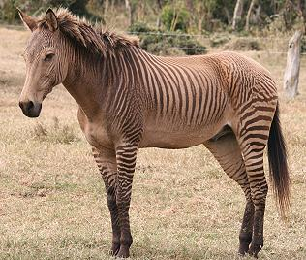
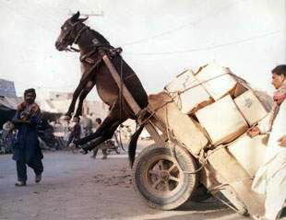
POST-reproduction barriers
Prevent hybrid offspring from developing into a viable, fertile adult
  reduced hybrid viability
  reduced hybrid fertility
  hybrid breakdown
zebroid

Slide 28
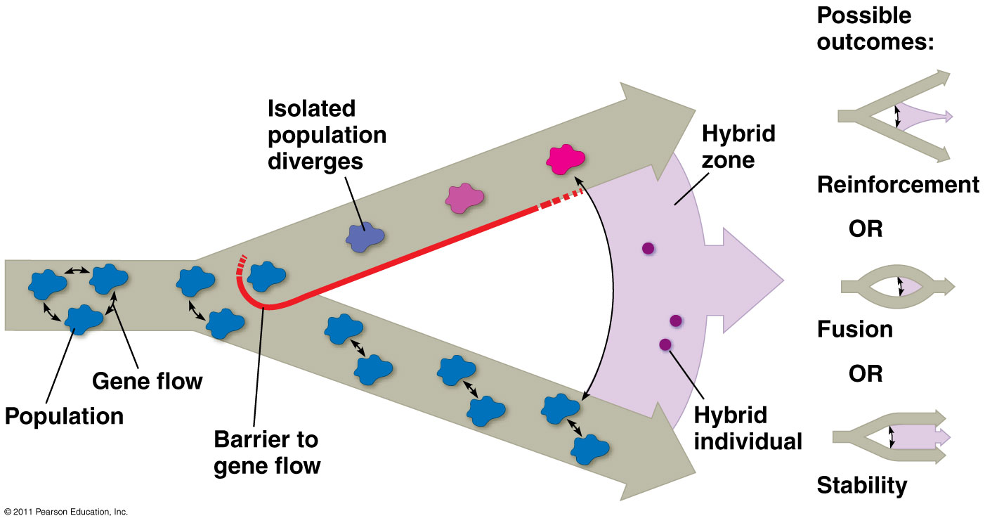
Hybrid Zones
Incomplete reproductive barriers
Possible outcomes: reinforcement, fusion, stability

Slide 29
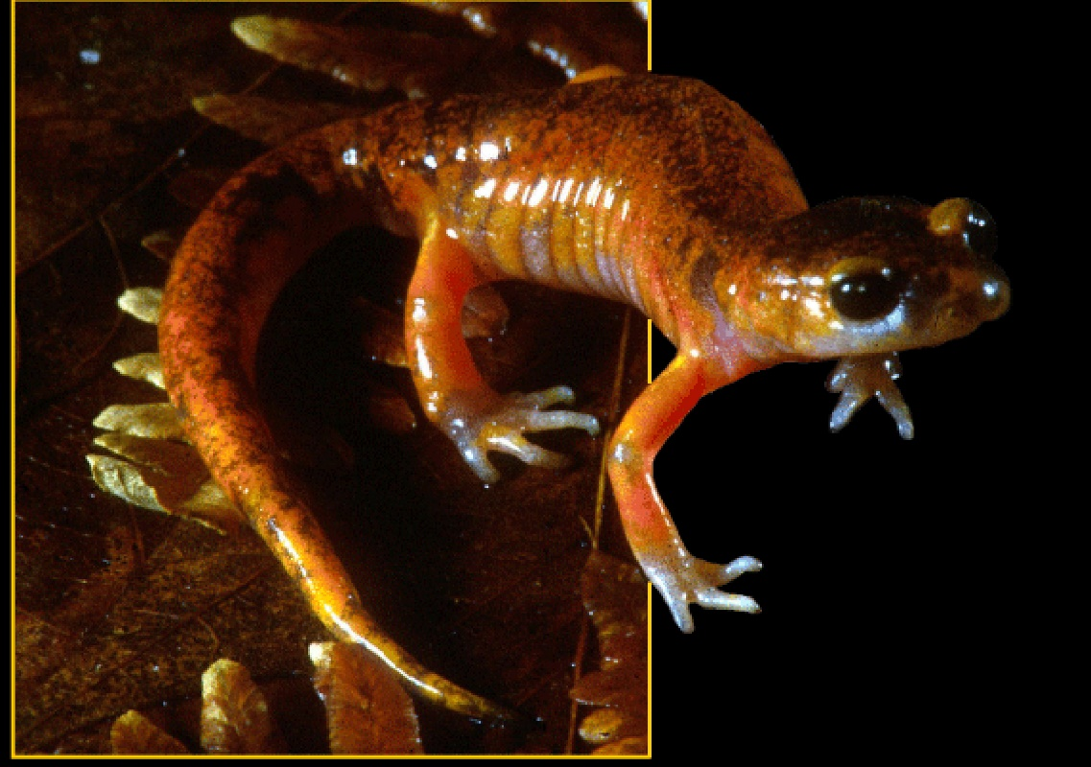
Reduced hybrid viability
sympatric speciation?
Genes of different parent species may interact & impair the hybrid’s development
Species of salamander genus, Ensatina, may interbreed, but most hybrids do not complete development & those that do are frail.

Slide 30
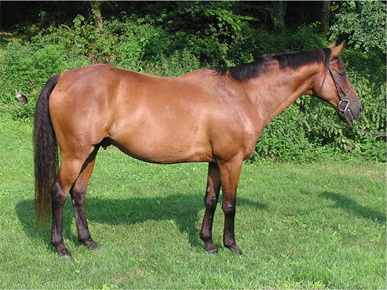
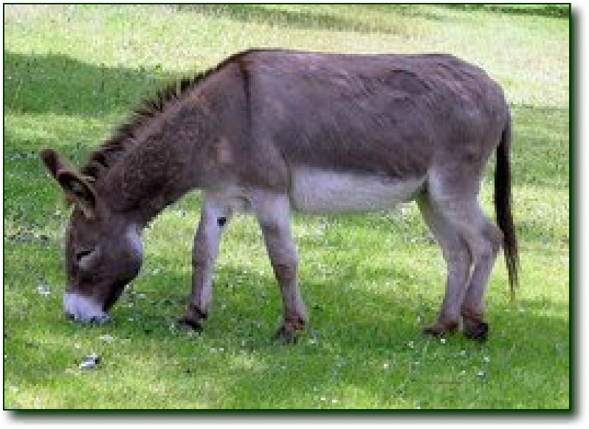
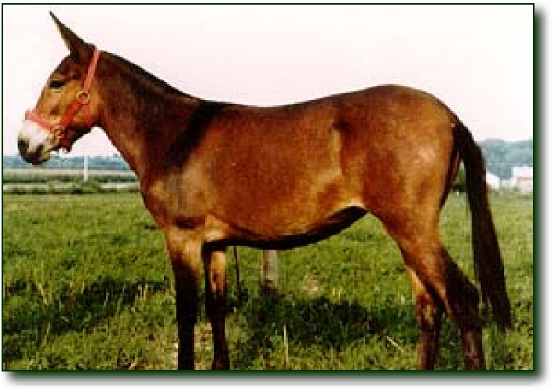
Reduced hybrid fertility
Even if hybrids are vigorous
they may be sterile
  chromosomes of parents may differ in number or structure & meiosis in hybrids may fail to produce normal gametes
Mules are vigorous, but sterile
Horses have 64 chromosomes
(32 pairs)
Donkeys have 62 chromosomes
(31 pairs)
Mules have 63 chromosomes!
Notes:
What’s wrong with having 63 chromosomes?
Odd number! Cannot pair up in meiosis.

Slide 31
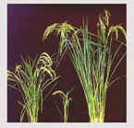
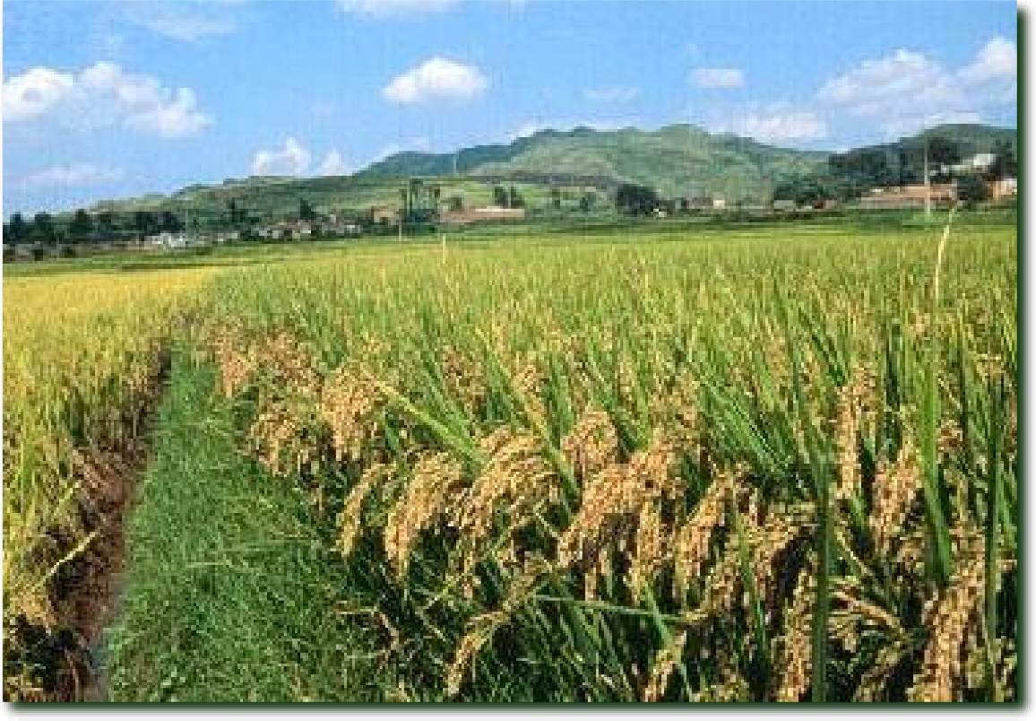
Hybrid breakdown
sympatric speciation?
Hybrids may be fertile & viable in first generation, but when they mate offspring are feeble or sterile
In strains of cultivated rice, hybrids are vigorous but plants in next generation are small & sterile.
On path to separate species.

Slide 32
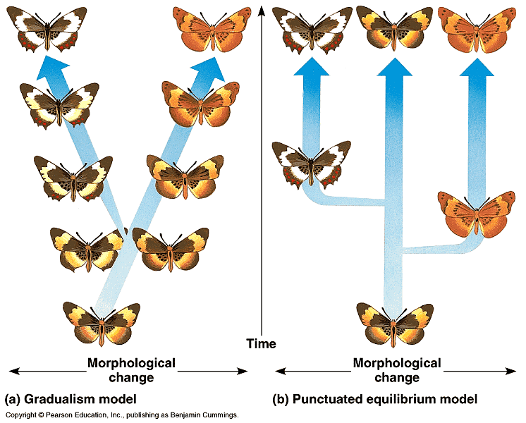
Rate of Speciation
Does speciation happen gradually or rapidly?
Gradualism
Punctuated Equilibrium
gradual accumulation of small changes over long time
  rapid bursts of change mixed with long periods of little or no change
Charles Darwin
Charles Lyell
Stephen Jay Gould
Niles Eldredge

Slide 33
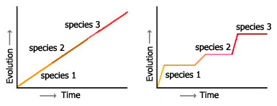
Tempo of Evolution
Gradualism
Common ancestor
Slow, constant change
Punctuated Equilibrium
Eldridge & Gould
Long period of stasis punctuated by short bursts of significant change

Slide 34
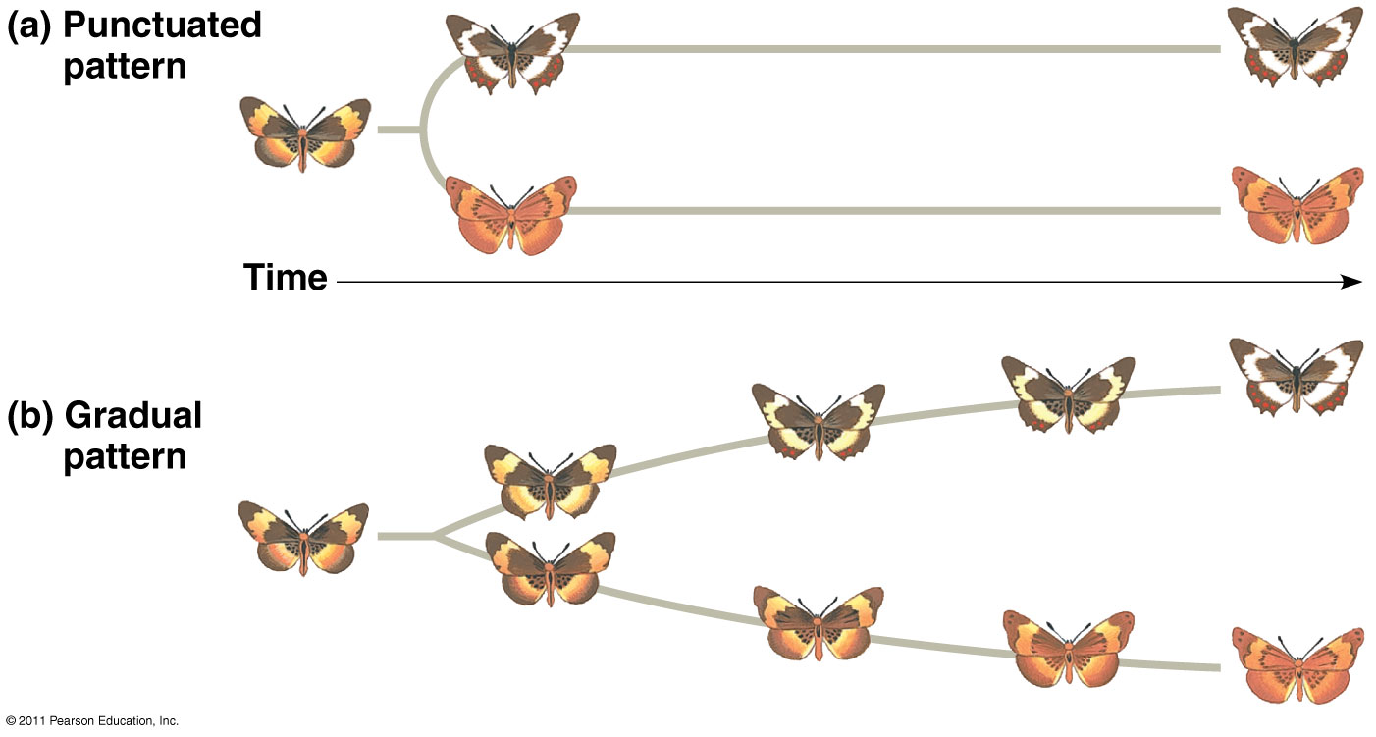
Tempo of Evolution

Slide 35
HHMI Short Film:
Lizards in an Evolutionary Tree
Topic: Adaptive Radiation
Running Time: 17:50 min
We will pause at 4 points during the film to hold Round Robin Discussion Sessions.
After the film, you will complete a an assignment. You may consult your discussion group or re-watch the film.
Notes:
http://www.hhmi.org/biointeractive/origin-species-lizards-evolutionary-tree

