Slide 1
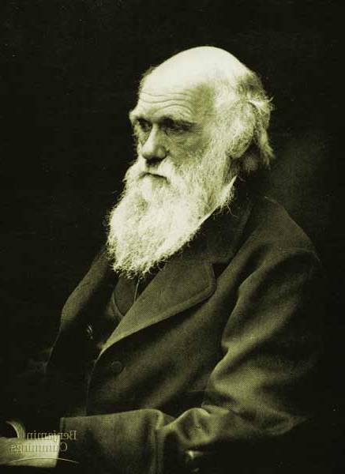
Chapter 22
Descent with Modification:
A Darwinian View of Life
Part A: Darwin &
Natural Selection

Slide 2
Descent with Modification
Theme:
Evolutionary change is based on the interactions between populations & their environment which results in adaptations (inherited characteristics) to increase fitness
Evolution = change over time in the genetic composition of a population

Slide 3
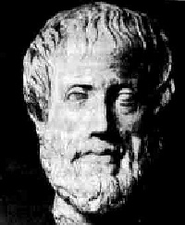
Historical Process of Science
Aristotle: life-forms arranged on scale
on increasing complexity (scala naturae)
Old Testament - Creationism: Earth ~6000 years old; perfect species individually designed by God
Natural theology: discovering Creator’s plan by studying nature; to classify nature
384-322 B.C.

Slide 4
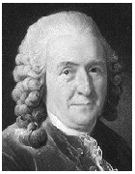
Linnaeus: founder of taxonomy; binomial nomenclature
Domain* – Kingdom – Phylum – Class – Order – Family - Genus – Species
(Dear King Philip Came Over For Good Spaghetti)
Domains =
Eubacteria, Archaea, Eukarya
Classification based on anatomy & morphology
Carolus Linnaeus 1707-1778
Notes:
Domains: not added until 1990 due to reexamination of previous Kingdoms: esp. Monera

Slide 5
Binomial Nomenclature
Binomial Nomenclature = scientific name
Genus species or Genus species
Genus name is capitalized
Species name is lower case
Whole thing in italics or underlined
Example: Human = Homo sapiens or Homo sapiens
All scientific names written in Latin; universal language that is unchanging

Slide 6
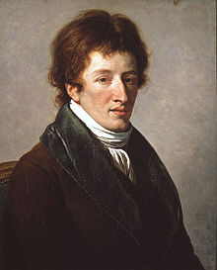
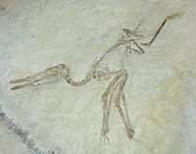
Cuvier:
Paleontologist – studied fossils
Deeper strata (layers) - very different fossils from current life
Opposed idea of evolution
Catastrophism – catastrophe destroyed many living species, then repopulated by immigrant species
George Cuvier
(1769-1832)

Slide 7
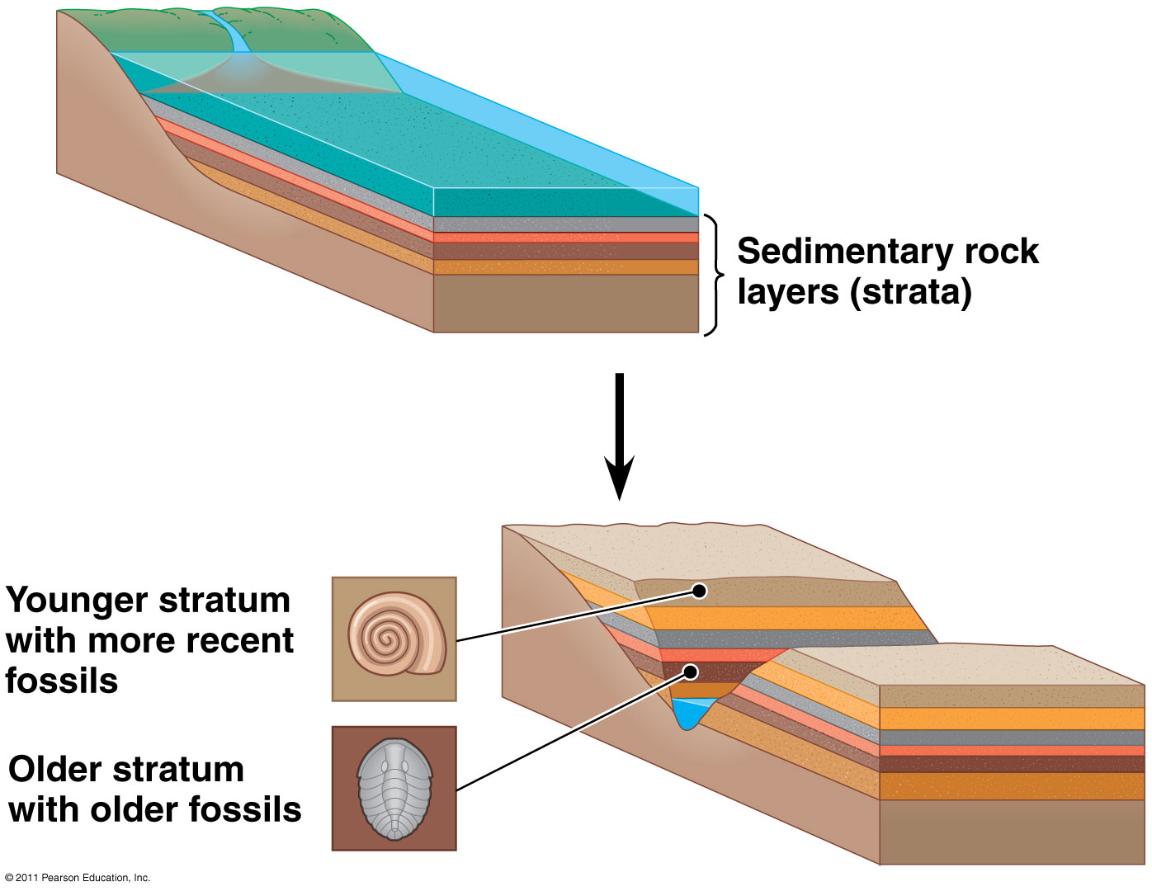
Formation of sedimentary strata with fossils

Slide 8
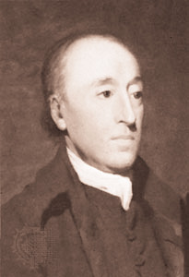
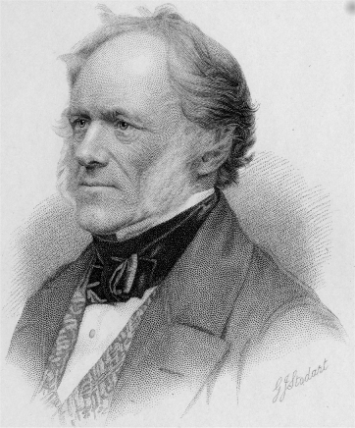
Hutton / Lyell:
Gradualism = geologic change results from slow & gradual, continuous process
Uniformitarianism = Earth’s processes same rate in past & present → therefore Earth is very old
Slow & subtle changes in organisms → big change
James Hutton 1726-1797
Charles Lyell 1797-1875

Slide 9
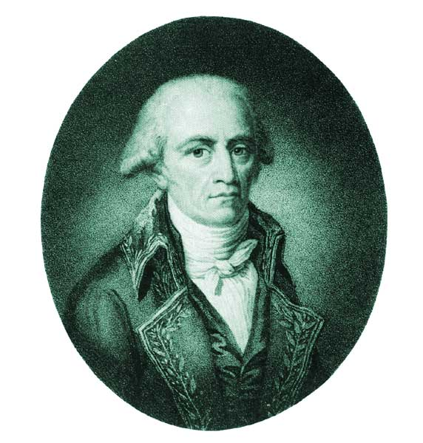
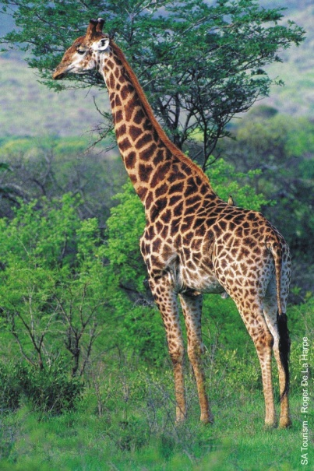
Jean-Baptiste Lamarck 1744-1829
Lamarck:
Published theory of evolution (1809)
Use and Disuse: parts of body used → bigger, stronger (Ex: giraffe’s neck)
Inheritance of Acquired Characteristics: modifications can be passed on
Importance: Recognized that species evolve, although explanation was flawed

Slide 10
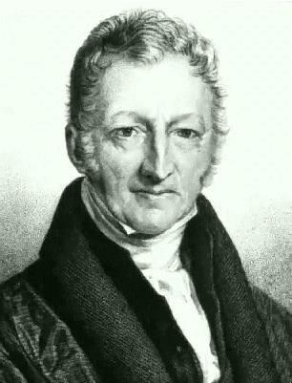
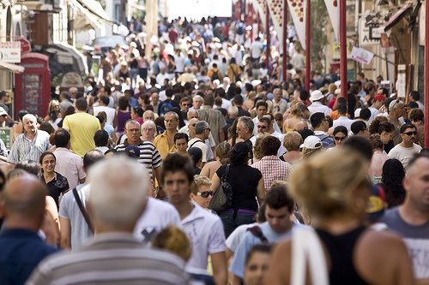
Malthus:
More babies born than deaths
Consequences of overproducing within environment = war, famine, disease (limits of human pop.)
Struggle for existence
Thomas Malthus
(1766-1834)

Slide 11
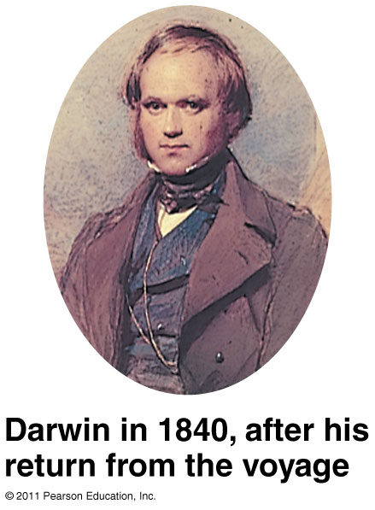
Charles Darwin (1809-1882)
English naturalist
1831: joined the HMS Beagle for a 5-year research voyage around the world
Collected and studied plant and animal specimens, bones, fossils
Notable stop: Galapagos Islands

Slide 12
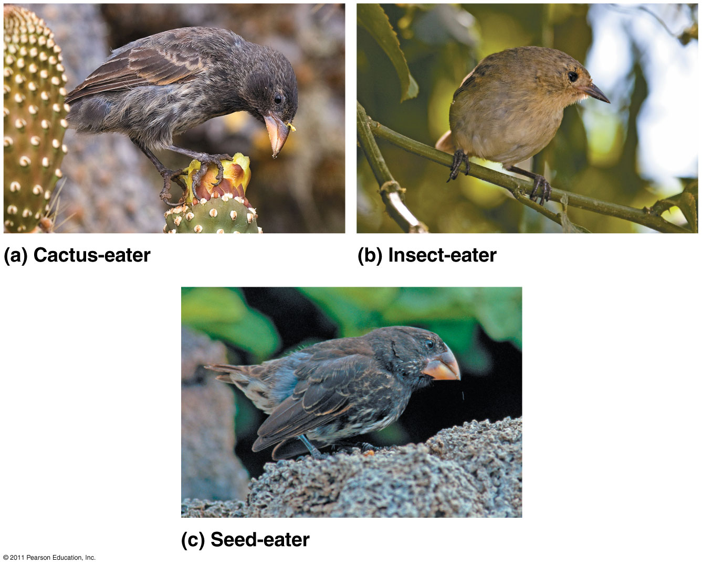
Darwin’s Finch Collection
The birds were all about the same size, but the shape and size of the beaks of each species were different.

Slide 13
“Evolutionary” Literature Timeline
Darwin waited 30 years before he published his ideas on evolution
Alfred Russell Wallace – published paper on natural selection first (1858)
Charles Darwin (1859): On the Origin of Species by Means of Natural Selection
Mechanism for evolution is Natural Selection
Darwin didn’t use “evolution”, but rather “descent with modification”

Slide 14
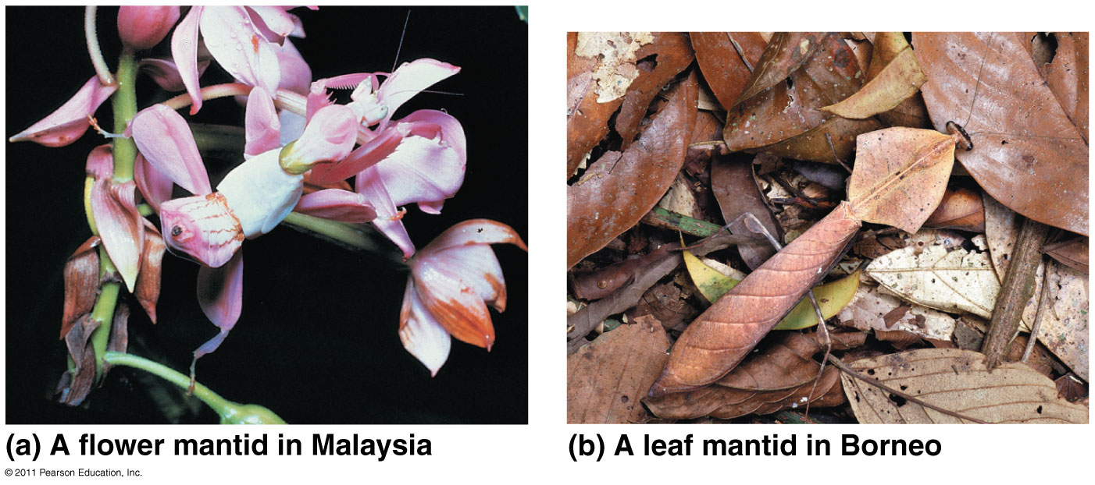
Adaptations: enhance an organism’s ability to survive and reproduce
Ex: Desert fox - large ears, arctic fox - small ears
Overproduction of offspring leads to competition for resources

Slide 15
Therefore, if humans can create substantial change over short time, nature can over long time.
Natural Selection | Artificial Selection
Nature decides | “Man” decides
Works on individual | Selective breeding
 | Inbreeding occurs
Ex: beaks | Ex: Dalmatians

Slide 16
Key Ideas of Natural Selection:
FITNESS: the ability to survive and reproduce!
ADAPTATIONS: favorable traits that increase fitness!
Competition for limited resources results in differential survival
Evolutionary Fitness: Individuals with more favorable phenotypes more likely to survive and produce more offspring, and pass traits to future generations
If environment changes or individuals move to new environment, new adaptations & new species may arise.
Populations evolve, not individuals.

Slide 17
HHMI Short Film: The Origin of Species:
Making of a Theory
Running Time: 30:51
The epic voyages of Darwin and Wallace led each to independently discover the natural origin of species and to formulate the theory of evolution by natural selection.

Slide 18
Discuss and Write
How was Lamarck’s view of the mechanism of evolution different from Darwin’s?
How was Darwin’s theory influenced by other scientists?

Slide 19
POGIL
Groups of ~4
Select or Assign each member a role:
READER → reads entire POGIL (directions, labels, questions, etc) aloud to the group. The group follows along. (sometimes gets bonus points added!)
MANAGER → Keeps the group on track. Only person that can ask Mrs. Mathis a question (on behalf of the group) (sometimes gets bonus points added!)
RECORDER → Job varies, but will write class results (when necessary); writes all members names and roles on the sticky note
REPORTER → Job varies, but will orally report answers to entire class when necessary
I will randomly collect 1 paper from each group to grade. Everyone in the group will receive the same grade…so work together!

Slide 20
1st block POGIL Groups
2nd Row in front of SSS | 4th Row in front of SSS | Front Row in front of TV | 3rd Row in front of TV | 4th Row in front of TV
Alzahara Yelena Molly Valeria | Katie W. Rose Mariana Sam | Wayne Maggie Rachel Sallie | Kate B. Daniel Janie Joshua | Darby Ellie Manpreet Liza Z.
Lab Table 1 | Lab Table 2 | Lab Table 5 | Lab Table 6
Addi Emma Joelle Olwyn | Ben Maya Morgan Madison | Jampel Matthew Grayson | Carly Dalton Jackson
If someone is ABSENT, do not include their on the sticky note.
For Groups of 3: one person should be both Recorder and Reporter

Slide 21
4th block POGIL Groups
Lab Table 1 | Lab Table 2 | Lab Table 5 | Lab Table 6 | Center Left | Center Right
Darien Aiden Caroline Akshra | David Halle Jackson | Joel Nick Cameron | Charlotte Kent Stuart Beth | Matthew Sophia Kate M. Collin | Bella Brooke Ashlyn Ian
For Groups of 3: one person should be both Recorder and Reporter
If someone is ABSENT, do not include their on the sticky note.

Slide 22
POGIL Roles
READER → reads entire POGIL (directions, labels, questions, etc) aloud to the group. The group follows along. (sometimes gets bonus points added!)
MANAGER → Keeps the group on track. Only person that can ask Mrs. Mathis a question (on behalf of the group) (sometimes gets bonus points added!)
RECORDER → Job varies, but will write class results (when necessary); writes all members names and roles on the sticky note
REPORTER → Job varies, but will orally report answers to entire class when necessary
I will randomly collect 1 paper from each group to grade. Everyone in the group will receive the same grade…so work together!
For Groups of 3: one person should be both Recorder and Reporter

Slide 23
Back to POGIL
Return to your assigned groups.
Complete ONLY Model 1.
Stop and return to your seats when your group finishes through #8

Slide 24
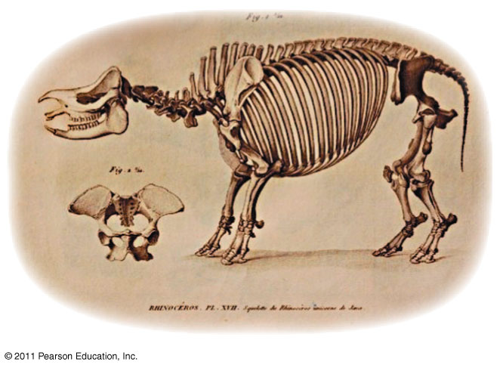
Chapter 22
Descent with Modification:
A Darwinian View of Life
Part B: Evidence for Evolution

Slide 25
What you must know:
Several examples of evidence for evolution.
The difference between structures that are homologous and those that are analogous, and how this relates to evolution.

Slide 26
Recap main ideas of natural selection:
Evolution is change in species over time.
There is overproduction of offspring, which leads to competition for resources.
Heritable variations exist within a population.
These variations can result in differential reproductive success.
Over generations, this can result in changes in the genetic composition of the population.
Remember:
Individuals do NOT evolve! Populations evolve.

Slide 27
Evidence for Evolution:
Direct Observations
Fossil Record
Homology
Biogeography

Slide 28
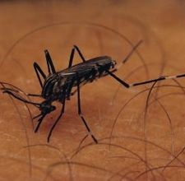
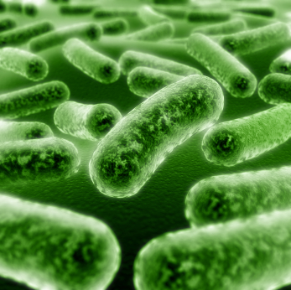
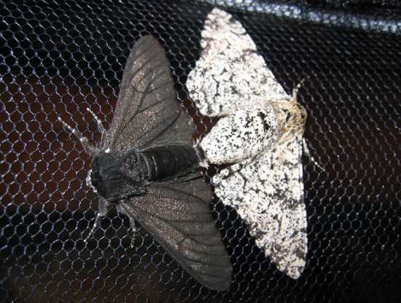
Evidence for Evolution: 1) Direct Observations
Examples:
Insect populations become resistant to pesticides (DDT)
Antibiotic-resistant bacteria (MRSA)
Peppered moth (pollution in city vs. country)

Slide 29
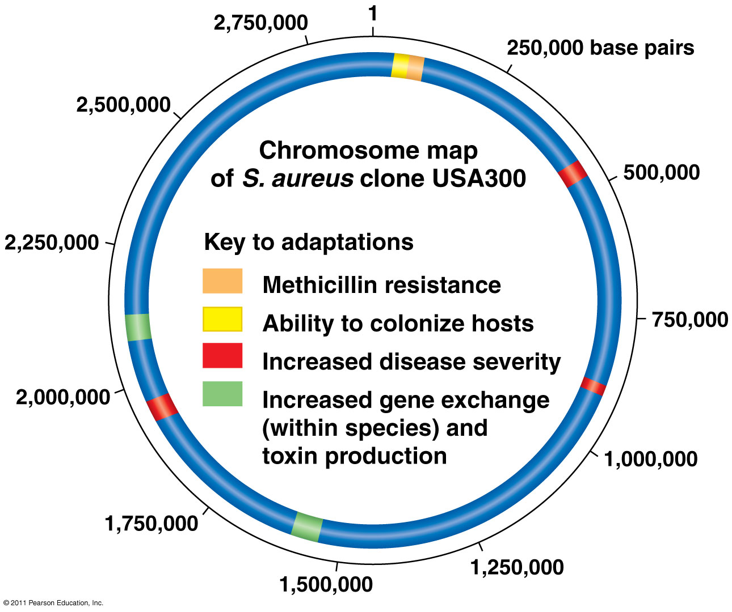
The Rise of MRSA (methicillin-resistant Staphylococcus aureus)

Slide 30
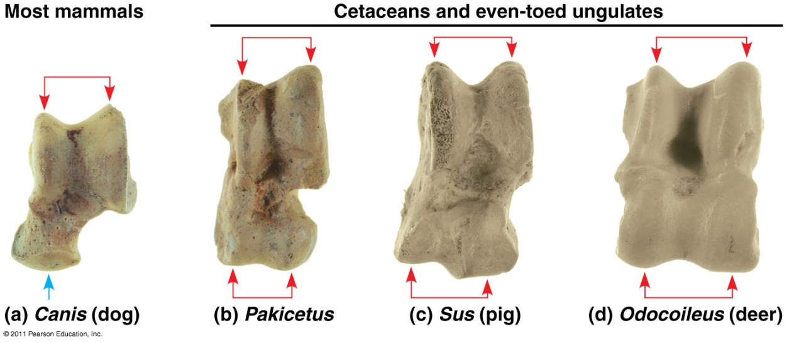
Evidence for Evolution: 2) Fossil Record
Fossils = remains or traces of organisms from past
Found in sedimentary rock
Paleontology: study of fossils
Show evolutionary changes that occur over time and origin of major new groups of organisms
Ankle bones

Slide 31
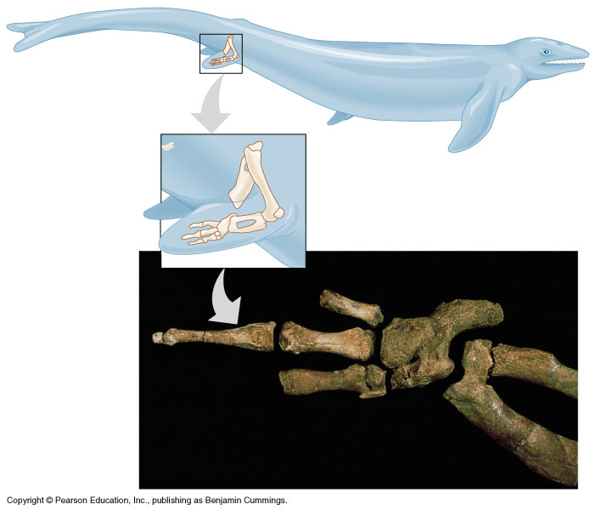
Evidence for Evolution: 2) Fossil Record (cont.)
Prokaryotes (oldest fossils)
Eukaryotes (fish →amphibians → reptiles →birds → mammals)
Transitional forms = links to modern species

Slide 32
Evidence for Evolution: 3) Homology
Homology: characteristics in related species can have underlying similarity even though functions may differ
Examples:
Homologous structures: similar anatomy from common ancestors (Ex: forelimbs of human/cat/whale/bat)
Embryonic homologies: similar early development (Ex: vertebrate embryos with tail & pharyngeal pouches)
Vestigial organs: structures w/little or no use (Ex: flightless bird wings)
Molecular homologies: similar DNA & amino acid sequences

Slide 33
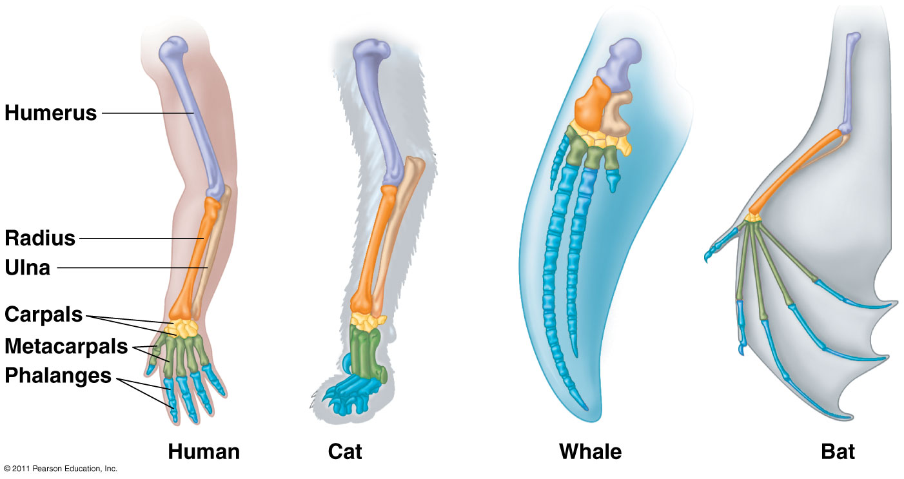
Homologous Structures

Slide 34
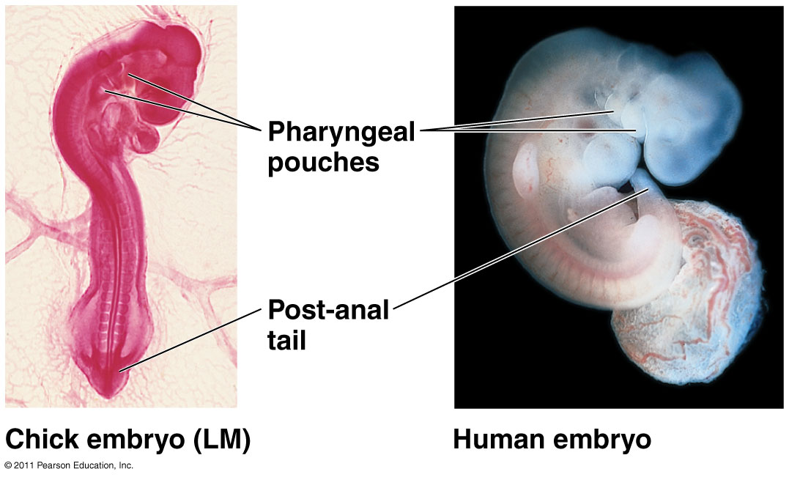
Embryonic Development

Slide 35
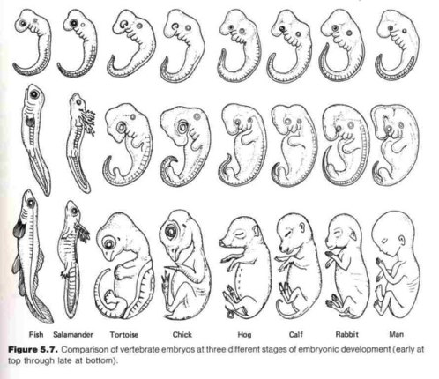
Comparative Embryology

Slide 36
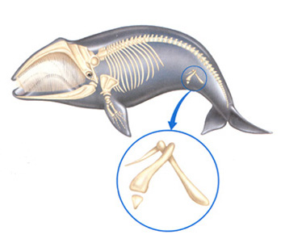
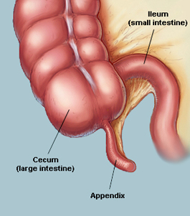
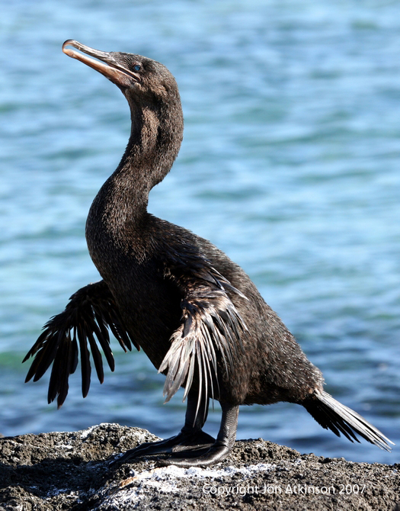
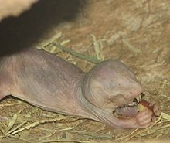
Vestigial Structures

Slide 37
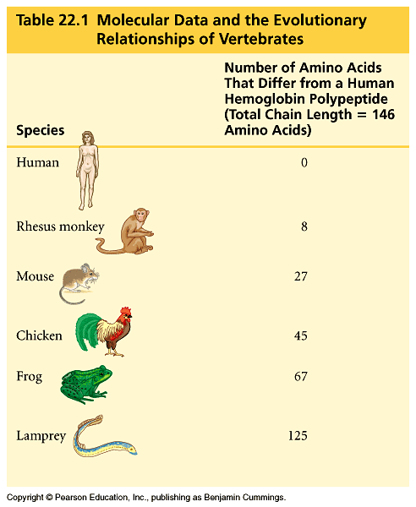
Molecular Homologies
Compare DNA and amino acid sequences
Fewer differences = more recent common ancestor;
Greater # differences = less related

Slide 38
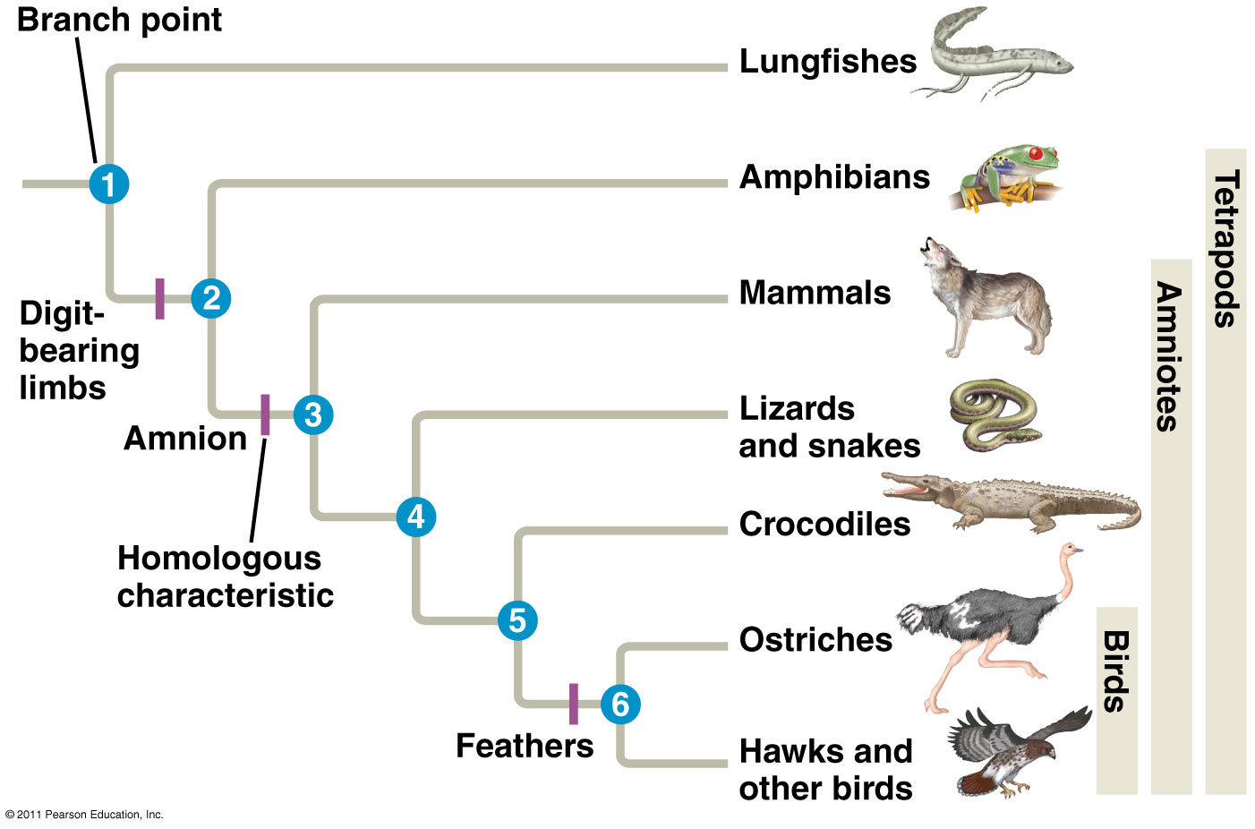
Evolutionary Tree
Are crocodiles more closely related to lizards or birds? Explain your reasoning.
A way to represent the pattern of descent from common ancestors
Represent common ancestors
All organisms to the right of this hatch mark share this homologous characteristic
Notes:
Answer: crocs are more closely related to birds because they share a more recent common ancestor (5) as opposed to (4) with lizards

Slide 39
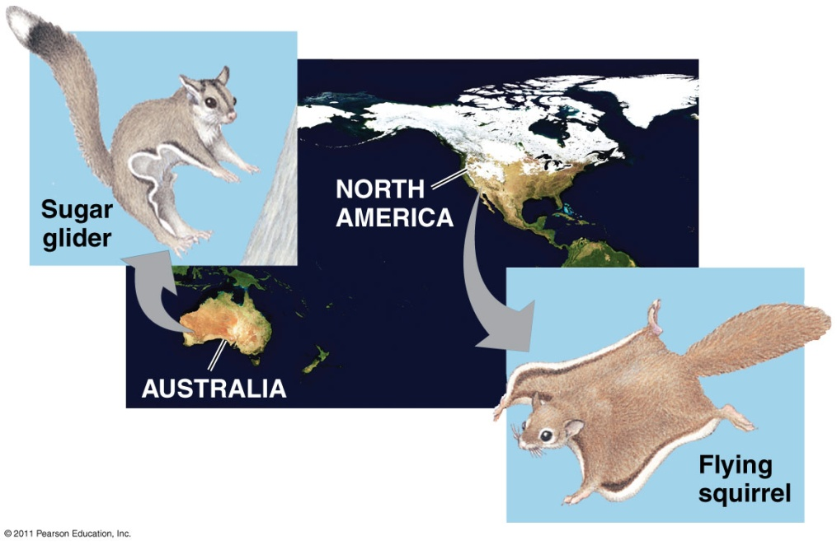
Convergent Evolution
Distantly related organisms can resemble each other through the independent evolution of similar features in similar environments
Analogous structures: similar function in similar environments but not common ancestry
Ex: Torpedo shape of shark, penguin, & dolphin

Slide 40
Evidence for Evolution: 4) Biogeography
Biogeography = geographic distribution of a species
Species in nearby geographic areas resemble each other
Continental drift and Pangaea explains similarities on different continents
Endemic species: found at a certain geographic location and nowhere else
Ex: Marine iguanas in the Galapagos

Slide 41
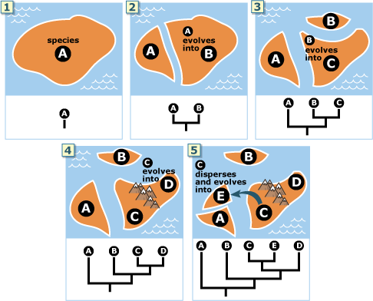
Island Biogeography

Slide 42
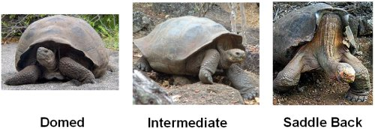
Galapagos Tortoises

Slide 43
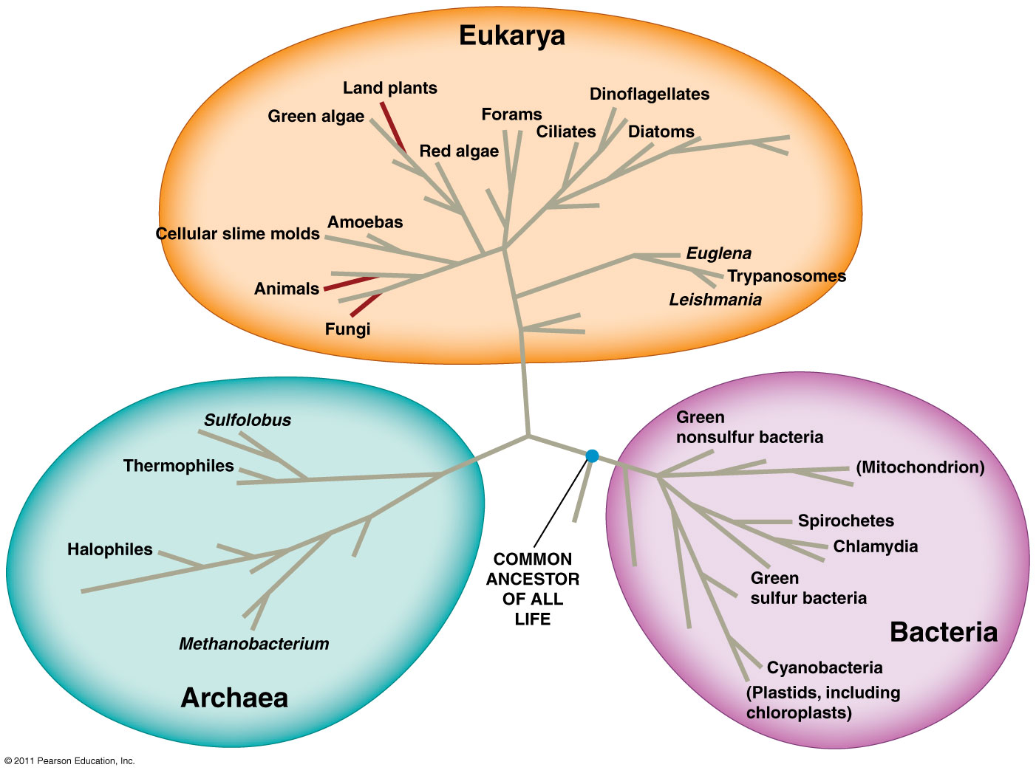
Tree of Life

Slide 44
HHMI Short Film: Natural Selection & Adaptation
Rock Pocket Mice
Running Time: 10:25 min

Slide 45
Rock Pocket Mice Questions
1) Why did dark-colored rock pocket mice first appear
in a population of light-colored rock pocket mice?
2) Why do dark-colored rock pocket mice on
dark lava flows have white bellies?
3) Mutations are always …
Notes:
A
A

Slide 46
ClEvR
Read the background and complete BOTH sides of the worksheet.
Refer to the additional data ½ sheet
You may work in small groups, but you must do your own work.
Turn this in when you finish.
Get back in to your POGIL groups and complete Module 2 & 3.

Slide 47
POGIL
Place a sticky note (with FIRST & LAST NAMES and ROLES) on the paper that will be turned in for your group grade.
The person who will turn their paper in today is the MANAGER
When your group is done, pick up a Ch. 22 Reading sheet on front table and see me for your textbook!

Slide 48
Ch. 22 Questions
Pick up a Ch. 22 Questions sheet and a textbook from back cabinet to work on.

