Slide 1
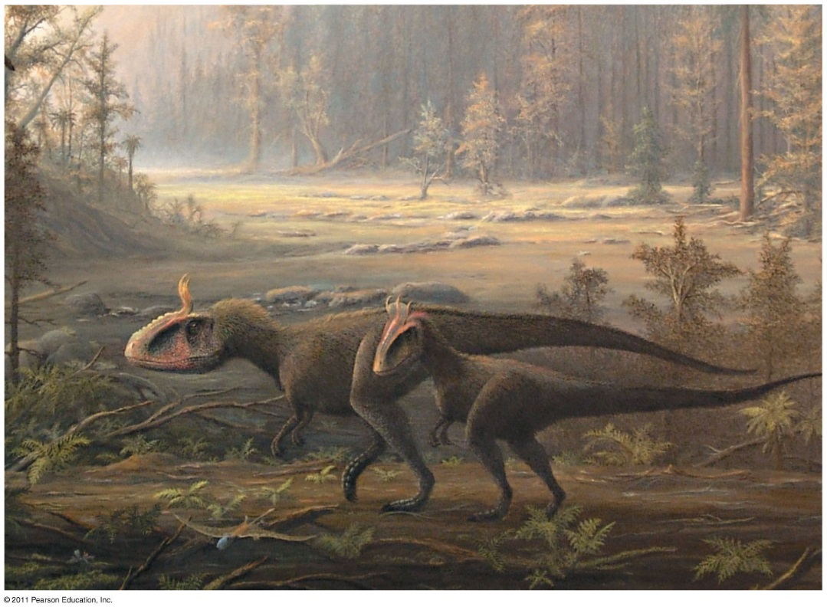
Chapter 25
The History of Life on Earth
BIG BANG!
Notes:
https://www.youtube.com/watch?v=CMSYv_Z4SI8 (1:45) Big Bang Song

Slide 2
What you need to know:
1) A scientific hypothesis about the origin of life on Earth.
2) The age of the Earth and when prokaryotic and eukaryotic life emerged.
3) Characteristics of the early planet and its atmosphere.
4) How Miller & Urey tested the Oparin-Haldane hypothesis and what they learned.
5) Methods used to date fossils and rocks and how fossil evidence contributes to our understanding of changes in life on Earth.
6) Evidence for endosymbiosis.
7) How continental drift can explain the current distribution of species (biogeography)
8) How extinction events open habitats that may result in adaptive radiation.

Slide 3
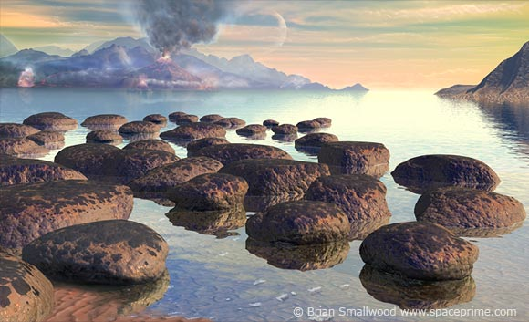
Early conditions on Earth

Slide 4
Earth = 4.6 billion years old
First life forms appeared ~3.8 billion years ago
How did life arise?
Small organic molecules were synthesized
Small molecules → macromolecules (proteins, nucleic acids)
Packaged into protocells (membrane-containing droplets)
Self-replicating molecules allow for inheritance
    “RNA World”: 1st genetic material most likely RNA
    First catalysts = ribozymes (RNA)

Slide 5
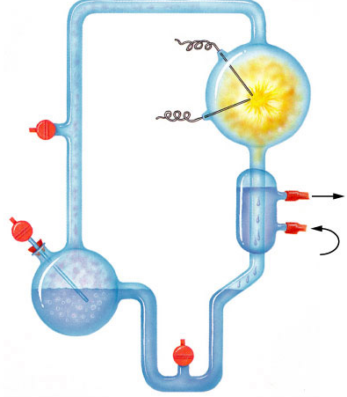
Origin of Organic Molecules
Electrodes discharge
sparks
(lightning simulation)
Abiotic synthesis
  1920
  Oparin & Haldane propose reducing atmosphere hypothesis
CH₄
Water vapor
H₂
NH₃
Mixture of gases
("primitive
atmosphere")
Condenser
Water
Condensed liquid with complex, organic
molecules
Heated water
("ocean")

Slide 6
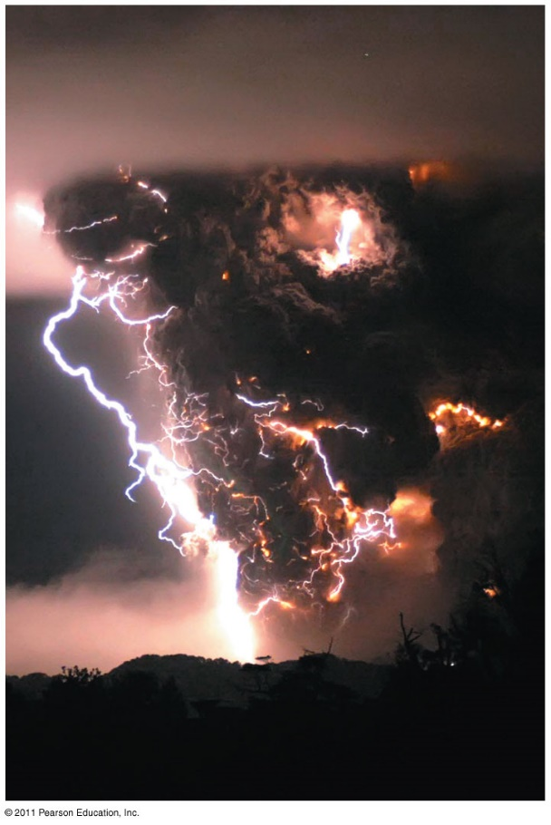
Synthesis of Organic Compounds on Early Earth
Oparin & Haldane:
  Early atmosphere = H₂O vapor, N₂, CO₂, H₂, H₂S methane, ammonia
  Energy = lightning & UV radiation
  Conditions favored synthesis of organic compounds
    - A “primitive soup”

Slide 7
Origin of Organic Molecules
Electrodes discharge
sparks
(lightning simulation)
Abiotic synthesis
  1920
  Oparin & Haldane propose reducing atmosphere hypothesis
  1953
  Miller & Urey
  test hypothesis
    formed organic compounds
      amino acids
      adenine
CH₄
Water vapor
H₂
NH₃
Mixture of gases
("primitive
atmosphere")
Condenser
Water
Condensed liquid with complex, organic
molecules
Heated water
("ocean")

Slide 8
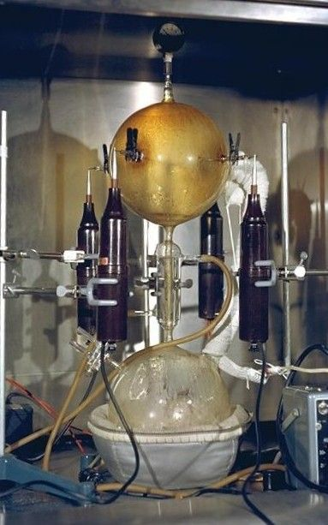
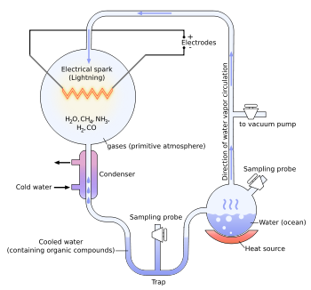
Miller & Urey:
Tested Oparin-Haldane hypothesis
Simulated conditions in lab
Produced amino acids
Creating the Potential for Life

Slide 9

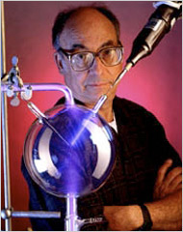
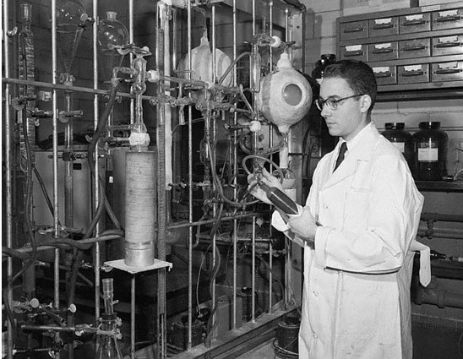
Stanley Miller
University of Chicago
produced
-amino acids
-hydrocarbons
-nitrogen bases
-other organics
Why was
this experiment
important??!
What was the Miller Urey Experiment? (7:29)

Slide 10
Key Events in Origin of Life
Origin of Cells (Protobionts)
  lipid bubbles → separate inside from outside
→ metabolism & reproduction
Origin of Genetics
  RNA is likely first genetic material
  multiple functions: encodes information (self-replicating), enzyme, regulatory molecule, transport molecule (tRNA, mRNA)
    makes inheritance possible
    makes natural selection & evolution possible
Origin of Eukaryotes
  endosymbiosis
Notes:
Life is defined partly by two properties: accurate replication and metabolism. Neither property can exist without the other. Self–replicating molecules and a metabolism–like source of the building blocks must have appeared together. How did that happen?
The necessary conditions for life may have been met by protobionts, aggregates of abiotically produced molecules surrounded by a membrane or membrane–like structure. Protobionts exhibit some of the properties associated with life, including simple reproduction and metabolism, as well as the maintenance of an internal chemical environment different from that of their surroundings.
Laboratory experiments demonstrate that protobionts could have formed spontaneously from abiotically produced organic compounds. For example, small membrane–bounded droplets called liposomes can form when lipids or other organic molecules are added to water.

Slide 11
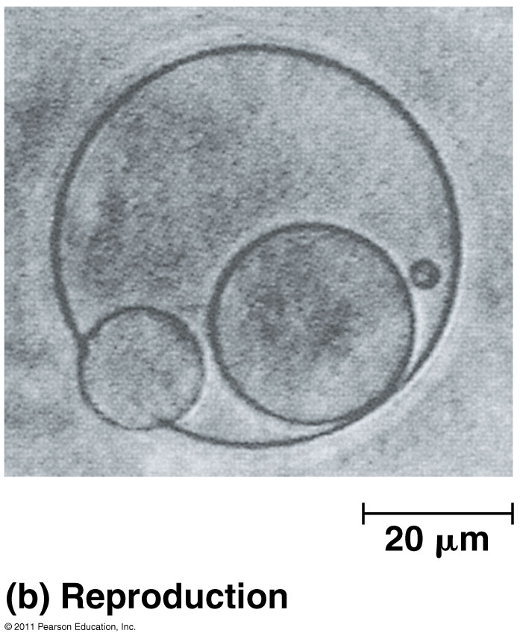
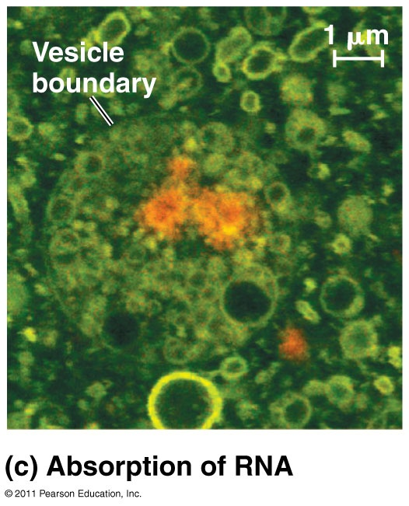
Protocells & Self-Replicating RNA

Slide 12
If life has to come from living things, how did life first start?!
https://www.youtube.com/watch?v=d4VS00it40o
Origin of Life – PBS NOVA

Slide 13
Fossil Record: used to reconstruct history
Sedimentary rock (layers called strata)
Mineralized (hard body structures)
Organic – rare in fossils but found in amber, frozen, tar pits
Incomplete record – many organisms not preserved, fossils destroyed, or not yet found

Slide 14
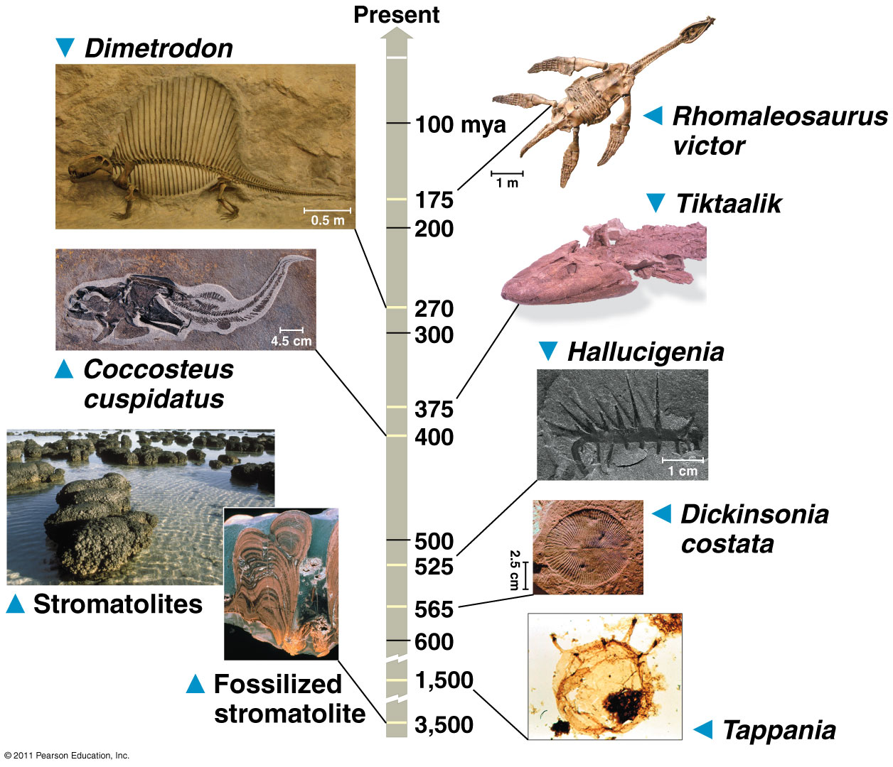
Cut to Video
Notes:
https://www.youtube.com/watch?feature=player_detailpage&v=yvDQCa7rleI (5:49)

Slide 15
Relative Dating
Radiometric Dating
Both used to date fossils and determine age
Uses order of rock strata to determine relative age of fossils
Measure decay of radioactive isotopes present in layers where fossils are found
Half-life: # of years for 50% of original sample to decay

Slide 16
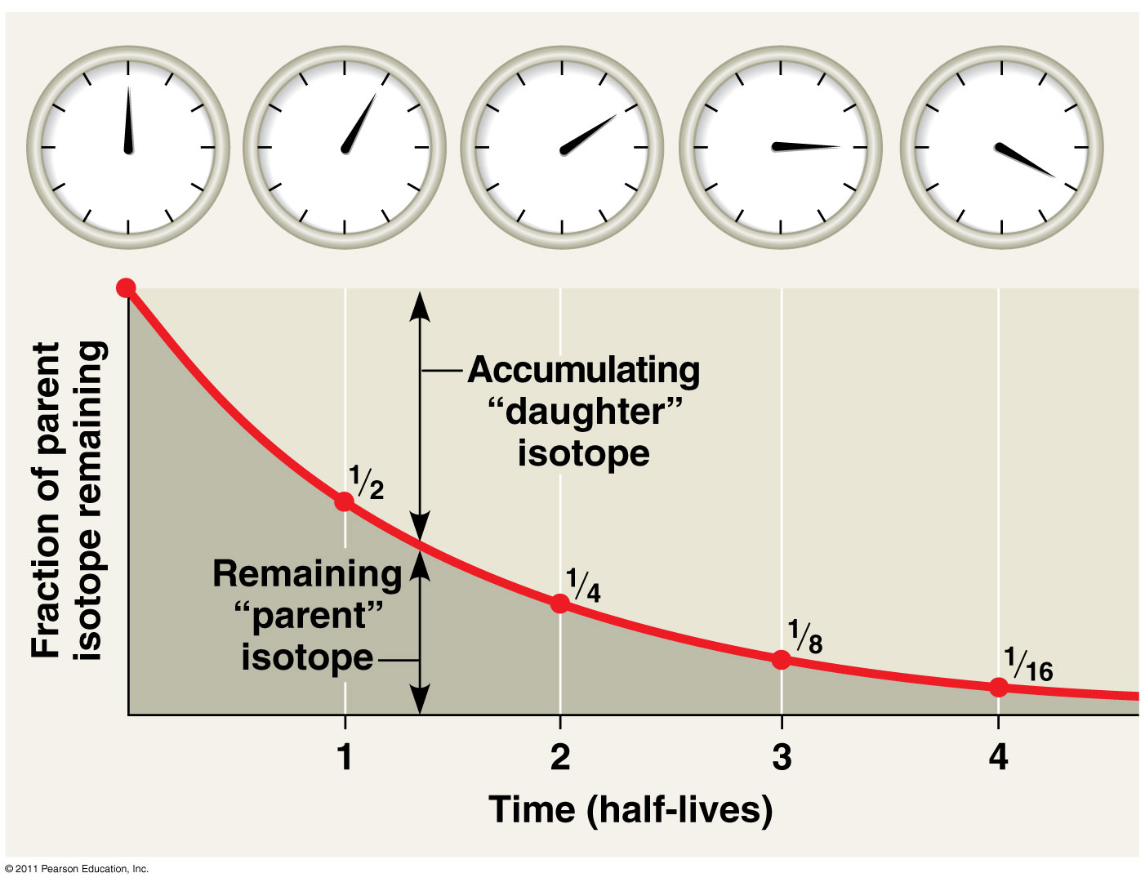

Slide 17
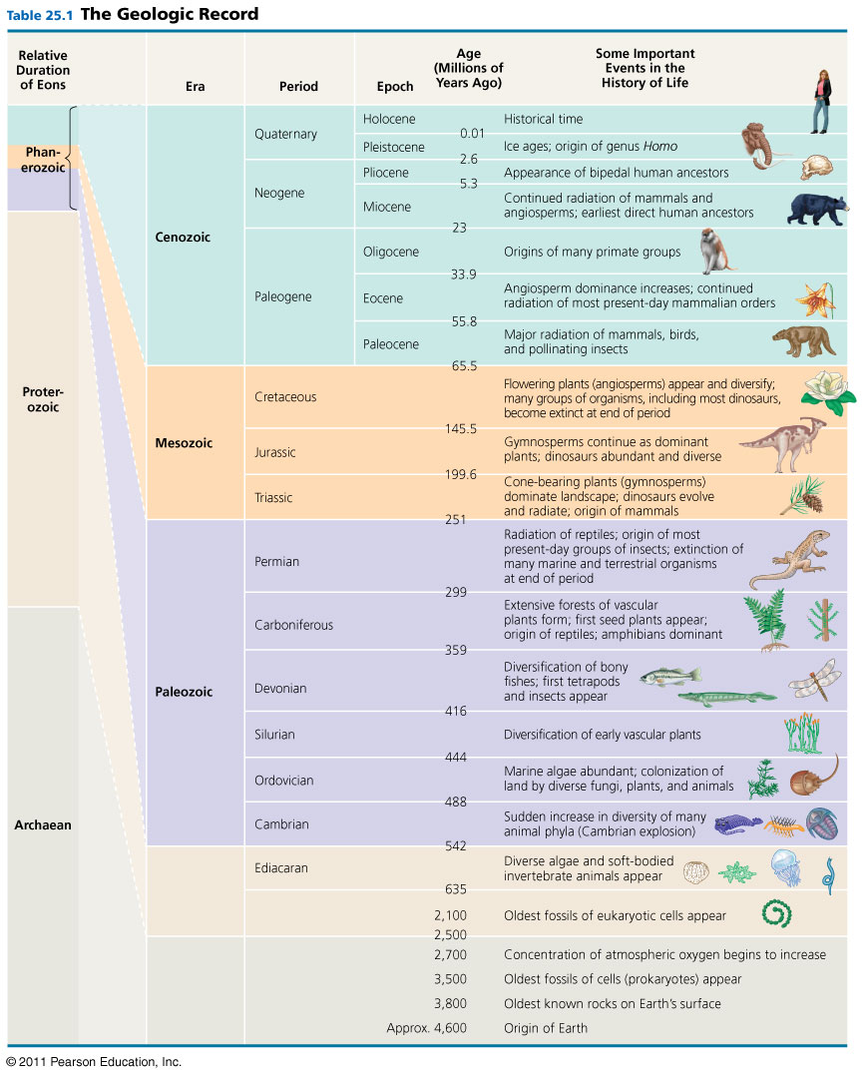
Geologic Time Scale
Eon → Era → Period → Epoch
(longest to shortest)
Present Day: Phanerozoic Eon, Cenozoic Era, Quaternary Period, Holocene Epoch

Slide 18
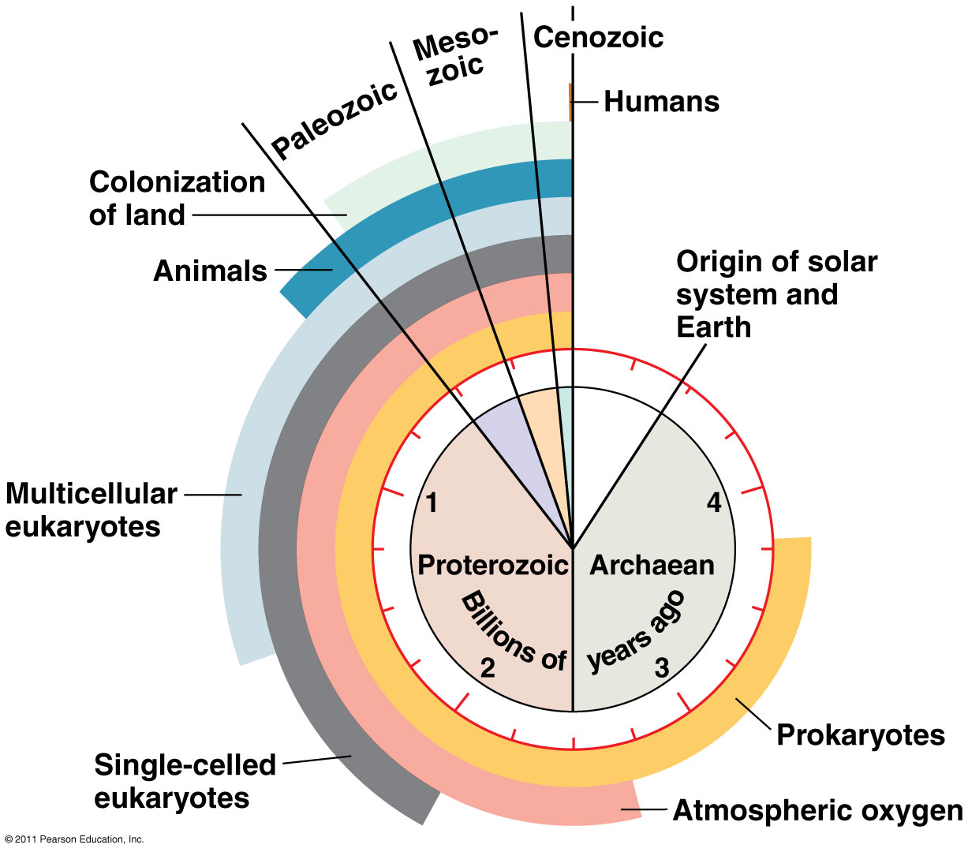
Clock Analogy of Earth’s History

Slide 19
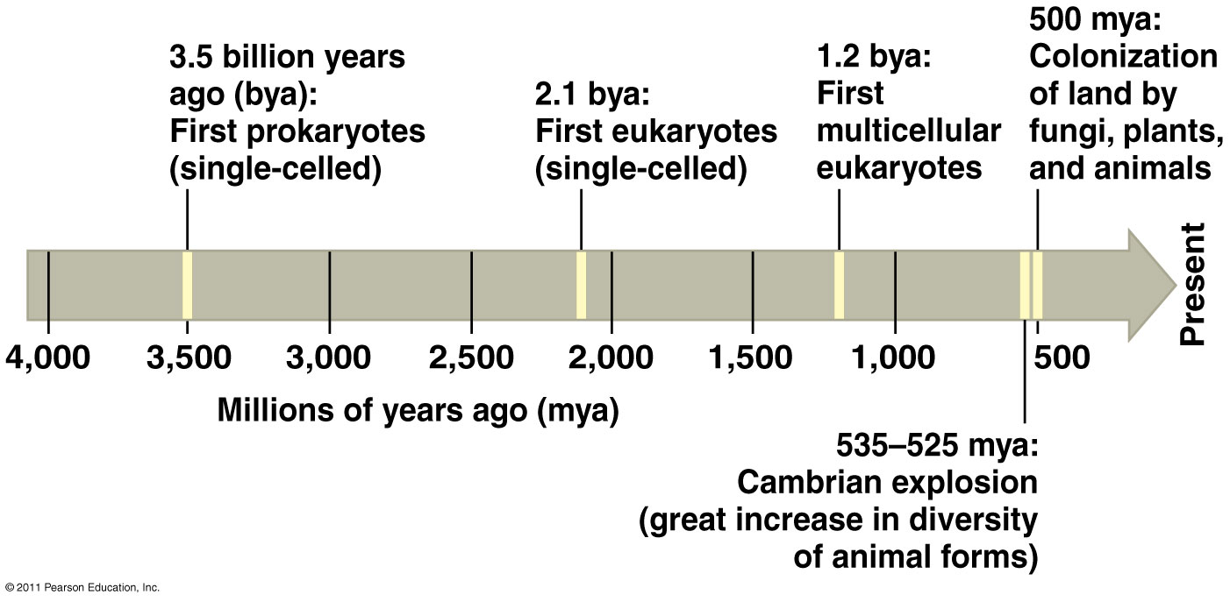
Key Events in Life’s History
O₂ accumulates in atmosphere
(2.7 bya)
Humans
(200,000)
Life Before Oxygen

Slide 20
HHMI Biointeractive Click & Learn
Geological History of O2
Deep History of Life on Earth
In groups of 4, spend some time exploring the 2 click & learns using the planner provided. Each person does NOT need to fill out the entire chart…it is for information gathering ONLY.
2. Use the rubric create an “Outstanding” Poster.
3. Class presentation of posters.
4. Poster evaluations.

Slide 21
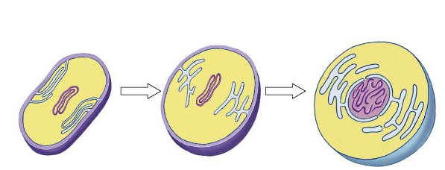
First Eukaryotes
~2 bya
Development of internal membranes
  create internal micro-environments
  advantage: specialization = increase efficiency
    natural selection!
endoplasmic
reticulum (ER)
nuclear envelope
infolding of the
plasma membrane
plasma
membrane
nucleus
DNA
cell wall
plasma
membrane
Prokaryotic
cell
Prokaryotic ancestor of eukaryotic cells
Eukaryotic
cell

Slide 22
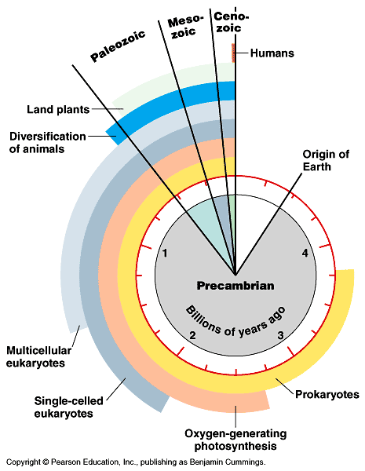
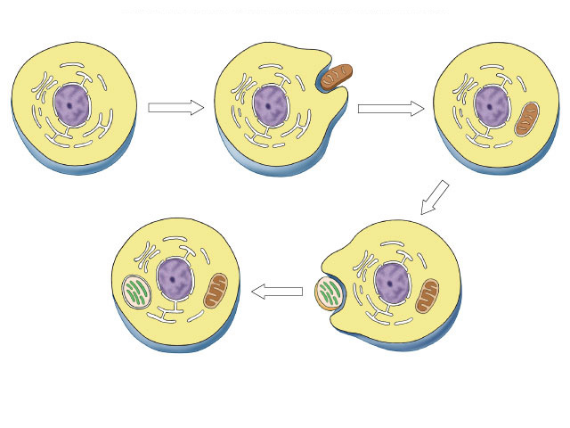
1st Endosymbiosis
Evolution of eukaryotes
  origin of mitochondria
  engulfed aerobic bacteria, but
  did not digest them
  mutually beneficial relationship
    natural selection!
internal membrane system
aerobic bacterium
mitochondrion
Endosymbiosis
Ancestral
eukaryotic cell
Eukaryotic cell
with mitochondrion

Slide 23
2nd Endosymbiosis
Eukaryotic
cell with
mitochondrion
Evolution of eukaryotes
  origin of chloroplasts
  engulfed photosynthetic bacteria,
  but did not digest them
  mutually beneficial relationship
    natural selection!
photosynthetic
bacterium
chloroplast
Endosymbiosis
mitochondrion
Eukaryotic cell with
chloroplast & mitochondrion

Slide 24
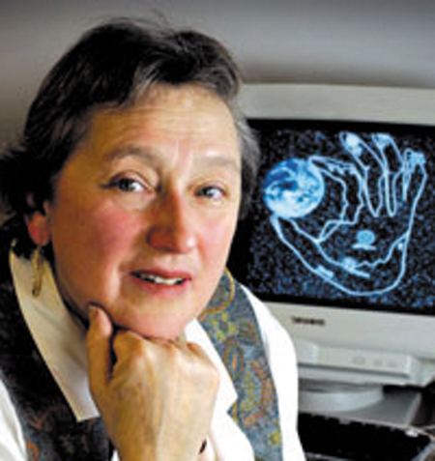
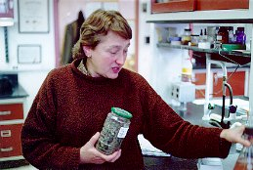
Theory of Endosymbiosis
Evidence
  structural
    mitochondria & chloroplasts
    resemble bacterial structure
    mitochondria & chloroplasts have enzymes similar to living prokaryotes
    mitochondria & chloroplasts two membranes
  genetic
    mitochondria & chloroplasts
    have their own circular DNA & no histones (like bacteria)
Lynn Margulis

Slide 25
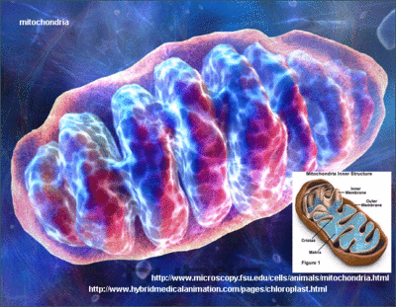
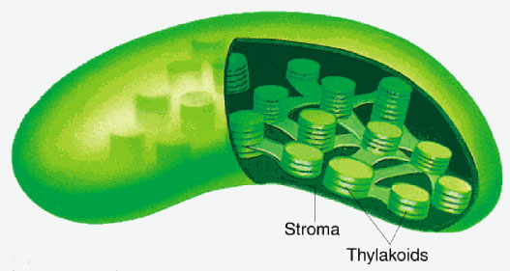
Endosymbiont Theory
Video
Evidence
functional
mitochondria & chloroplasts move freely within the cell
mitochondria & chloroplasts reproduce independently from the cell (binary fission)
mitochondria & chloroplasts have their own ribosomes to make proteins
How Two Microbes Changed History
Our favorite sisters here: https://www.youtube.com/watch?v=FGnS-Xk0ZqU

Slide 26
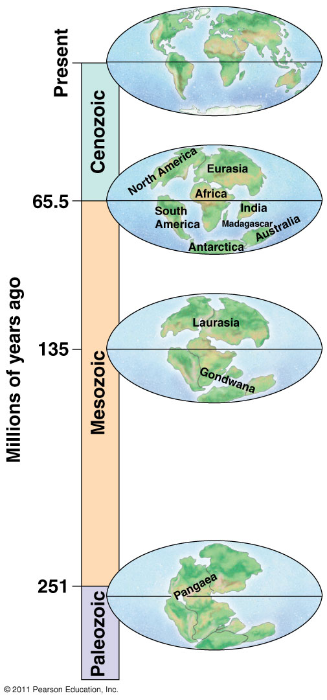
Pangaea = Supercontinent
Formed 250 mya
Continental drift explains many biogeographic puzzles
Video

Slide 27
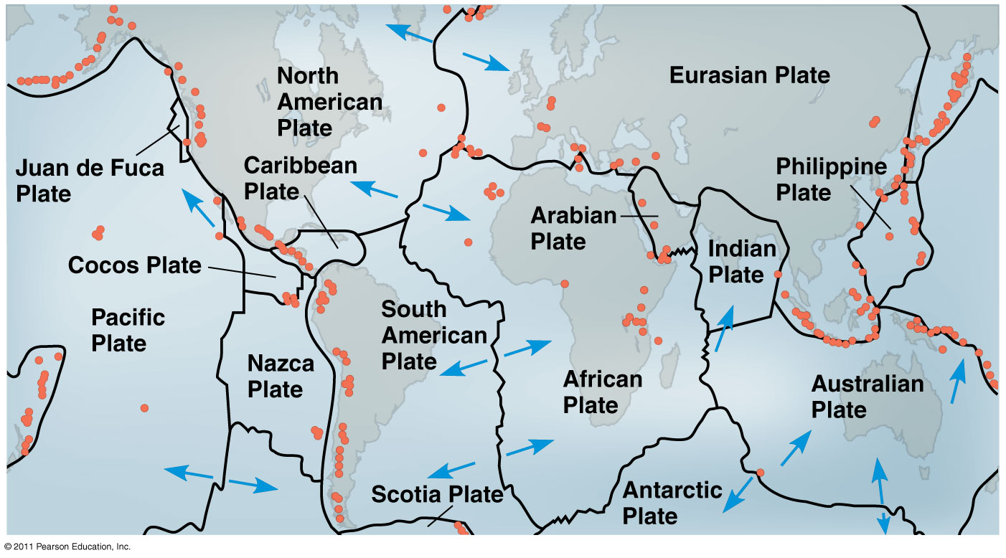
Movement of continental plates change geography and climate of Earth → Extinctions and speciation

Slide 28
POGIL: Mass Extinctions
SHORTEST PERSON → turn in your POGIL with sticky note ☺

Slide 29
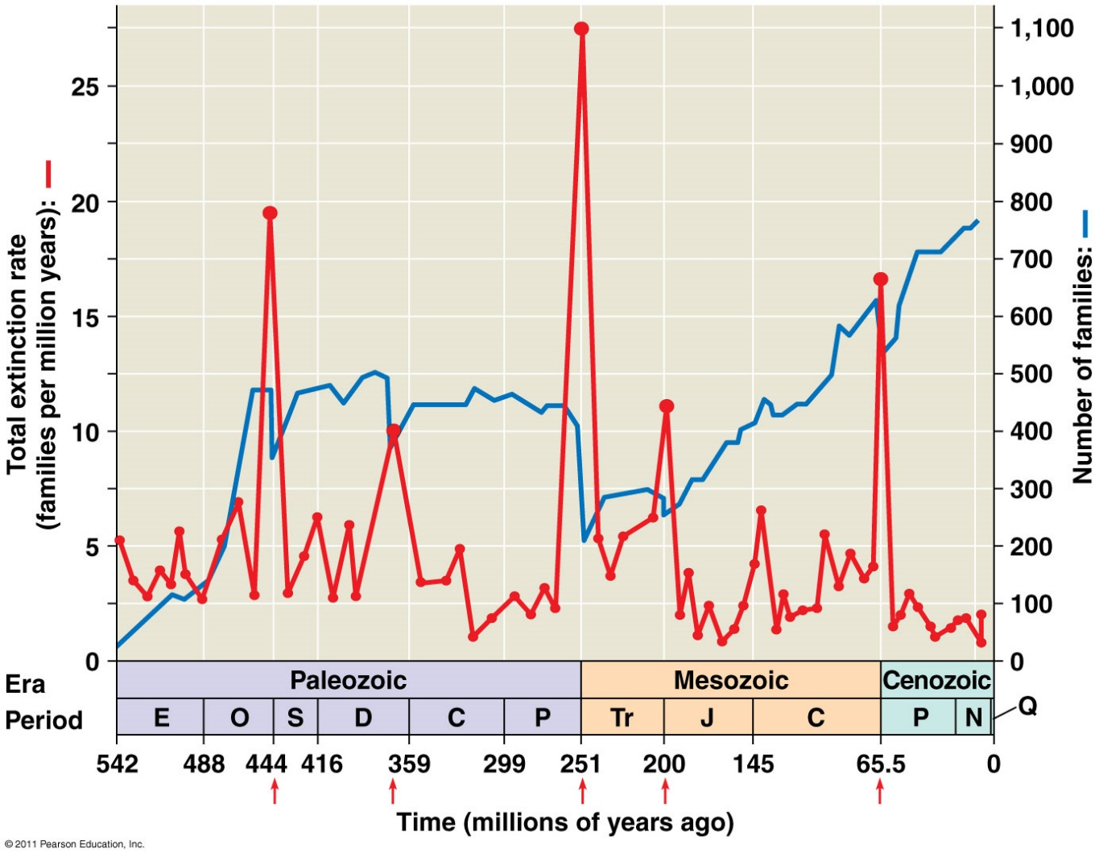
Mass extinctions → Diversity of life
Major periods in Earth’s history end with mass extinctions & new ones begin with adaptive radiations

Slide 30
Major events during each Era
Precambrian: microscopic fossils (stromatolites)
  Photosynthesis, atmospheric O₂
  Eukaryotes (endosymbiont theory)
Paleozoic: Cambrian Explosion
  Plants invade land, many animals appear
  Permian Extinction (-96% species)
Mesozoic: “Age of Reptiles”, dinosaur, plants
  Formation of Pangaea supercontinent
  Cretaceous Extinction – asteroid off Mexico’s coast
Cenozoic: Primates
Note: All end with major extinction & start with adaptive radiation

Slide 31
Discovery Education Video:
Mass Extinction and Adaptive Radiation
Running Time: 2:25
Notes:
https://www.youtube.com/watch?v=jrpjhbA-c5A

Slide 32
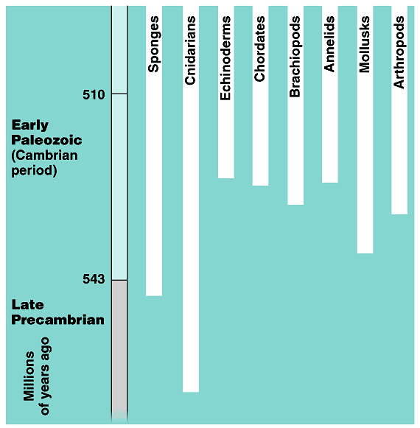
Cambrian explosion
Diversification of Animals
  within 10–20 million years most of the major phyla of animals appear in fossil record
543 mya

Slide 33
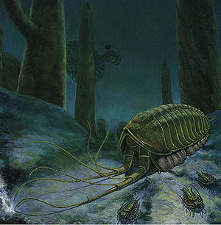
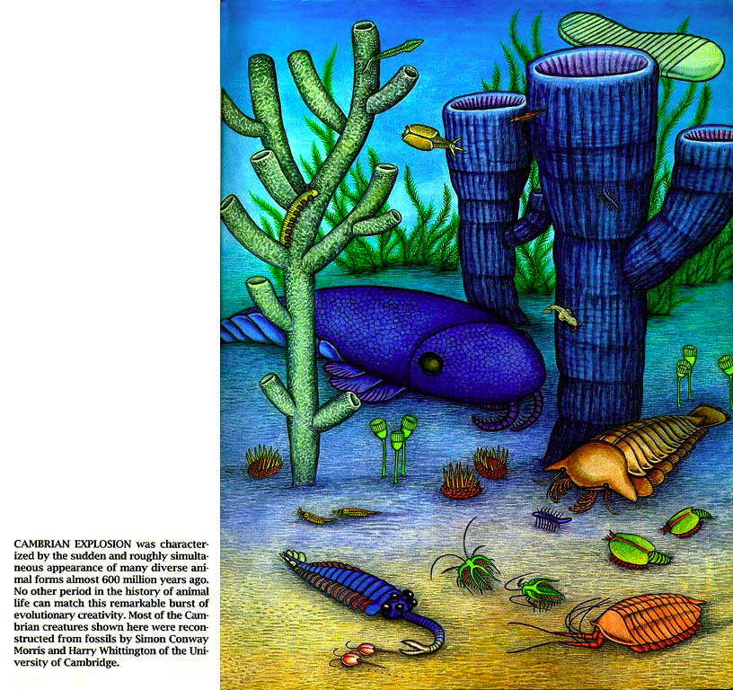
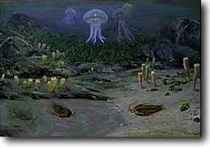


Slide 34
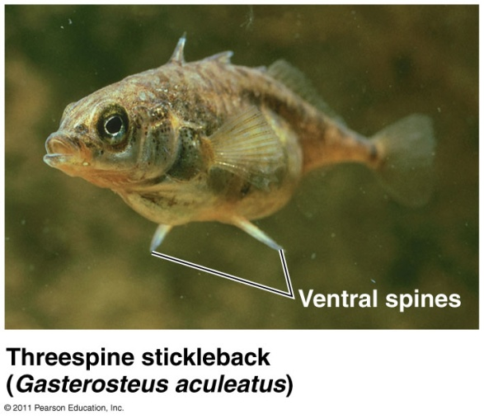
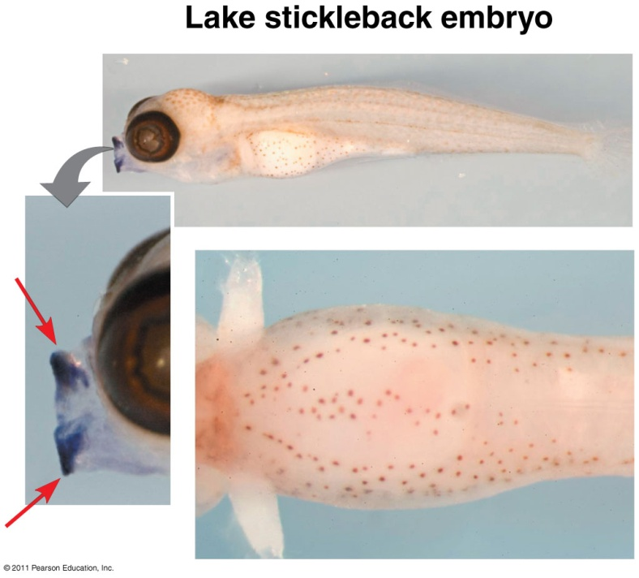
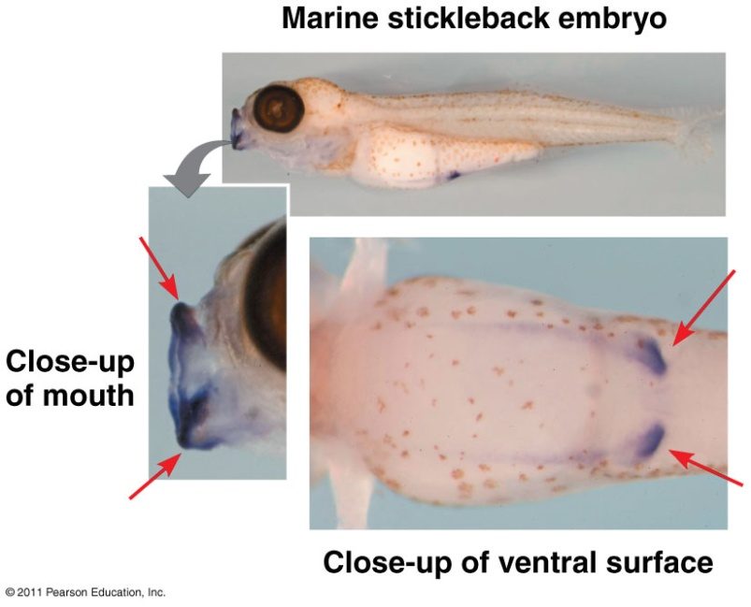
Evo-Devo: evolutionary + developmental biology
Evolution of new forms results from changes in DNA or regulation of developmental genes

Slide 35
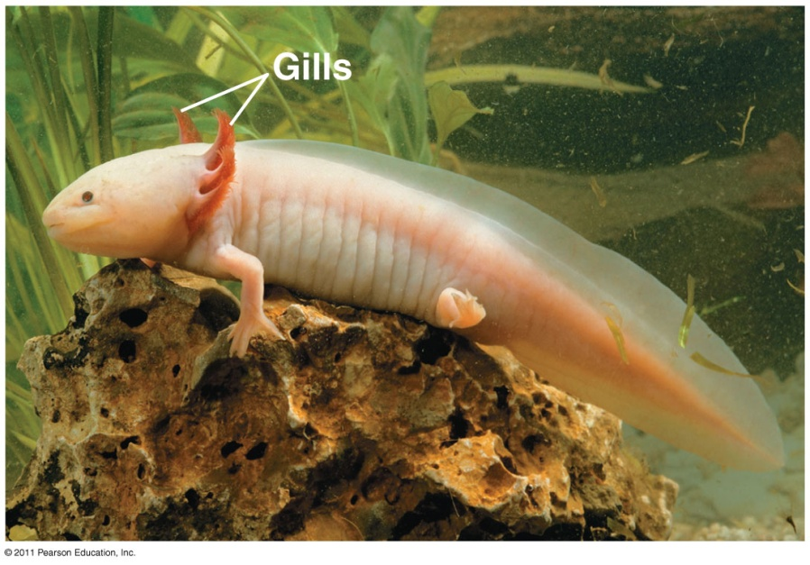
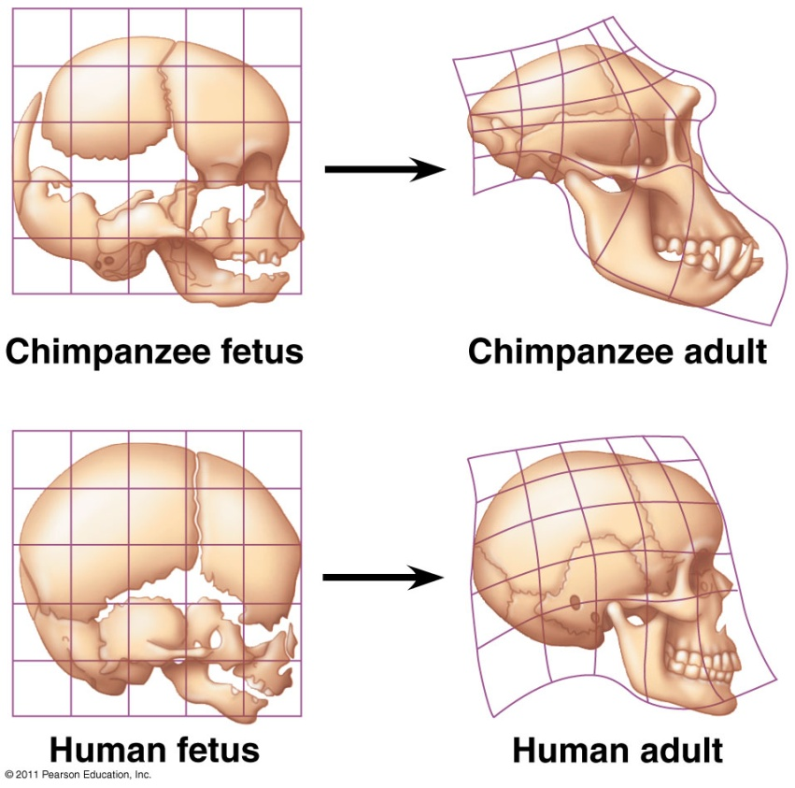
Heterochrony: evolutionary change in rate or timing of developmental events
Paedomorphosis: adult retains juvenile structures in ancestral species

Slide 36
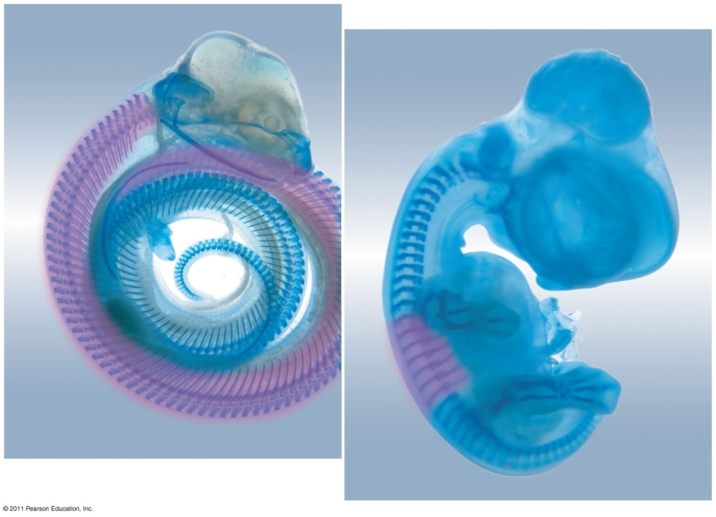
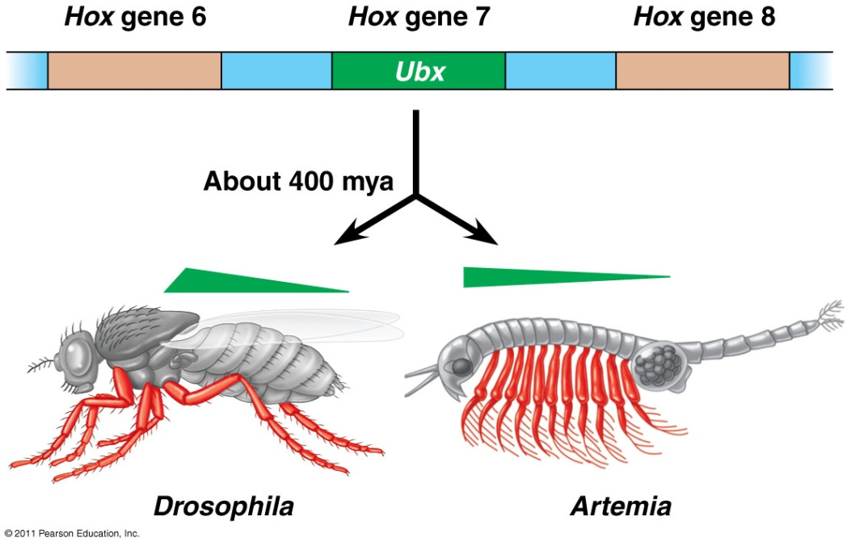
Homeotic genes: master regulatory genes determine location and organization of body parts
Ex: Hox genes
Evolution of Hox genes changes the insect body plan.
Hox gene expression and limb development.

Slide 37
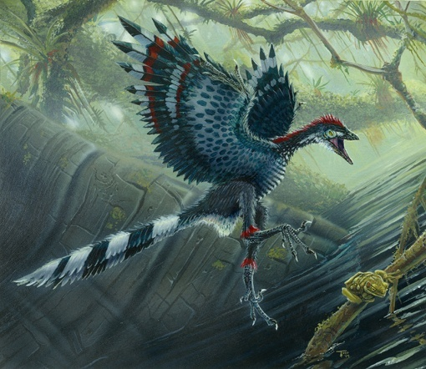
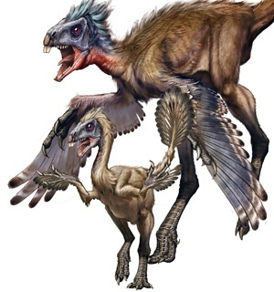
Exaptations: structures that evolve but become co-opted for another function
  Ex: bird feathers = thermoregulation → flight

