Slide 1
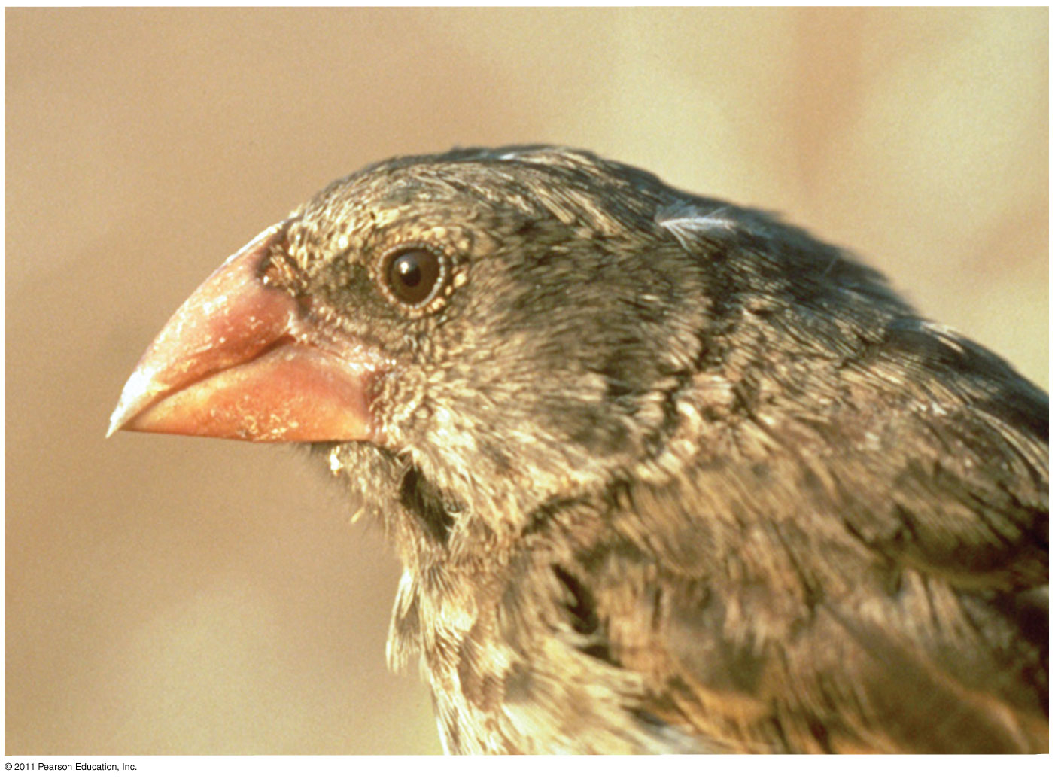
The Evolution of Populations
Chapter 23

Slide 2
What you must know: Ch. 23
1) How mutation and sexual reproduction
each produce genetic variation.
2) The conditions for Hardy-Weinberg equilibrium.
3) How to use the H-W equation to calculate
allelic frequencies and to test whether a population is evolving.

Slide 3
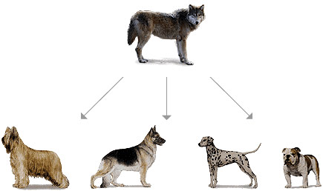
Smallest unit of evolution
Microevolution: change in the allele frequencies of a population over generations

Slide 4
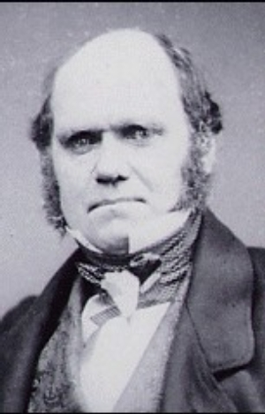
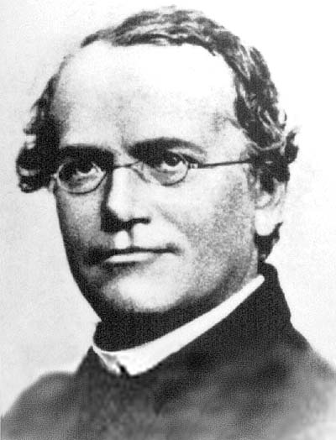
Bridging the connection
Darwin did not know how organisms passed traits to offspring
1866 - Mendel published his paper on genetics
Mendelian genetics supports Darwin’s theory that evolution is based on genetic variation

Slide 5
Sources of Genetic Variation
Point mutations: changes in one base (sickle cell)
Chromosomal mutations: delete, duplicate, disrupt, rearrange → usually harmful
Sexual recombination: contributes to most of genetic variation in a population
  Crossing Over (Meiosis: Prophase I)
  Ind. Assortment of Chromosomes (Meiosis)
  Random Fertilization (sperm + egg)

Slide 6
Population definitions
Population genetics: study of how populations change genetically over time
Population: group of individuals that live in the same area & interbreed, producing fertile offspring

Slide 7
Definitions continued
Gene pool: all of the alleles for all genes in all the members of the population
  Diploid (2n) species: 2 alleles for a gene (homozygous/heterozygous)
Fixed allele: when all members of a population only have 1 allele for a particular trait
  The more fixed alleles a population has, the LOWER the species’ diversity

Slide 8
Hardy-Weinberg Principle
Hardy-Weinberg Principle: The allele and genotype frequencies of a population will remain constant from generation to generation
  …UNLESS they are acted upon by forces other than Mendelian segregation and recombination of alleles
Equilibrium = allele and genotype frequencies remain constant

Slide 9
Conditions for
Hardy-Weinberg equilibrium
No mutations
Random mating
No natural selection
Extremely large population size
No gene flow (no migration)
If at least one of these conditions is NOT met, then the population is EVOLVING!

Slide 10
Hardy-Weinberg Principle
Allele Frequencies:
Gene with 2 alleles : p, q
p = frequency of dominant allele (A) q = frequency of recessive allele (a)
Note:
1 – p = q
1 – q = p
p + q = 1

Slide 11
Hardy-Weinberg Equation
Genotypic Frequencies:
3 genotypes (AA, Aa, aa)
p² = AA (homozygous dominant)
2pq = Aa (heterozygous)
q² = aa (homozygous recessive)
p² + 2pq + q² = 1

Slide 12
Strategies for solving H-W Problems:
If you are given the genotypes (AA, Aa, aa), calculate p and q by adding up the total # of A and a alleles.
If you know phenotypes, then use “aa” to find q², and then q. (p = 1-q)
Use p² + 2pq + q² to find genotype frequencies.
If p and q are not constant from gen. to gen., then the POPULATION IS EVOLVING!

Slide 13
Hardy-Weinberg lab
AP lab 2

Slide 14
Causes of evolution

Slide 15
REVIEW: Conditions for
Hardy-Weinberg equilibrium
No mutations
Random mating
No natural selection
Extremely large population size
No gene flow
If at least one of these conditions is NOT met, then the population is EVOLVING!

Slide 16
Causes of Evolution
Minor Causes of Evolution:
#1 - Mutations
  Rare, very small changes in allele frequencies
#2 - Nonrandom mating
  Affect genotypes, but not allele frequencies
Major Causes of Evolution:
#3 – Natural Selection (is occurring)
#4 – Small Population → Genetic Drift
#5 – Gene Flow (is occurring)
Notes:
5 Pillars:
https://www.youtube.com/watch?v=5NdMnlt2keE&_sm_byp=iVVrsV1rvVTVPH8P&_sm_byp=iVVqp03ZnmW25P5F

Slide 17
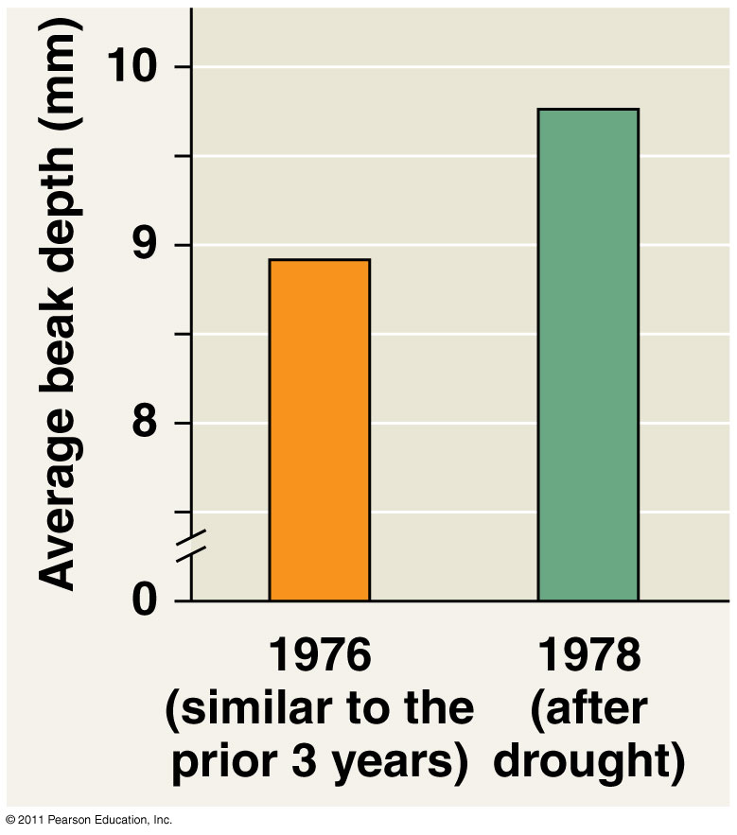
Major Causes of Evolution
#3 – Natural Selection
  Individuals with variations better suited to environment pass more alleles to next gen.

Slide 18
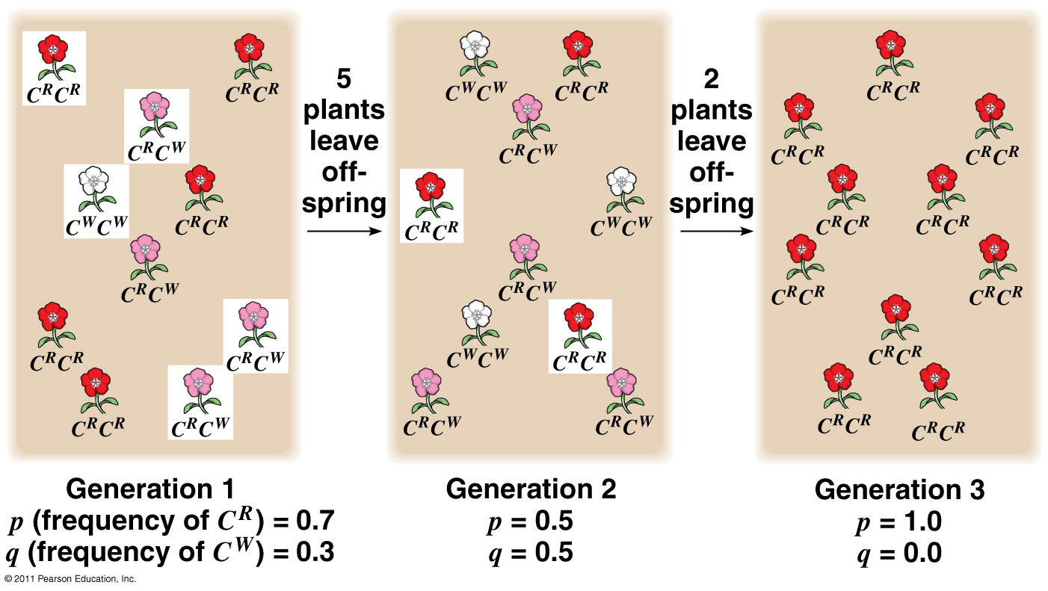
Major Causes of Evolution
#4 – Genetic Drift
  Small populations have greater chance of fluctuations in allele frequencies from one generation to another
  Examples:
    A)Founder Effect
    B) Bottleneck Effect

Slide 19
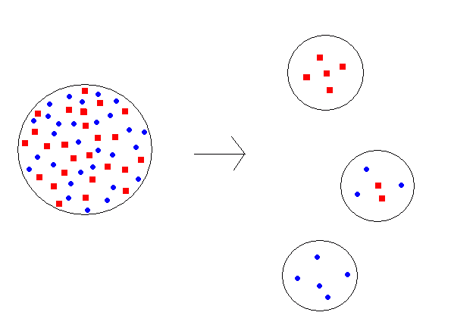
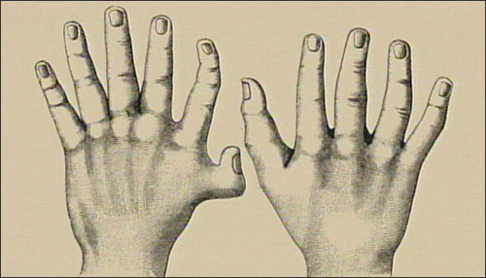
A) Founder Effect
A few individuals isolated from larger population
Certain alleles under/over represented
Polydactyly in Amish population

Slide 20
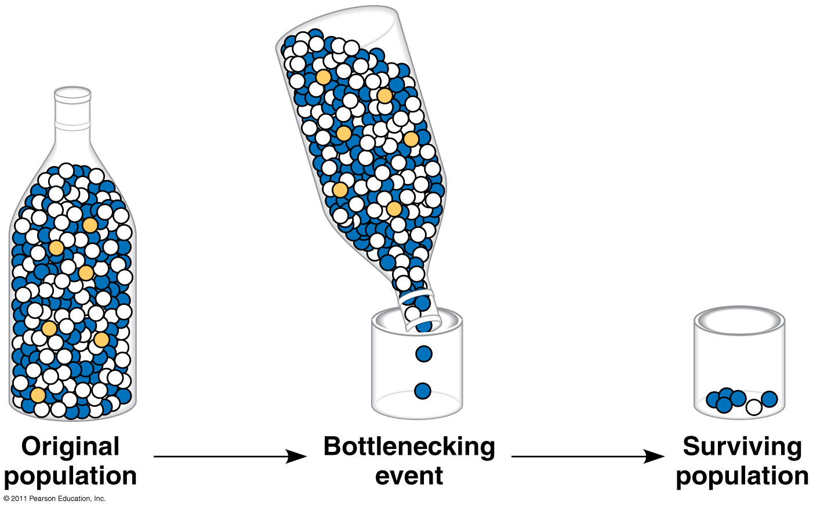
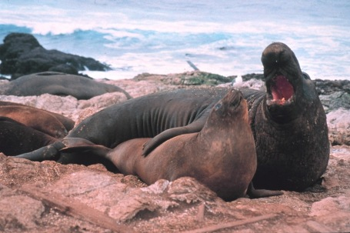
B) Bottleneck Effect
Sudden change in environment drastically reduces population size
Northern elephant seals hunted nearly to extinction in California

Slide 21
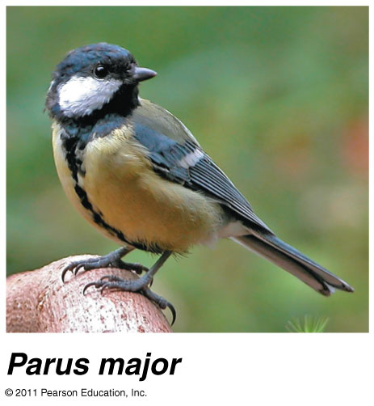
Major Causes of Evolution
#5 – Gene Flow
  Movement of fertile individuals between populations
  Gain/lose alleles
  Reduce genetic differences between populations
Amoeba Sisters: Genetic Drift

Slide 22
Hardy-Weinberg lab
Back to AP lab 2

Slide 23
How does natural selection bring about adaptive evolution?

Slide 24
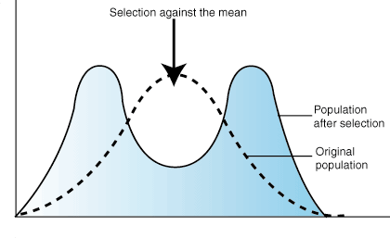
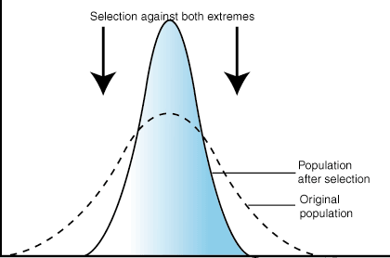
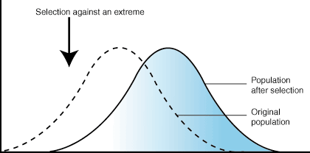
Fitness : the contribution an individual makes to the gene pool of the next generation
Natural selection can alter frequency distribution of heritable traits in 3 ways:
Directional selection
Disruptive (diversifying) selection
Stabilizing selection

Slide 25
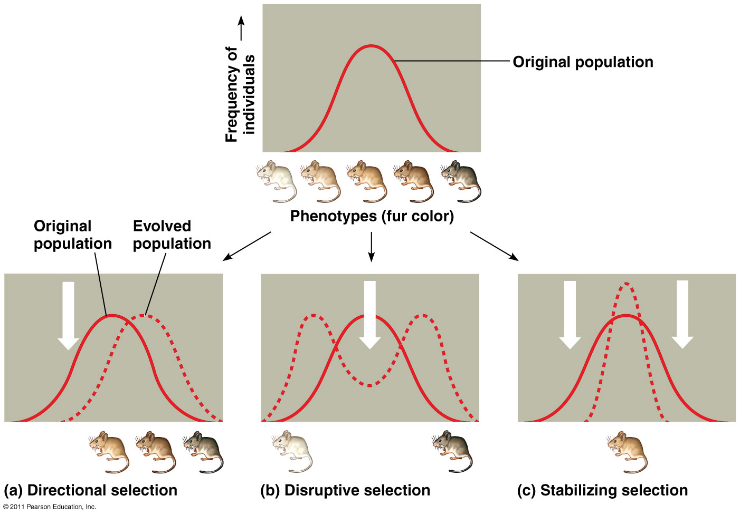
Directional Selection: Ex: larger black bears survive extreme cold better than small ones
Disruptive Selection: Ex: small beaks for small seeds; large beaks for large seeds
Stabilizing Selection: Ex: narrow range of human birth weight

Slide 26
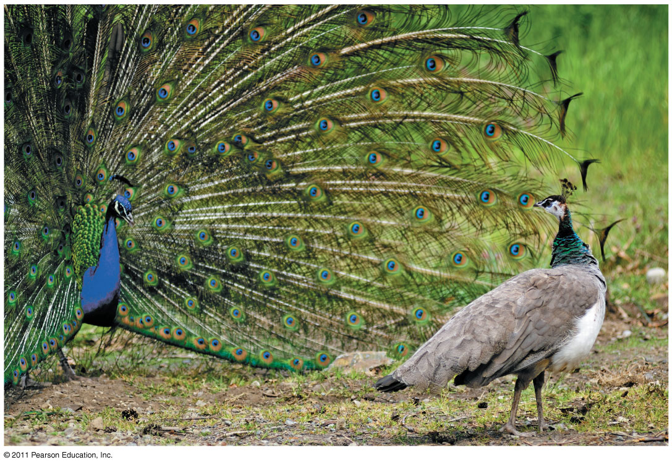
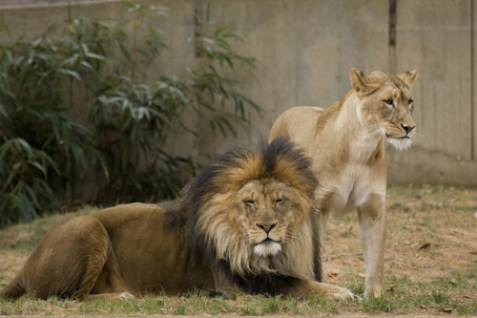
Sexual selection
Form of natural selection – certain individuals more likely to obtain mates
Sexual dimorphism: difference between 2 sexes
  Ex: Size, color, ornamentation, behavior

Slide 27
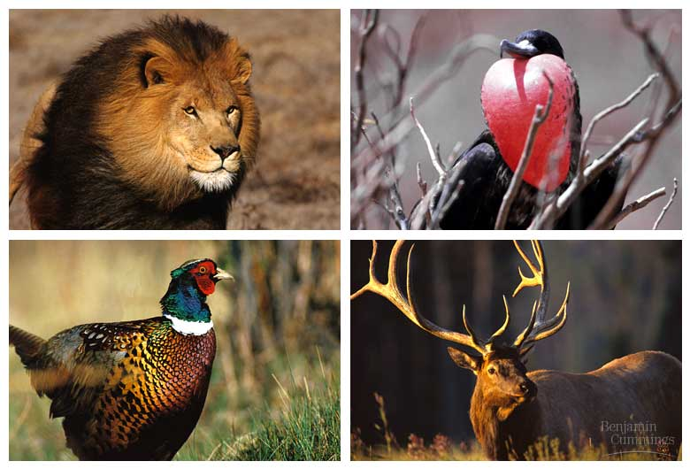
Sexual selection
Intrasexual – selection within same sex (Ex: M compete with other M)
Intersexual – mate choice (Ex: F choose showy M)

Slide 28
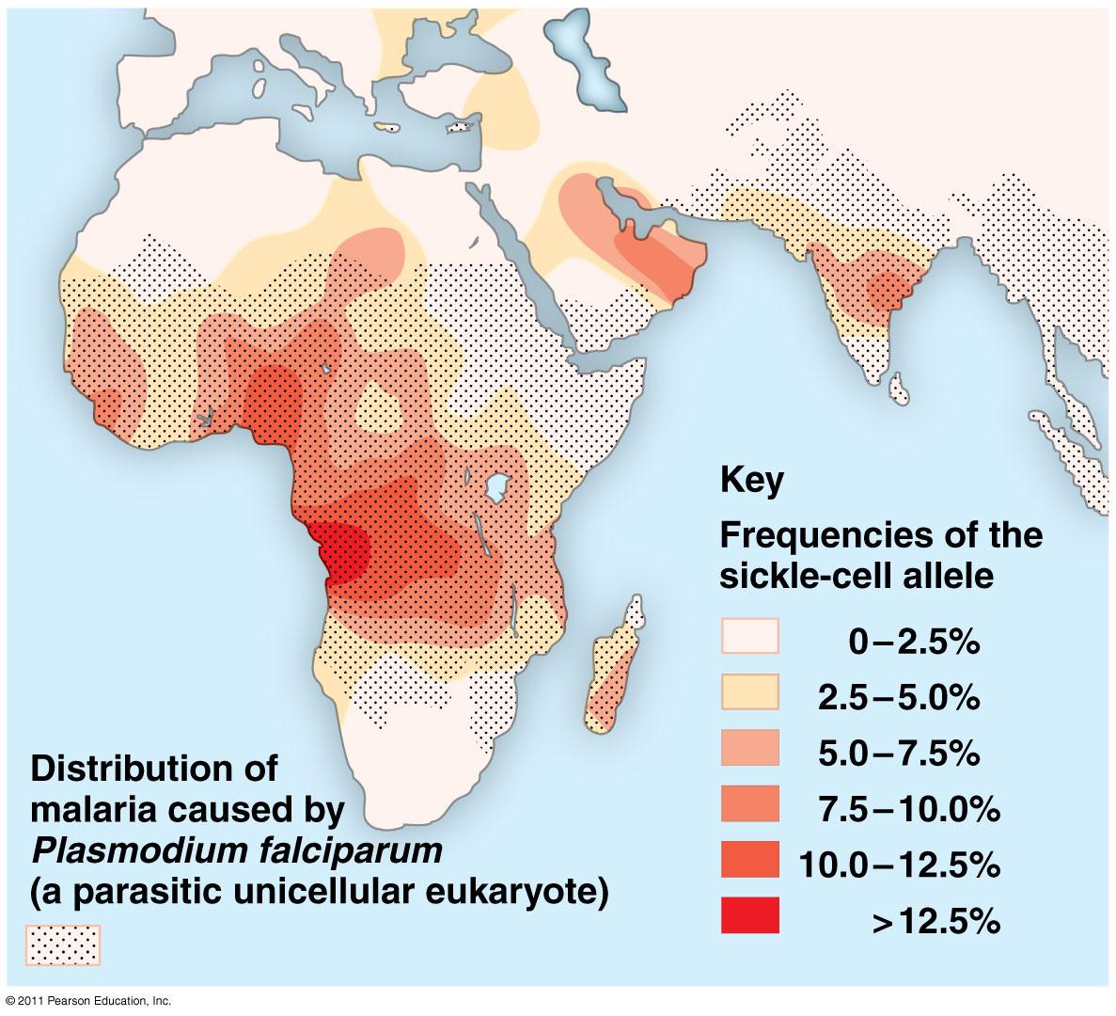
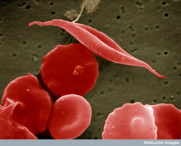
Preserving genetic variation
Diploidy: hide recessive alleles that are less favorable
Heterozygote advantage: greater fitness than homozygotes
  Ex: Sickle cell disease

Slide 29
HHMI Video:
Natural Selection in Humans
Running Time: 14:03 min
Notes:
https://www.youtube.com/watch?v=Zsbhvl2nVNE

Slide 30
Natural selection cannot fashion perfect organisms.
Selection can act only on existing variations.
Evolution is limited by historical constraints.
Adaptations are often compromises.
Chance, natural selection, and the environment interact.

Slide 31
Sample Problems
Define the following examples as directional, disruptive, or stabilizing selection:
    Tiger cubs usually weigh 2-3 lbs. at birth
    Butterflies in 2 different colors each represent a species distasteful to birds
    Brightly colored birds mate more frequently than drab birds of same species
    Fossil evidence of horse size increasing over time

Slide 32
Solving H-W Problems

Slide 37
5.
After graduation, you and 19 of your closest friends (lets say 10 males and 10 females) charter a plane to go on a round-the-world tour. Unfortunately, you all crash land (safely) on a deserted island. No one finds you and you start a new population totally isolated from the rest of the world. Two of your friends carry (i.e. are heterozygous for) the recessive cystic fibrosis allele (c).
Assuming that the frequency of this allele does not change as the population grows, what will be the incidence of cystic fibrosis on your island? ______

Slide 38
6
Cystic fibrosis is a recessive condition that affects about 1 in 2,500 babies in the Caucasian population of the United States. Please calculate the following.
The frequency of the recessive allele in the population. ______
The frequency of the dominant allele in the population. ______
The percentage of heterozygous individuals (carriers) in the population. ____

Slide 39
Back to H-W lab

Slide 40
Everyone starts off Aa (heterozygous)
Always mate with someone different in the room.
Each mating event produces 2 offspring (must mate twice with the same person).
  When you mate, one partner record genotype of first offspring
  Other partner record genotype of second offspring
After the mating, each partner will become one of the offspring you just produced.

Slide 42
Case 2: Selection Against homozygous recessive
(natural selection)

Slide 44
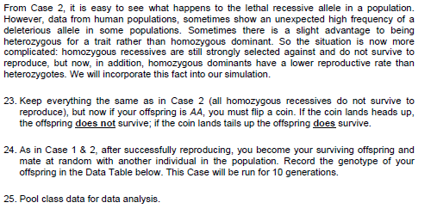
Case 3: heterozygote advantage

Slide 45


Slide 46
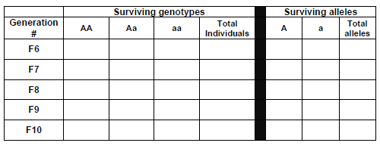

Slide 47
Case 3: heterozygote advantage

Slide 48
Case 4: genetic drift

Slide 49
Case 4: genetic drift

Slide 50
Case 4: genetic drift

