Slide 1
AP Biology Review
DNA Replication
Protein Synthesis

Slide 2
What do you remember about DNA in Prokaryotes vs Eukaryotes?
Fill in the double bubble
PROKARYOTE
EUKARYOTE

Slide 3
DNA Comparison
Need to add anything?
Prokaryotic DNA
Eukaryotic DNA
Double-stranded
Circular
One chromosome
In cytoplasm
No histones
Supercoiled DNA
Double-stranded
Linear
Usually 1+ chromosomes
In nucleus
DNA wrapped around histones (proteins)
Forms chromatin

Slide 4
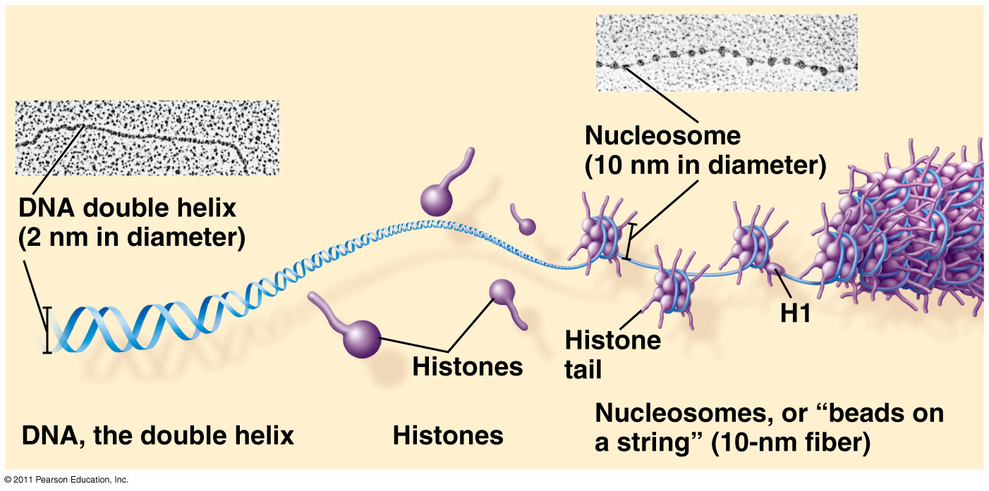

Slide 5
Major Steps of Replication:
Helicase: unwinds DNA at origins of replication
Initiation proteins separate 2 strands → forms replication bubble
Primase: puts down RNA primer to start replication
DNA polymerase III: adds complimentary bases to leading strand (new DNA is made 5’ → 3’)
Lagging strand grows in 3’→5’ direction by the addition of Okazaki fragments
DNA polymerase I: replaces RNA primers with DNA on lagging strand
DNA ligase: seals fragments together

Slide 6
1. Helicase unwinds DNA at origins of replication and creates replication forks
2. Replication bubble formed; held open by single-stranded-binding proteins

Slide 7
3a. Primase lays down RNA primer

Slide 8
3b. DNA polymerase III adds complementary nucleotides to leading strand in 5’→3’ direction

Slide 9
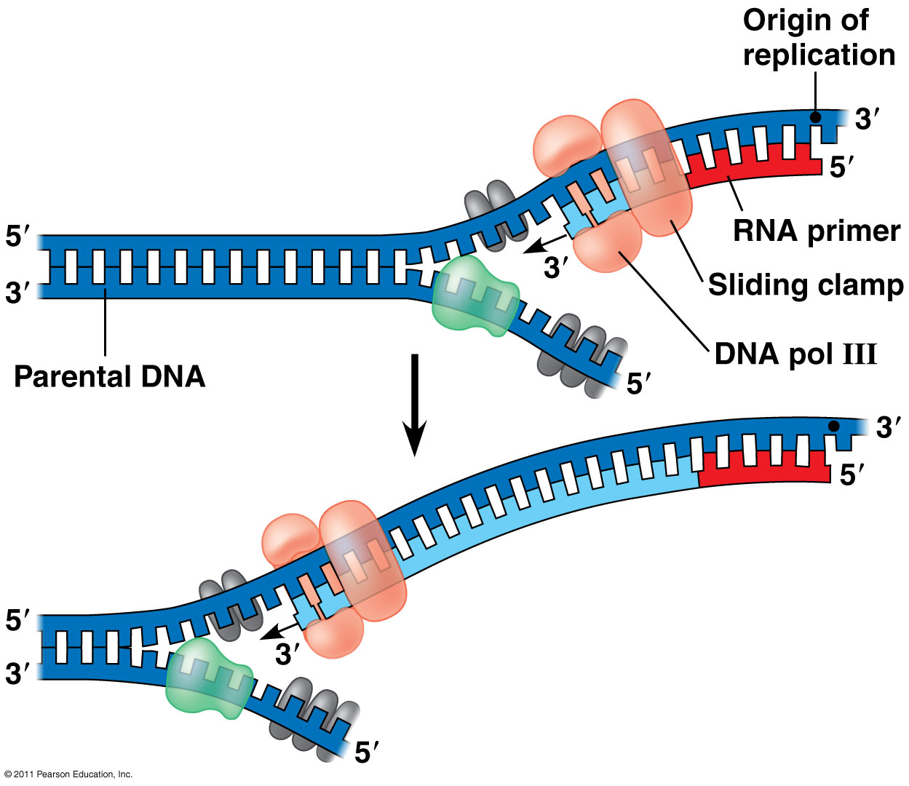
Replication on leading strand

Slide 10
Leading strand vs. Lagging strand
4. Lagging strand grows in 3’ → 5’ direction by the addition of Okazaki fragments

Slide 11
Okazaki Fragments: Short segments of DNA that grow 5’→3’ that are added onto the lagging strand
5a. DNA Polymerase III replaces RNA primers with DNA on lagging strand

Slide 12
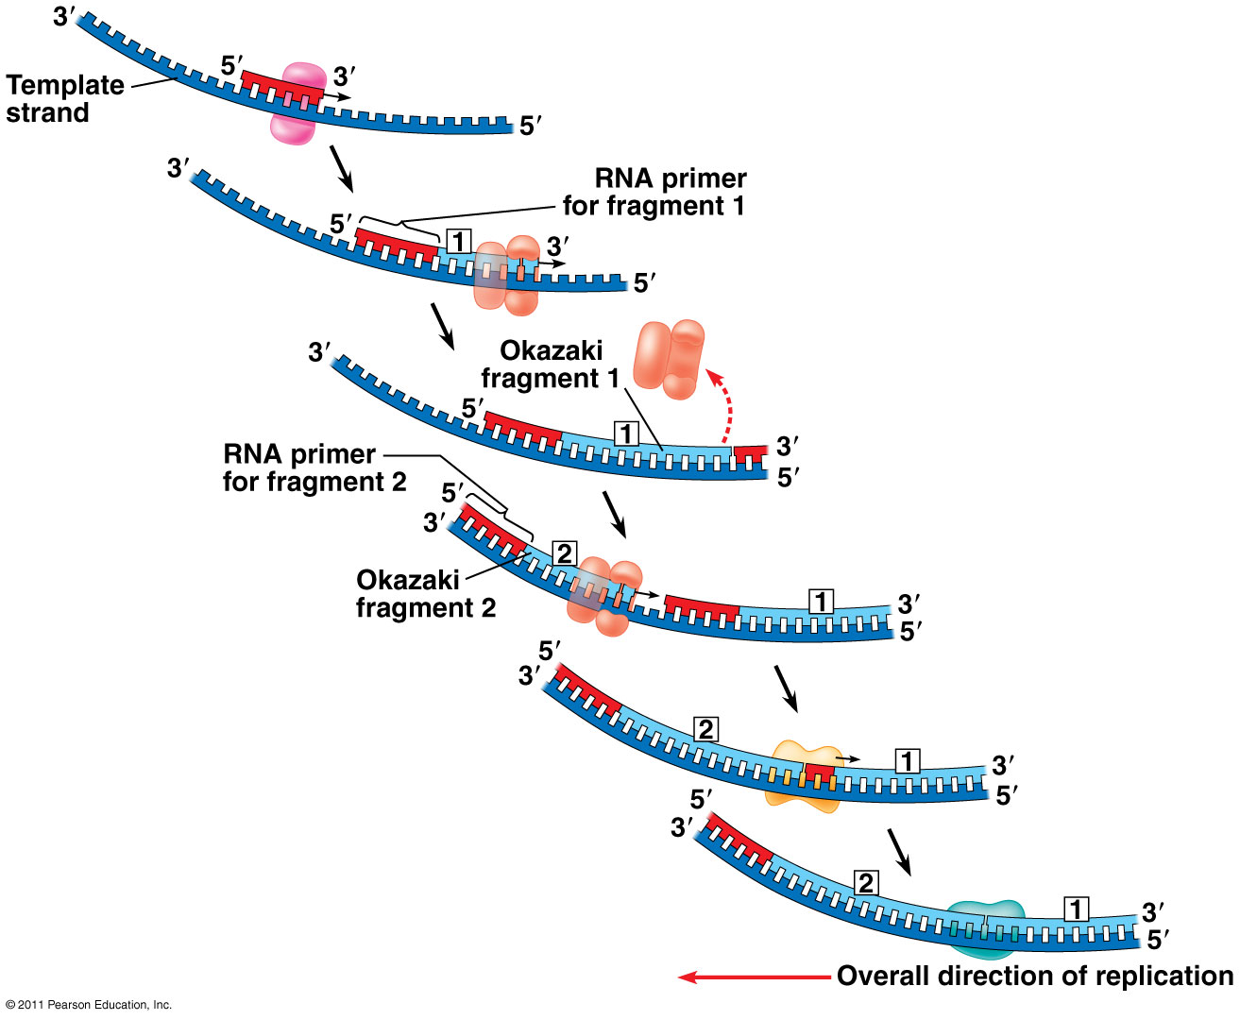
5b.DNA Ligase: seals together Okazaki fragments

Slide 14
PROTEIN SYNTHESIS
CENTRAL DOGMA: DNA → RNA → protein
Transcription: DNA → RNA
Translation: RNA → protein
Ribosome = site of translation

Slide 15
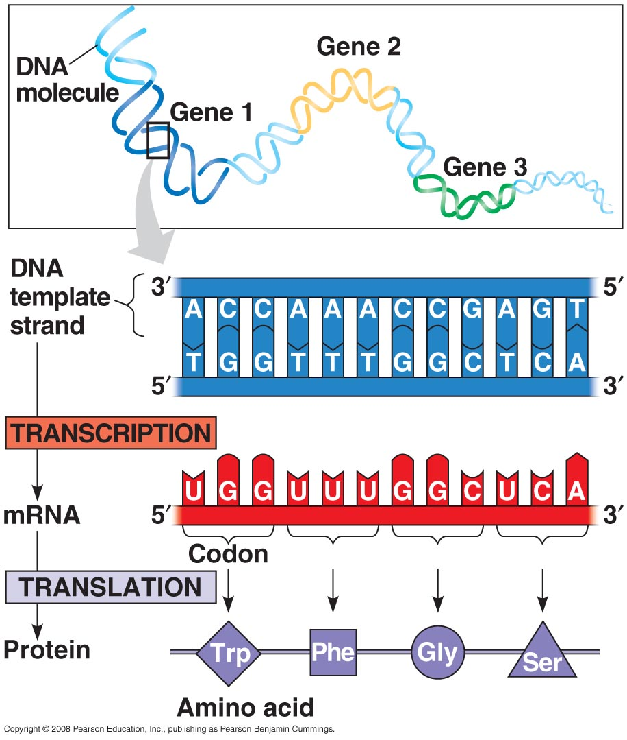
The Genetic Code
For each gene, one DNA strand is the template strand
mRNA (5’ → 3’) complementary to template
mRNA triplets (codons) code for amino acids in polypeptide chain

Slide 16
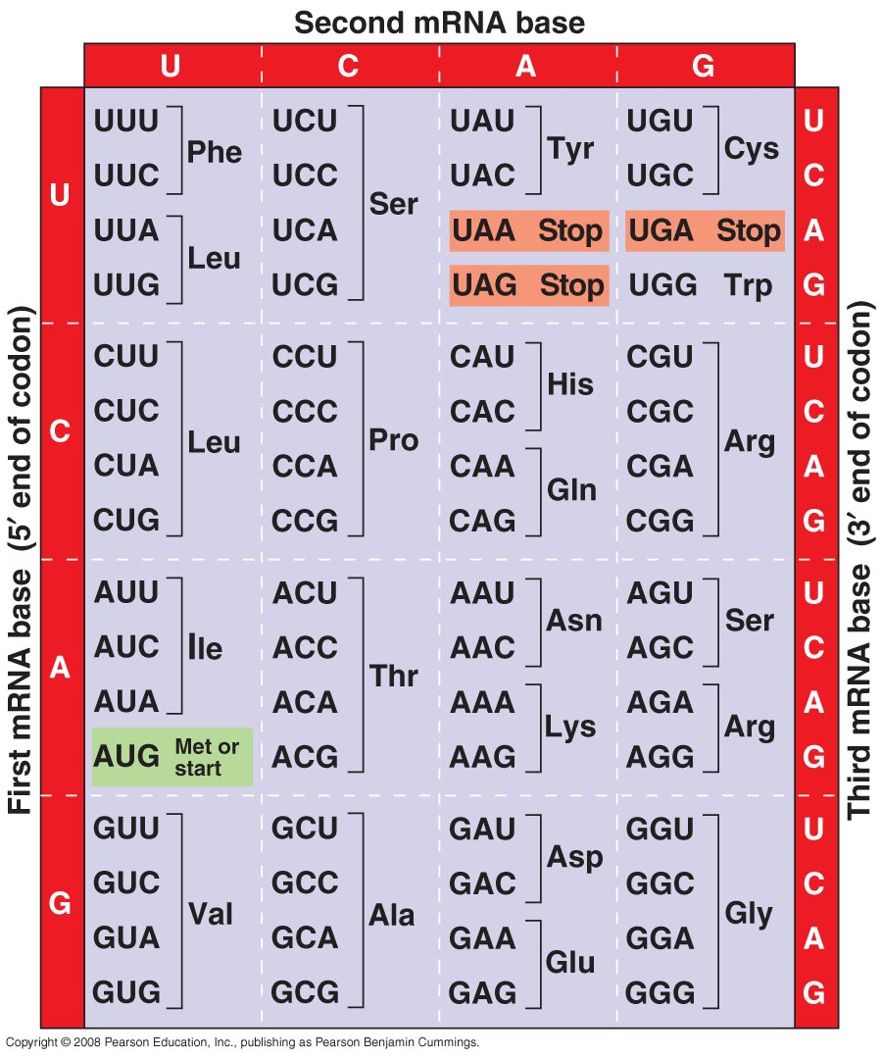
The Genetic Code
64 different codon combinations
Redundancy: 1+ codons code for each of 20 AAs
Reading frame: groups of 3 must be read in correct groupings
This code is universal: all life forms use the same code.

Slide 17
Transcription
Transcription unit: stretch of DNA that codes for a polypeptide or RNA (eg. tRNA, rRNA)
RNA polymerase:
Separates DNA strands and transcribes mRNA
mRNA elongates/grows in 5’ → 3’ direction
Uracil (U) replaces thymine (T) when pairing to adenine (A)
Attaches to promoter (start of gene) and stops at terminator (end of gene)

Slide 18
How is Protein Synthesis Different in Prokaryotes vs Eukaryotes?
Fill in what you remember!
PROKARYOTE
EUKARYOTE

Slide 19
1. Initiation
Bacteria: RNA polymerase binds directly to promoter in DNA

Slide 20
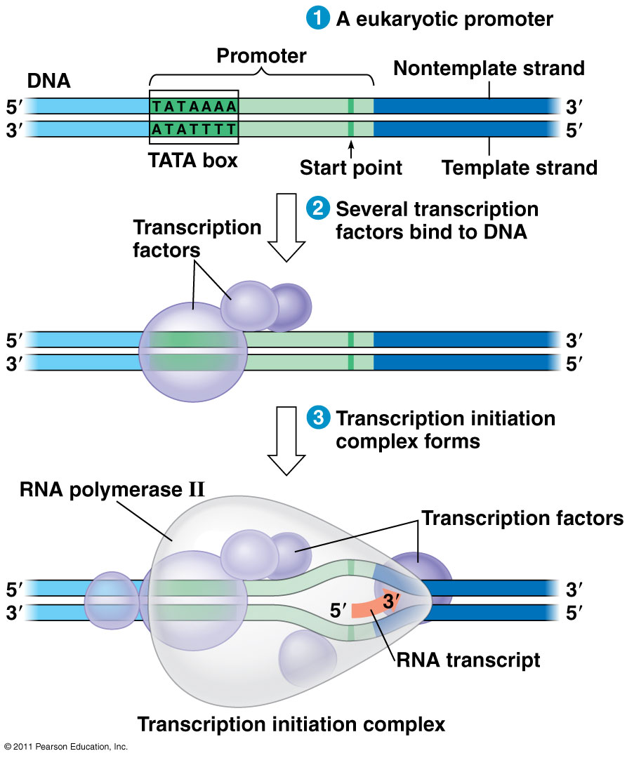
1. Initiation
Eukaryotes:
TATA box = DNA sequence (TATAAAA) upstream from promoter
Transcription factors must recognize TATA box before RNA polymerase can bind to DNA promoter

Slide 21
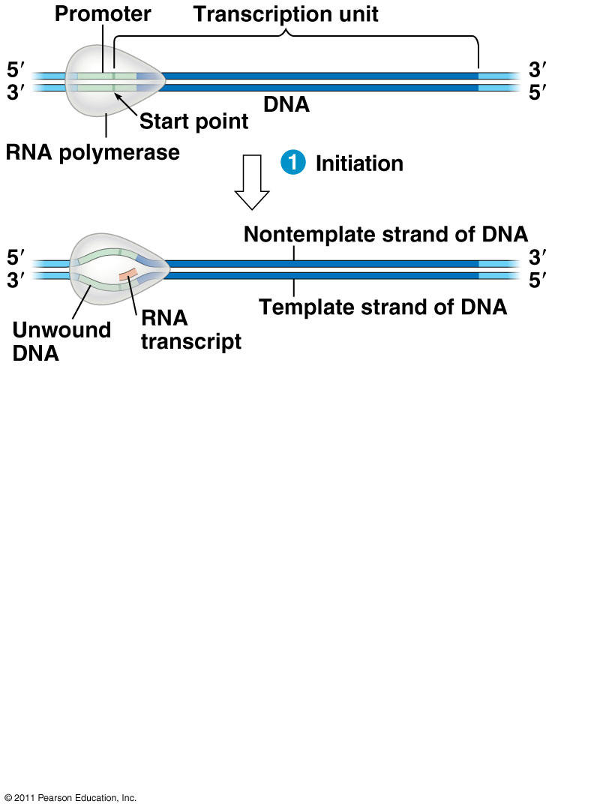
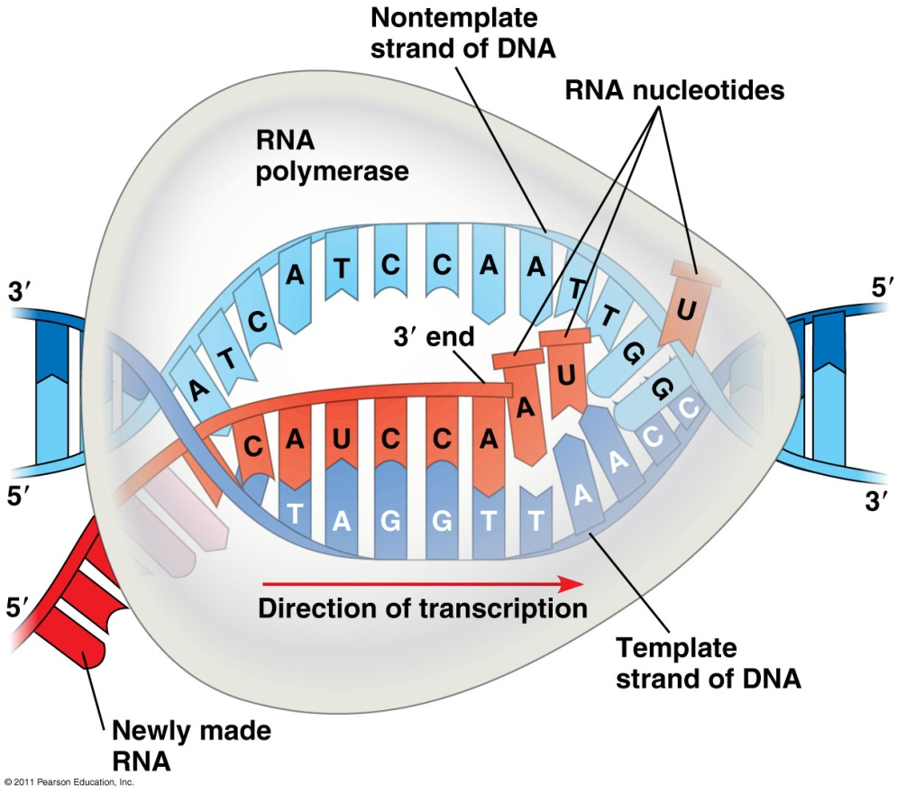
2. Elongation
RNA polymerase adds RNA nucleotides to the 3’ end of the growing chain (A-U, G-C)

Slide 22
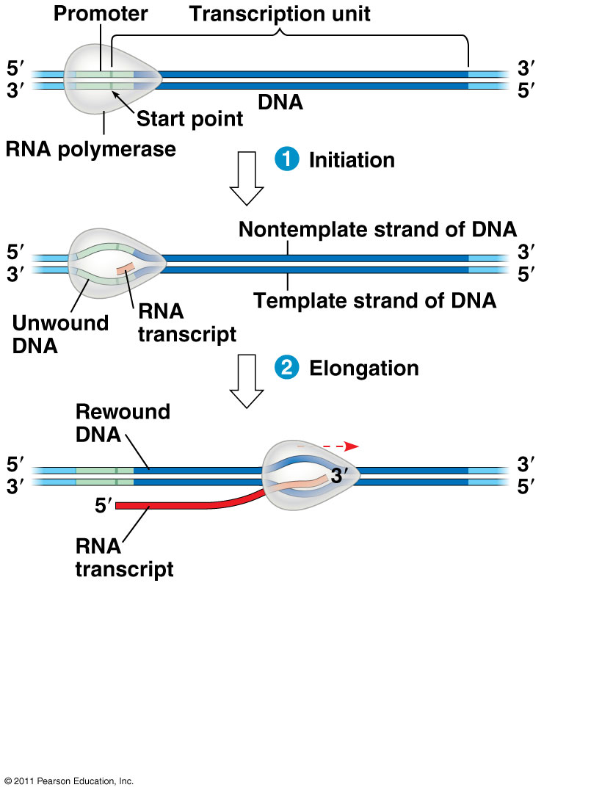
2. Elongation
As RNA polymerase moves, it untwists DNA, then rewinds it after mRNA is made

Slide 23
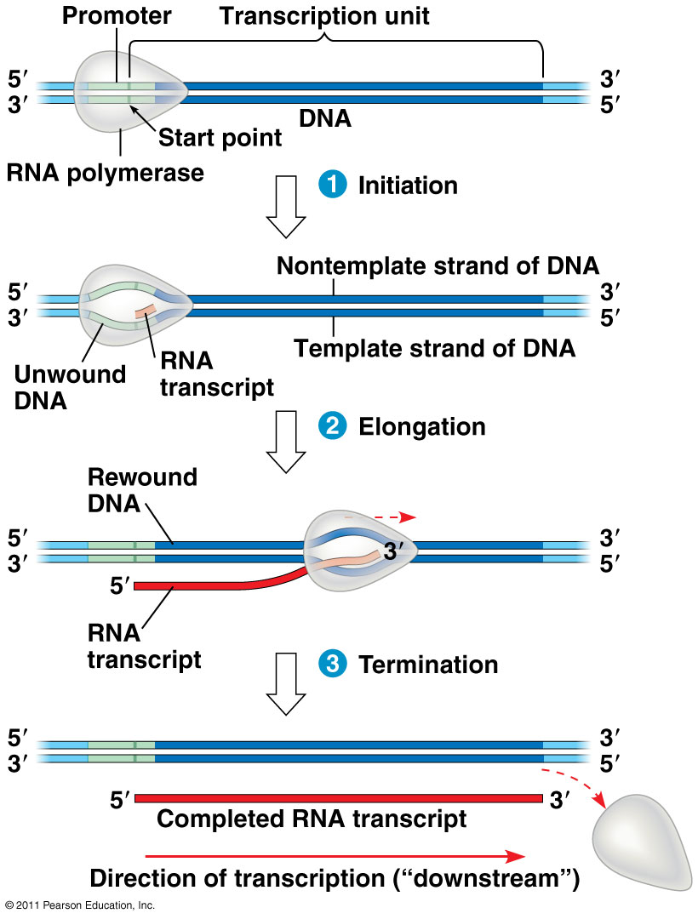
3. Termination
RNA polymerase transcribes a terminator sequence in DNA, then mRNA and polymerase detach.
It is now called pre-mRNA for eukaryotes.
Prokaryotes = mRNA ready for use

Slide 24
Additions to pre-mRNA:
5’ cap (modified guanine) and 3’ poly-A tail (50-520 A’s) are added
Help export from nucleus, protect from enzyme degradation, attach to ribosomes
This is also called RNA processing

Slide 25
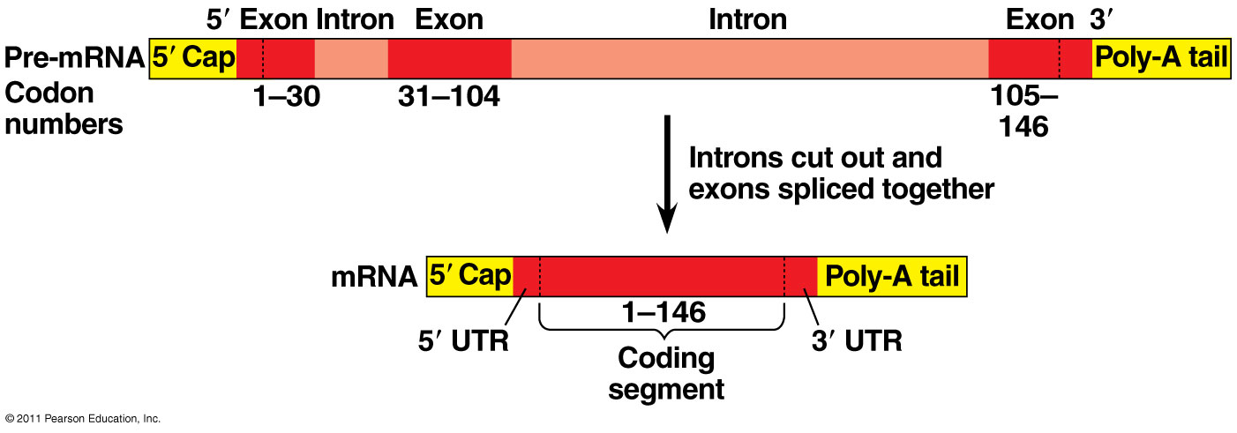
RNA Splicing
Pre-mRNA has introns (noncoding sequences) and exons (codes for amino acids)
Splicing = introns cut out, exons joined together

Slide 26
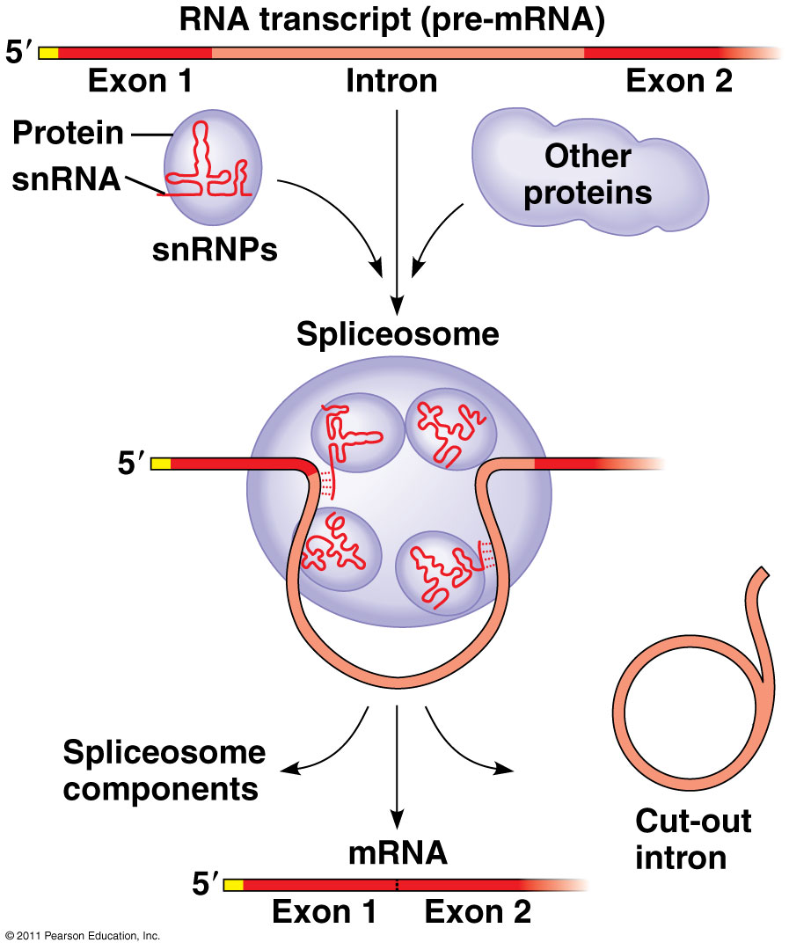
RNA Splicing
small nuclear ribonucleoproteins = snRNPs
snRNP = snRNA + protein
Pronounced “snurps”
Recognize splice sites
snRNPs join with other proteins to form a spliceosome
Spliceosomes catalyze the process of removing introns and joining exons
Ribozyme = RNA acts as enzyme

Slide 27
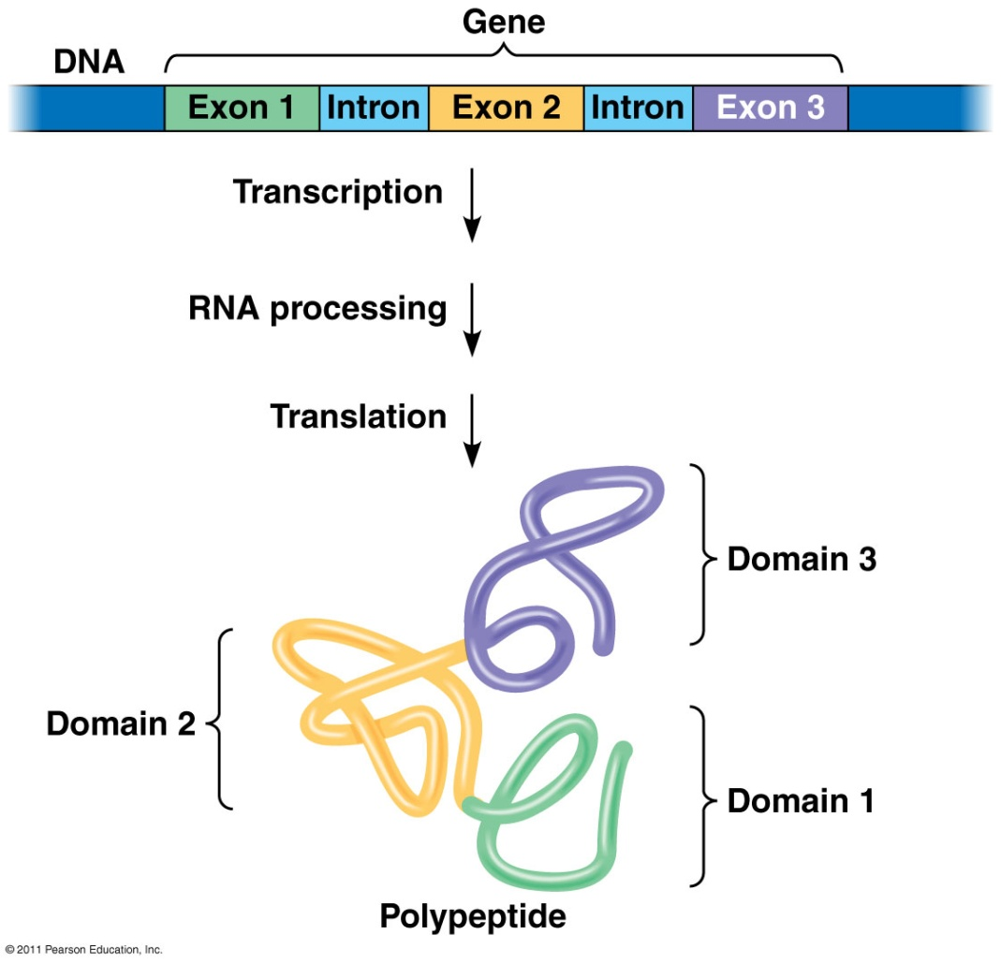
Why have introns?
Some regulate gene activity
Alternative RNA Splicing: produce different combinations of exons
One gene can make more than one polypeptide!
20,000 genes → 100,000 polypeptides
Increases genetic variation and possible proteins/phenotypes

Slide 28
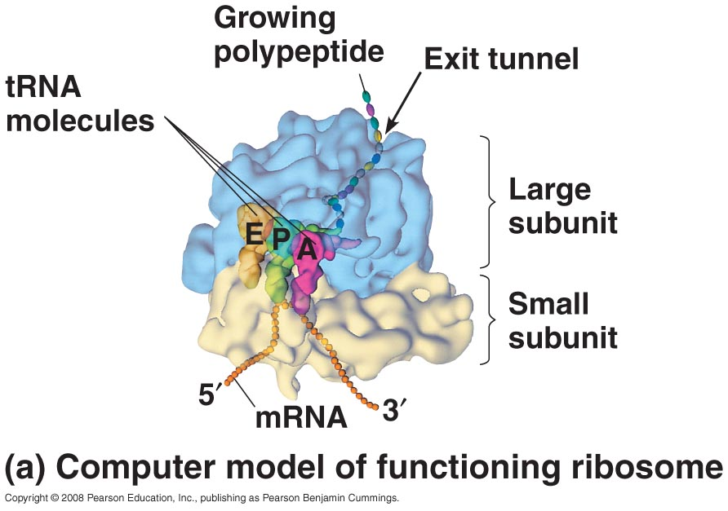
Occurs at Ribosomes
TRANSLATION
Ribosome = rRNA + proteins
made in nucleolus
2 subunits

Slide 29
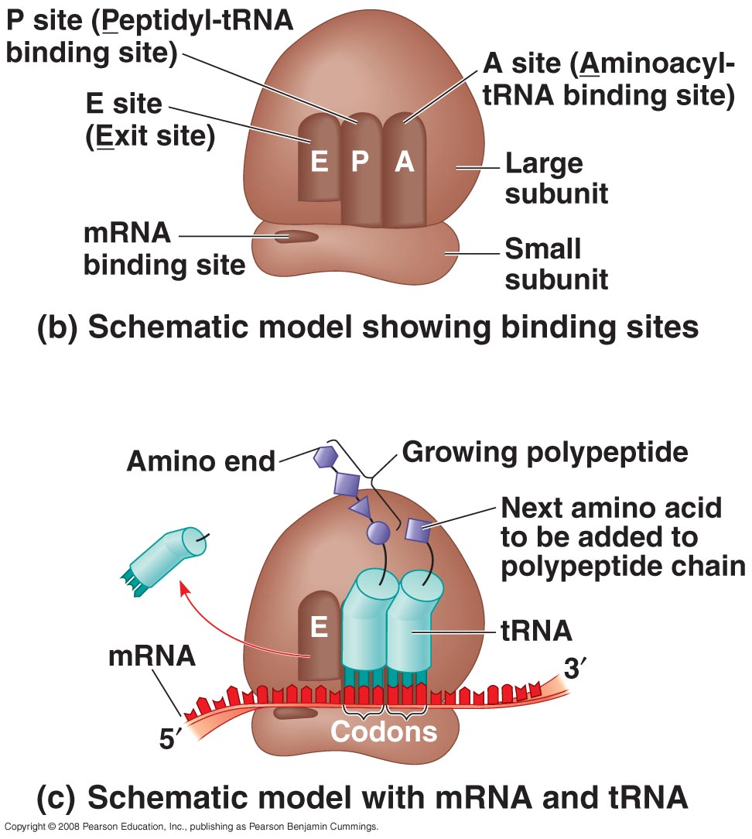
Ribosomes
Active sites:
A site: holds AA to be added
P site: holds growing polypeptide chain
E site: exit site for tRNA

Slide 30
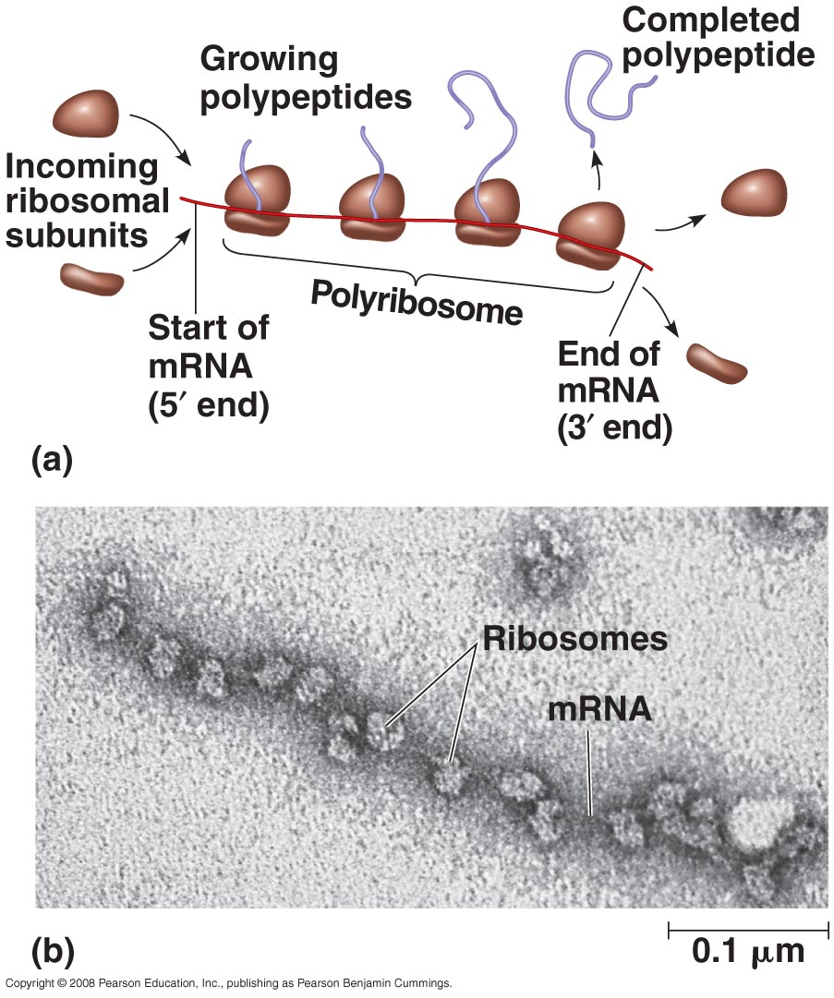
Polyribosomes
A single mRNA can be translated by several ribosomes at the same time

Slide 31
Types of Ribosomes
Free ribosomes: synthesize proteins that stay in cytosol and function there
Bound ribosomes (proteins attached to ER):
make proteins of endomembrane system (nuclear envelope, ER, Golgi, lysosomes, vacuoles, plasma membrane)
make proteins for secretion
Uses signal peptide to target location

Slide 32
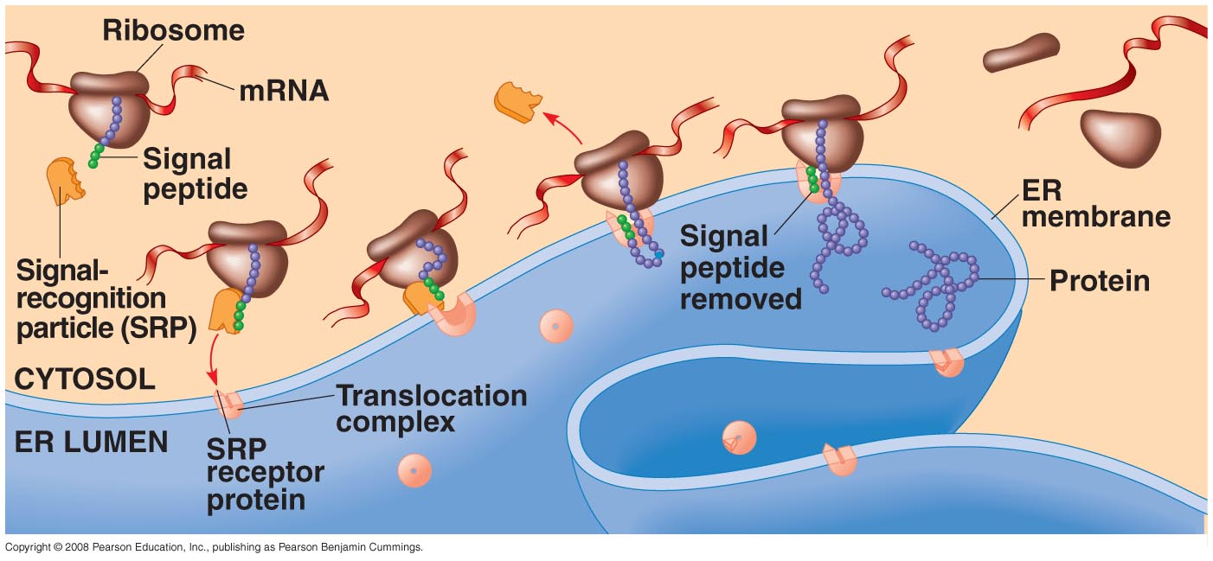
Proteins bound for intracellular destinations receive cellular “Zip Codes”
Signal peptide: 20 AA at leading end of polypeptide determines destination
Signal-recognition particle (SRP): brings ribosome to ER

Slide 33
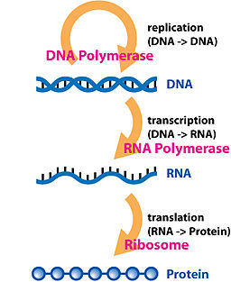
The Central Dogma
Mutations happen here
Effects play out here

Slide 34
Prokaryotes vs. Eukaryotes
Need to add anything?
Prokaryotes
Eukaryotes
Transcription and translation both in cytoplasm
DNA/RNA both in cytoplasm
RNA polymerase binds directly to promoter
Transcription makes mRNA (mRNA not processed)
No introns
Transcription in nucleus; translation in cytoplasm
DNA in nucleus, RNA travels in/out nucleus
RNA polymerase binds to TATA box & transcription factors
Transcription makes pre-mRNA → RNA processing → final mature mRNA
Has exons, introns (spliced/cut out)

Slide 35
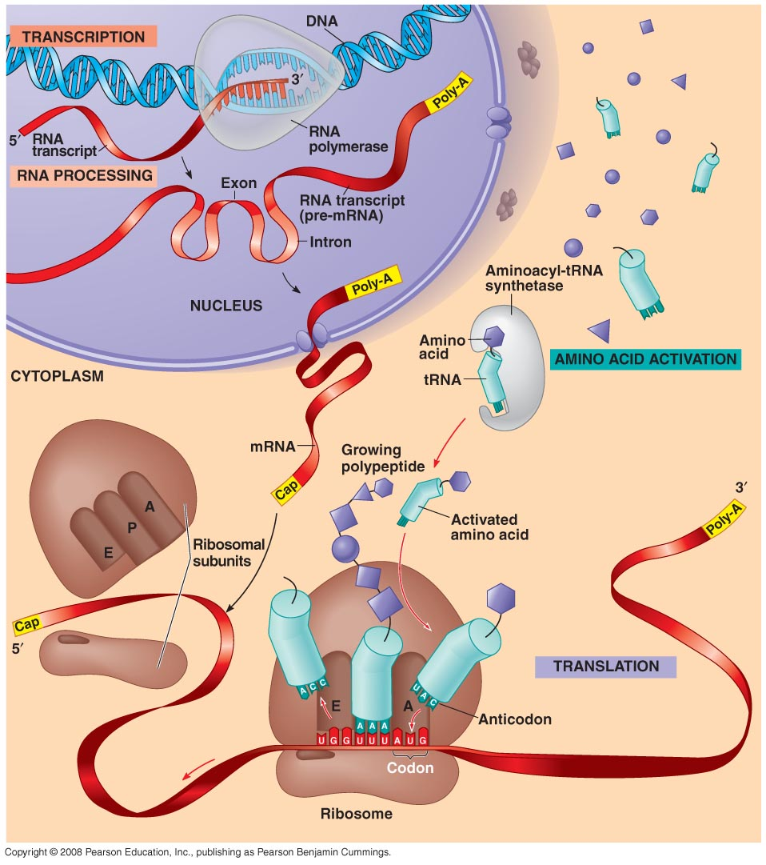
A Summary of Protein Synthesis (p. 348)
Most current definition for a gene: A region of DNA whose final product is either a polypeptide or an RNA molecule

Slide 36
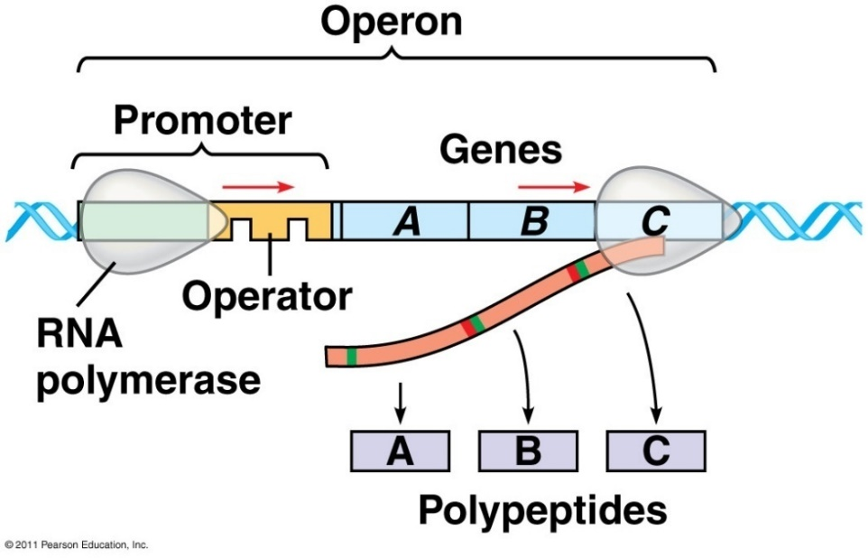
Bacterial control of gene expression
Bacteria can respond to environmental change by regulating transcription (to make more or less protein/RNA)
Bacteria have genes clustered into units called operons.
Operons can be regulated.
Turned off: repressed/inhibited .
Turned on: induced

Slide 37
Bacterial control of gene expression
Operon: cluster of related genes with on/off switch
Three Parts:
Promoter – where RNA polymerase attaches
Operator – “on/off”, controls access of RNA poly
Genes – code for related enzymes in a pathway

Slide 38
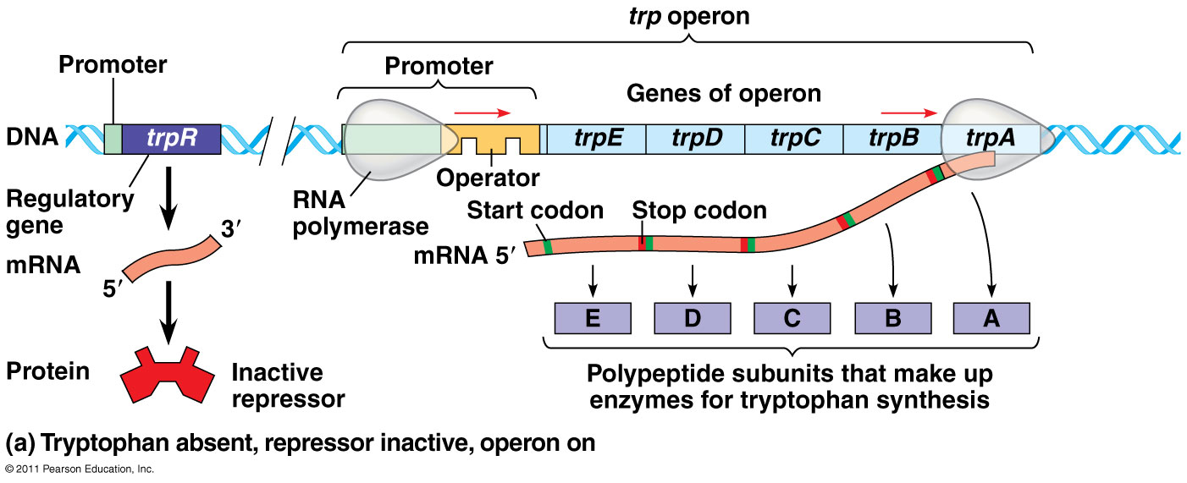
Regulatory gene: produces repressor protein that binds to operator to block RNA polymerase and turn operon off

Slide 39
Repressible Operon
Normally ON
Anabolic (builds organic molecules)
Organic molecule product acts as corepressor → binds to repressor protein to activate it
Operon is turned OFF
Eg. trp operon

Slide 40
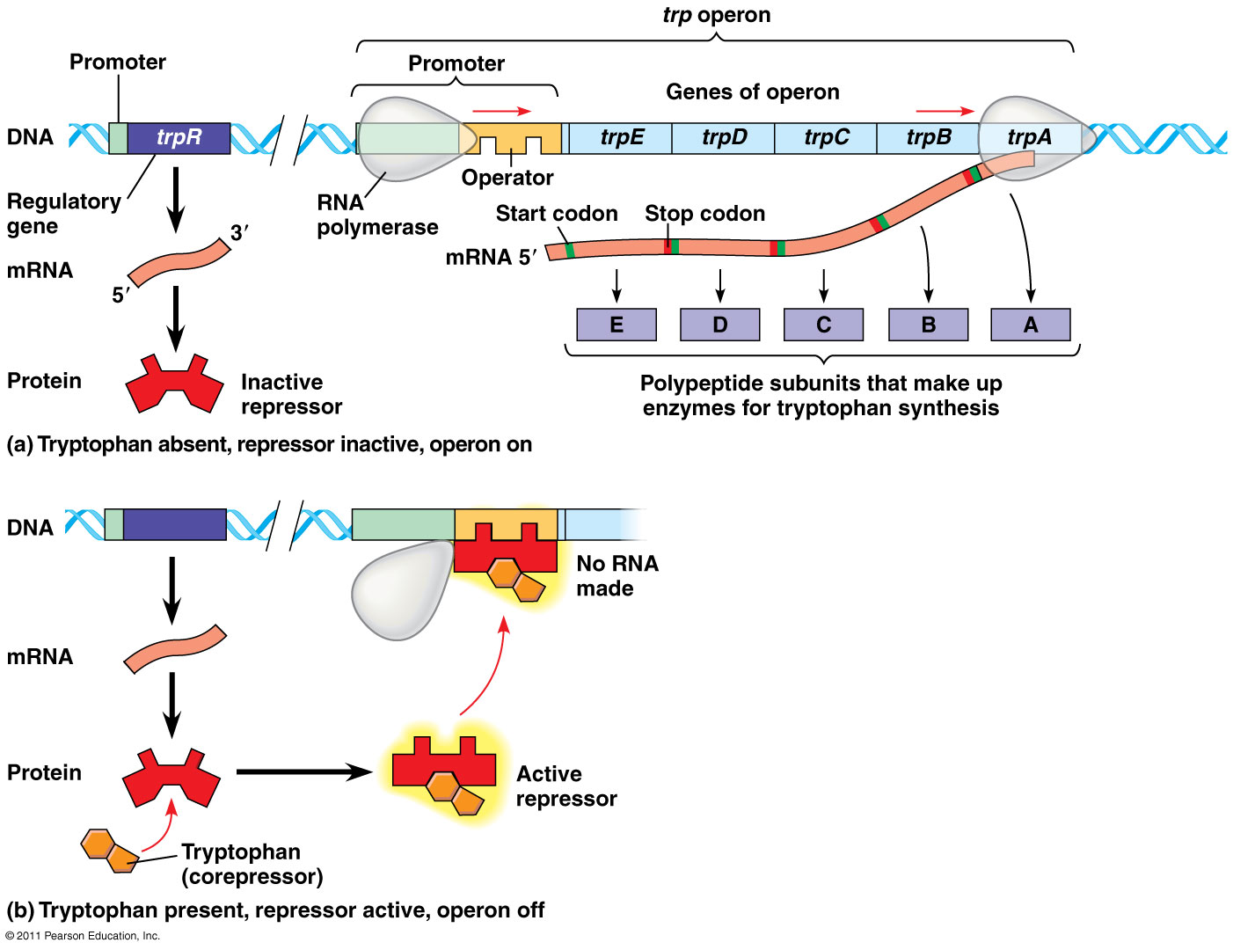
trp operon

Slide 41
Inducible Operon
Normally OFF
Catabolic (break down food for energy)
Repressor is active → inducer molecule binds to and inactivates repressor protein
Operon is turned ON and RNA polymerase can transcribe genes
Eg. lac operon

Slide 42
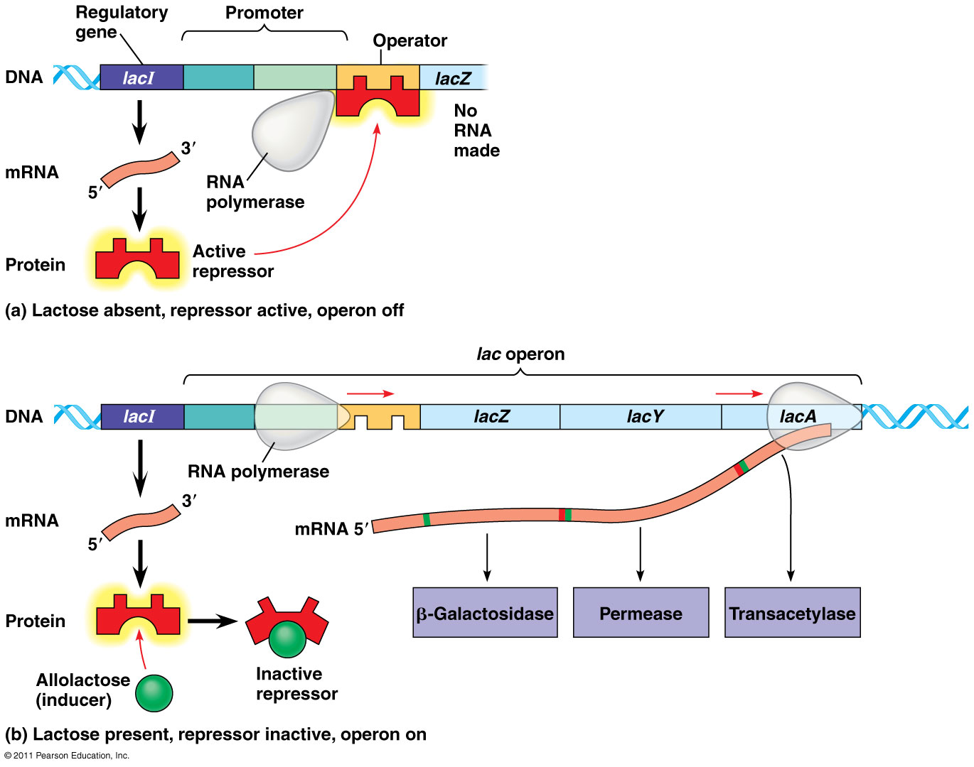
lac operon

Slide 43
Gene Regulation: Positive vs. Negative Control
Negative control: operons are switched off by active form of repressor protein
Eg. trp operon, lac operon
Positive control: regulatory protein interacts directly with genome to increase transcription
Eg. cAMP & CAP

Slide 44
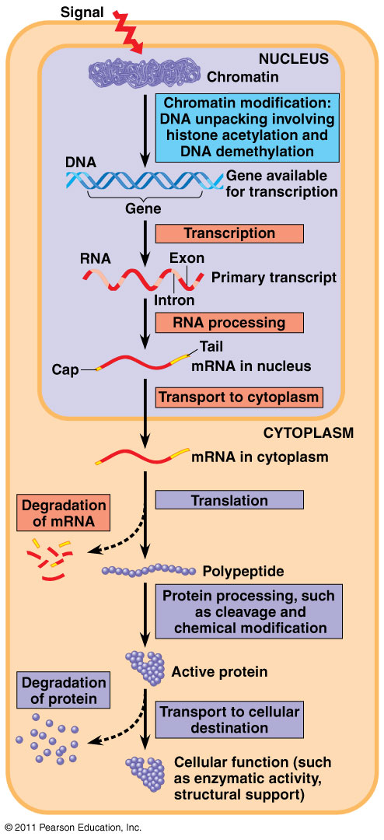
Eukaryotic gene expression regulated at different stages

Slide 45
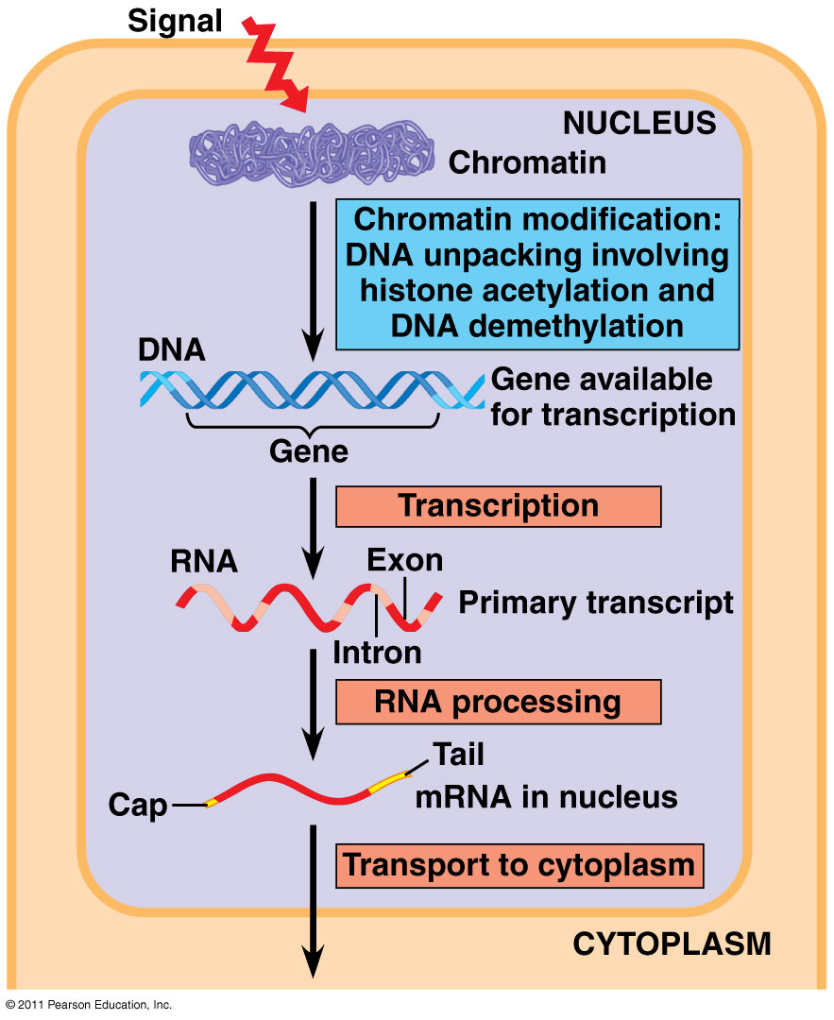
Chromatin Structure:
Tightly bound DNA → less accessible for transcription
DNA methylation:
methyl groups added to DNA
keeps DNA/chromosome tightly packed, unaccusable
dec. transcription
(turns genes off)
Histone acetylation:
acetyl groups added to histones
chromatin loosened – easily accessed
inc. transcription
(turns genes on)

Slide 46
Transcription Initiation:
Specific transcription factors (activators or repressors) bind to control elements (enhancer region)
Activators: increase transcription
Repressors: decrease transcription

Slide 47
Regulation of mRNA:
micro RNAs (miRNAs) and small interfering RNAs (siRNAs) can bind to mRNA and degrade it or block translation

Slide 48
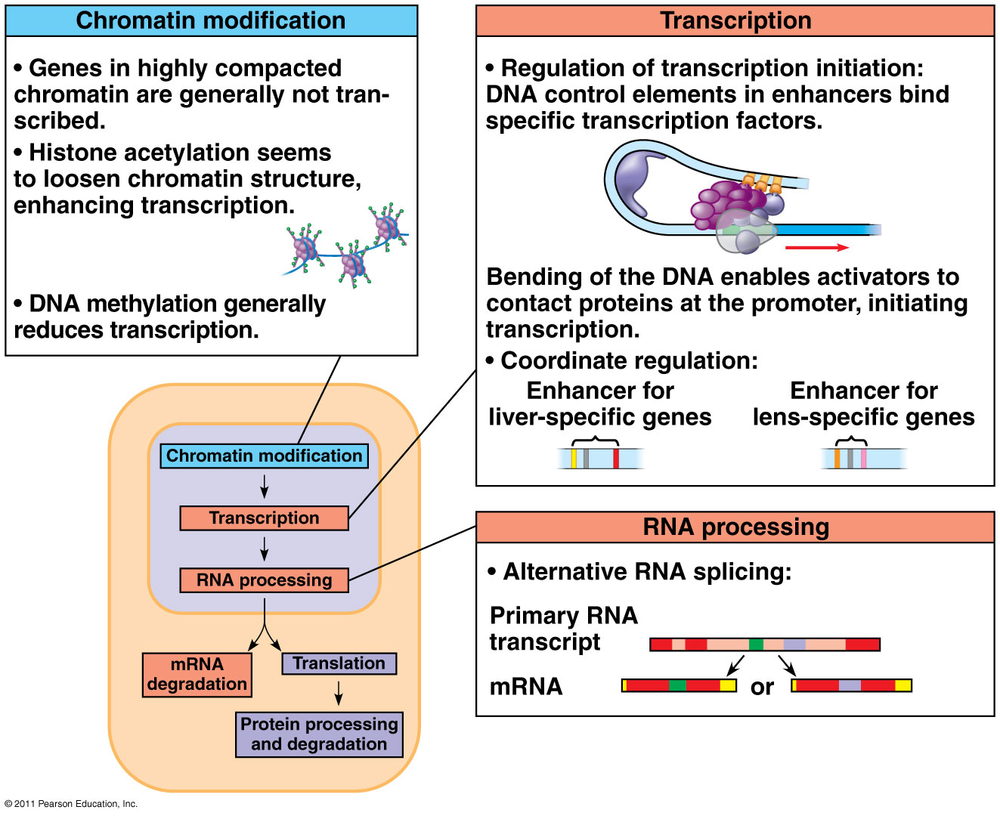

Slide 49
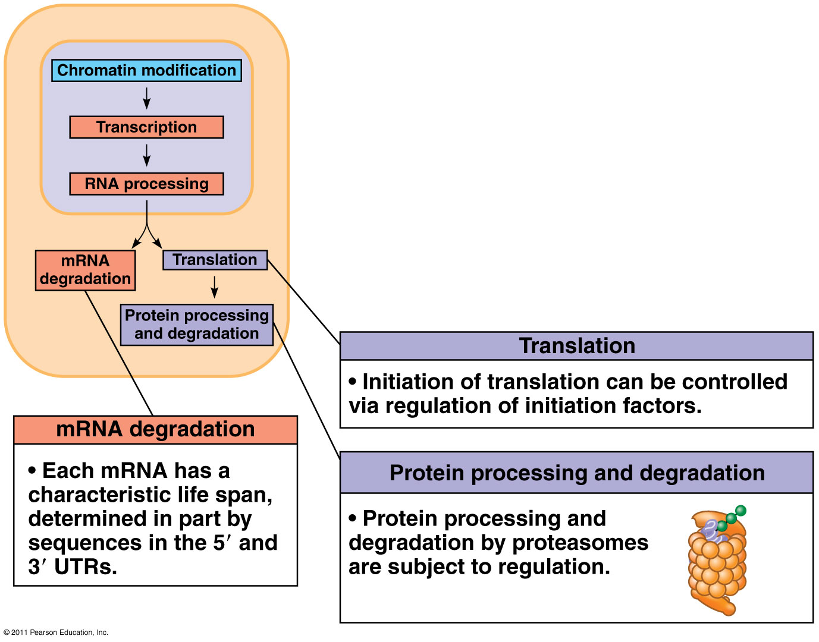
In the cytoplasm, translation is regulated by:

Slide 50
