Slide 1
Cell Communication:
Neuron

Slide 2
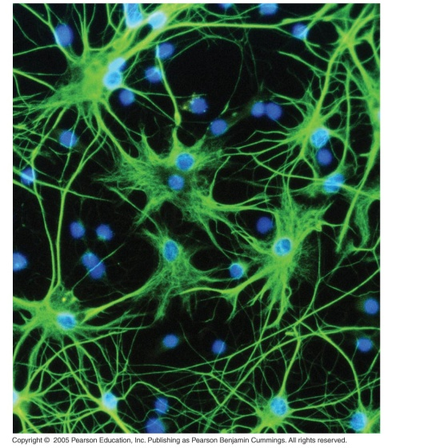
Neuron = dendrite + cell body + axon

Slide 3
Neuron
cell body: contains nucleus & organelles
dendrites: receive incoming messages
axons: transmit messages away to other cells
myelin sheath: fatty insulation covering axon, speeds up nerve impulses
synapse: junction between 2 neurons
neurotransmitter: chemical messengers sent across synapse
Glia: cells that support neurons
Eg. Schwann cells (forms myelin sheath)

Slide 4
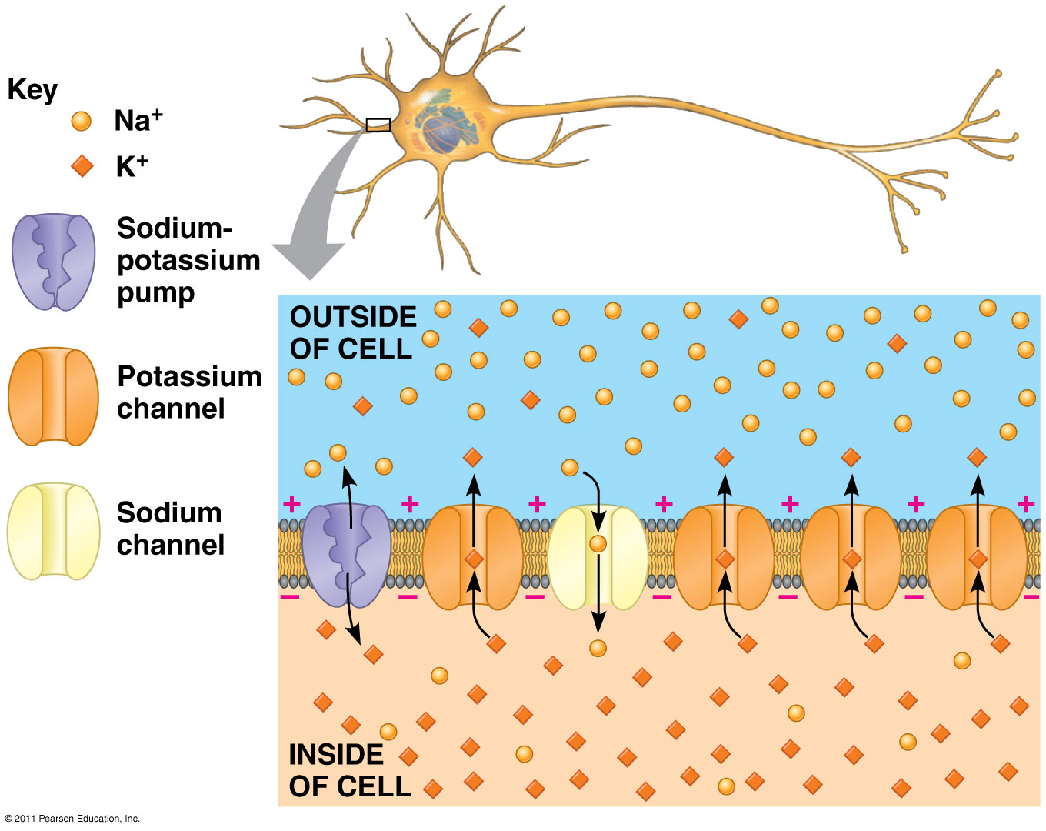
The Na⁺/K⁺ pump (using ATP) maintains a negative potential inside the neuron.
Greater concentration of positive ions (Na+) outside of cell

Slide 5
Action potentials (nerve impulses) are the signals conducted by axons
Resting potential: membrane potential at rest is said to be polarized
More Na⁺ outside, more K⁺ inside cell (overall neg. charge inside axon)
Ion distribution is maintained by the Na⁺/K⁺ pump (requires ATP!)
Voltage-gated Na⁺ channel are CLOSED
Nerve impulse: stimulus causes a change in membrane potential
Action potential: neuron membrane depolarizes = becomes more positive inside
All-or-nothing response
Na⁺ channels open
K⁺ channels open
Na⁺ enters cell
K⁺ leaves cell

Slide 6
Action Potential
3
Depolarization
More Na+ channels open
K+ channels still closed
Cell becomes more positive inside
4
Repolarization
Na+ channels close
K+ channels open and K+ goes out
Interior of cell becomes more negative
2
Stimulus opens some Na+ channels
IF threshold is reached, an AP is triggered
5
Refractory Period
K+ channels close
1
Resting state (-70mv)
Voltage-gated Na+ and K+ channels closed
1
Return to resting state
Na+ and K+ concentrations are maintained by Na+/K+ Pump

Slide 7
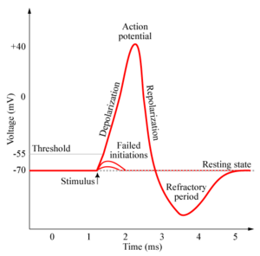
Action Potential

Slide 8
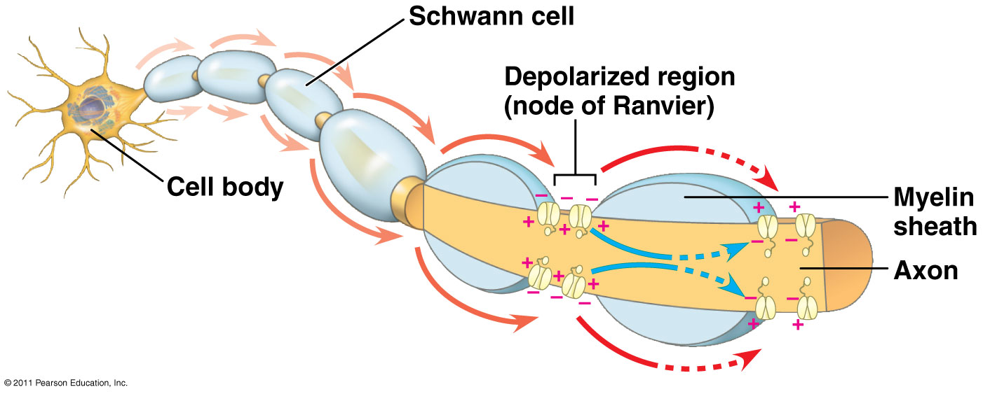
Saltatory conduction: nerve impulse jumps between nodes of Ranvier (unmyelinated gaps) → speeds up impulse
Myelinated neurons carry faster nerve impulses than unmyelinated axons

Slide 9
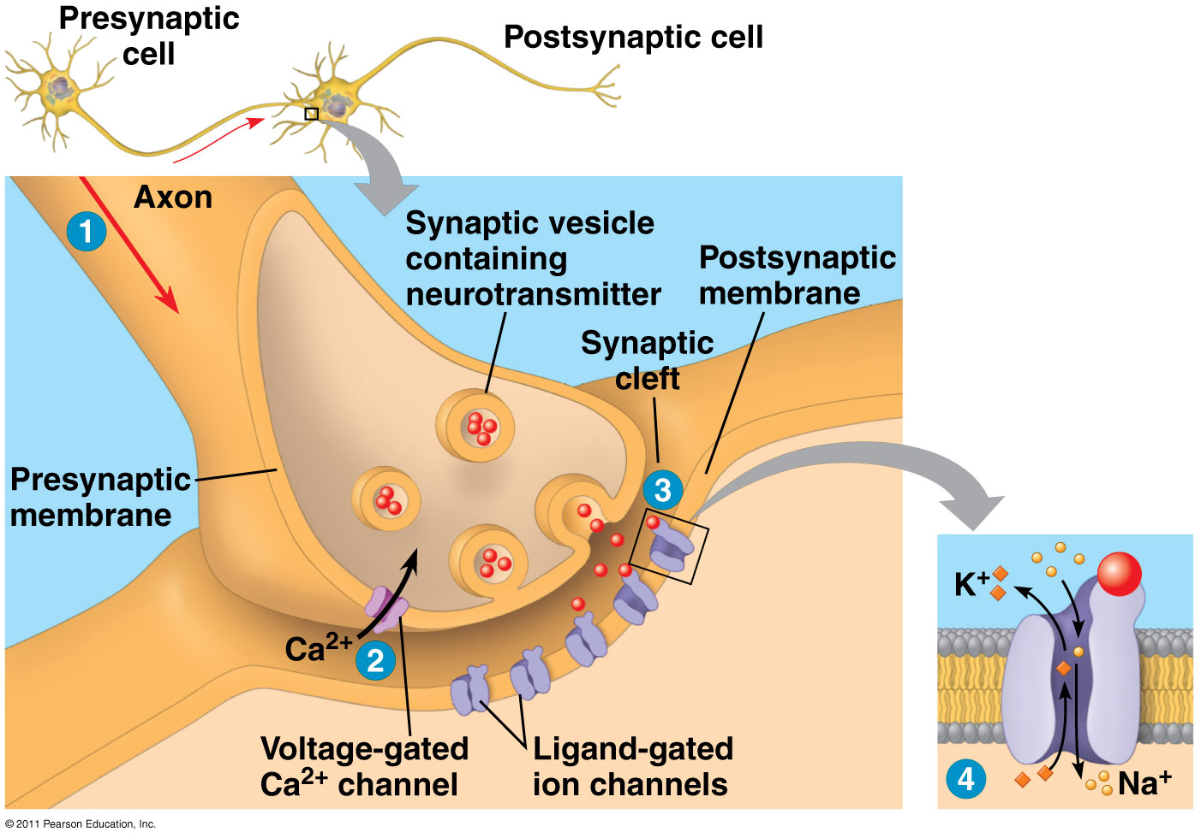
Cell communication: neurotransmitter released at synapses at the ends of axon on presynaptic cell → Dendrite of the postsynaptic cell

Slide 10
3
Increase in Ca²⁺ causes vesicles to fuse with presynaptic membrane
Neurotransmitter released into synaptic cleft via exocytosis
1
Action Potential arrives
Presynaptic membrane is depolarized
2
Depolarization opens voltage-gated Ca²⁺ channels
Ca²⁺ enters presynaptic cell
4
Neurotransmitter binds to ligand-gated ion channel on postsynaptic membrane
Possible cell responses include:
Initiating depolarization and an Action Potential of this neuron (excitatory)
Inhibiting an action potential in the neuron

Slide 11
Neurotransmitters
Chemicals released from vesicles by exocytosis into synaptic cleft
Diffuse across synapse
Bind to receptors on neurons, muscle cells, or gland cells
Broken down by enzymes or taken back up into surrounding cells
Types of neurotransmitters:
Excitatory: speed up impulses by causing depolarization of postsynaptic membrane
Inhibitory: slow impulses by causing hyperpolarization of postsynaptic membrane

